Slide 1

TRAINING PACKAGE
INTERAGENCY TOOLKIT: PREVENTING AND RESPONDING TO CHILD LABOUR IN HUMANITARIAN ACTION

Slide 2
SESSION 8: WORKING WITH COMMUNITIES TO ADDRESS CHILD LABOUR

Slide 3
LEARNING OUTCOMES
By the end of the session you will be able to:
Discuss how community norms and attitudes can positively and negatively impact child labour
Describe how children in child labour can be safely involved in community level/led activities
Describe how to overcome common challenges in working with communities on child labour

Slide 4
WORKING WITH COMMUNITIES ON CHILD LABOUR
SOCIAL NORMS
Beneficial, harmful, fluid
Underlying beliefs, values, risk and protective factors which drive child labour
Communities differ with their views and considerations around child labour as well as opportunities
Do not condone harmful practices

Slide 5

ACTIVITY
DISCUSSION: SOCIAL NORMS
In your group:
Use the discussion questions on the sheet to identify local community norms and attitudes that positively and negatively impact child labour.
Share in plenary your discussions.

Slide 6
WORKING WITH COMMUNITIES ON CHILD LABOUR
KEY CONSIDERATIONS
Profile and mapping
Consult with key community members, including children and adolescents
Create a common understanding and starting point for humanitarian action
Do no harm
Promote peacebuilding and social cohesion
Promote gender equality
Engage with and build capacity of community-level actors, networks, and structures
Notes:
It is important to start by profiling and mapping informal and formal support systems at community level that can support children at-risk of child labour and their families across sectors if this has not already been done.
Consulting with key community members including children and adolescents who are affected by or knowledgeable about child labour including its worst forms, to help create a common understanding and starting point for humanitarian action at the community level.
Always consider do no harm issues especially when involving the community in addressing sensitive or dangerous forms of child labour, such as illicit work or trafficking. Conducting a risk assessment and put in place measures to ensure activities do not put children, families or community members at risk of (further) harm.
Promote gender equity to promote girls’ freedom to choose, lead, participate in activities which address which address child labour and harmful gender norms. ]
Be very aware and take care in conflict and protracted emergencies to promote peacebuilding and social cohesion in communities. Child labour intersects closely with resources and employment in communities which are often a trigger of rising tensions in emergency affected communities.
Finally, we should build the capacity of community-level actors, networks and structures to safely and appropriately engage in child labour prevention and response actions. We shall talk more about this later on.

Slide 7
MODELS FOR WORKING WITH
COMMUNITIES ON CHILD LABOUR
Notes:
Working with community level focal points or champions such as CSOs, religious and traditional leaders, educators, youth and community workers and other influential community members. Developing and strengthen community-level monitoring systems to identify and track children who are at risk of or in child labour/WFCL including through community level school monitoring, those from vulnerable households or known at-risk groups, or children are already out of school and known to be working in communities and linking identified children and families with available preventative and response services. Supporting community-level authorities or structures to develop and resource local action plans or legislation to monitor, prevent and respond to child labour such as monitoring access and barriers to service delivery for at-risk groups at advocating for improvement, planning and implementing quick impact projects which benefit those at-risk or identifying and mobilising community resources including those which can play a part in referral pathways. We must also be aware that while all this is vitally important, sometimes communities in crisis, particularly those who are newly displaced or affected by conflict have limited coverage or capacity of community level structures, and when this is the case, humanitarian actors will need to provide alternative approaches to meeting children’s needs and preventing child labour.

Slide 8
WORKING WITH COMMUNITIES ON CHILD LABOUR
COMMUNITY-LEVEL MONITORING, PREVENTION, AND RESPONSE TO CHILD LABOUR
Engage with local actors through:
Community-level focal points
Monitoring child labour/WFCL
Supporting children and linking families to services
Supporting community-level authorities/structures to develop and resource plans to prevent and respond to child labour
When coverage/capacity in communities is weak, providing alternative approaches/mobile services
Notes:
Facilitate dialogue to reflect on these practices and consider alternatives
Communities differ from place to place and so will the opportunities to engage community-level structures and actors. Engage with communities to address child labour by strengthening the links between at-risk families and service providers; by supporting community-led awareness-raising; and by strengthening capacities to monitor, prevent and respond to child labour.

Slide 9
WORKING WITH COMMUNITIES ON CHILD LABOUR
STRENGTHEN LINKS BETWEEN FAMILIES AT-RISK, SERVICES, AND SYSTEMS:
Identify and refer to case management and other services
Conducting outreach to hard-to-reach children in child labour/WFCL
Report child labour/WFCL trends, patterns, risks, and protective factors
Improve working conditions
Notes:
Once formal and informal support systems have been identified, linkages between at-risk children and families, community-level and formal services and systems can be strengthened through referrals to case management and other services, conducting outreach to hard-to-reach children in child labour/WFCL or hard to reach locations; reporting child labour and WFCL trends, patterns and risk and protective factors which are observed in communities and at-risk families; Working to improve the working conditions of adolescents above the minimum age, through local employers/landowners

Slide 10
WORKING WITH COMMUNITIES ON CHILD LABOUR
SUPPORTING COMMUNITY-LED AWARENESS RAISING
Community-led understanding and prioritisation of protective factors, risk factors, social and gender norms, and cultural practices
Counter assumptions in the community on child labour and respond to local (mis-) conceptions around child labour
Incorporate awareness raising in broad community activities and opportunities for dialogue
Notes:
Consultation and capacity building with key community members including children and adolescents who are affected by or knowledgeable about child labour including its worst forms, helps create a common understanding and starting point for awareness raising, which benefits from community level prioritisation around building protective factors and beneficial social norms and tackling risk factors and harmful social and gender norms and cultural practices related to child wellbeing, child protection, child labour and its worst forms. At the community level, messages should aim to counter commonly held assumptions in the community including those which are harmful for children but also those which assume that child labour is caused solely by social norms and community acceptance of child labour. They should be informed by childhood and cultural norms in the context, but also tackle false and misinformation that leads to child labour the WFCL and other rights violations. Communities can integrate child labour messages into broader community-level activities such as community dialogues, education awareness campaigns and other awareness raising.

Slide 11
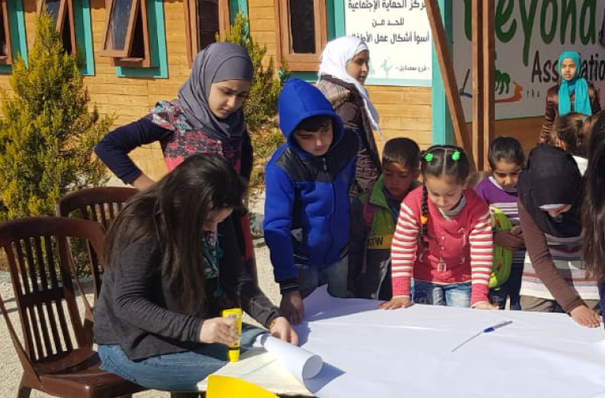
INVOLVING WORKING CHILDREN IN COMMUNITY LED/LEVEL PREVENTION AND RESPONSE
WORKING WITH COMMUNITIES ON CHILD LABOUR
Participation in assessments and response planning
Creating key messages and awareness-raising activities
Peer-to-peer education, activities, ambassadors
School-level initiatives
Showcase skills
Notes:
Working children can be widely involved in leading and contributing to community level prevention and response actions. Children and adolescents can be supported to participate in actions to protect themselves and other children, for example through participation in assessments and response planning; creating key messages and awareness-raising activities including peer-to-peer education, integrating child labour prevention into school-based child and adolescent participation activities such as school councils, youth groups, mentoring and other school-based activities, and supporting adolescents to showcase how they can make positive contributions to their communities, for example through organising community dialogues, sports events, marketplaces where adolescents can showcase their work or skills

Slide 12
ACTIVITY: WORKING WITH COMMUNITIES TO COMBAT CHILD LABOUR IN HUMANITARIAN
In your group, appraise the community-level/led approach, which is detailed in your case study.
Identify potential positive and negative aspects/impacts of the approach.
Consider the following factors:
  Cultural and social norms around child labour (gender norms, childhood, school, education, work, etc.)
  Communication and relationships in the community
  How communities keep working children safe, including reducing the numbers of children in child labour and the WFCL, especially vulnerable children, etc.
Identify what support community-level structures – who have a defined role to provide services to children in child labour in the context – will need.
Present in plenary, including potential challenges and how the approach could be effectively used in the context.

Slide 13
DO NO HARM!
SAFE PARTICIPATION OF CHILDREN
Conduct risk assessments for working children’s participation
Monitor demands on children's time and how participation changes that
Put in place mitigation measures to prevent or respond to risks raised in monitoring
Gradual and consistent involvement
Training, information, and awareness
Child-friendly, contextually sensitive, and sustainable
Notes:
The essential principal of do no harm must underpin all humanitarian action which directly involves children.
Carry out a risk assessment and put in place measures to ensure activities do not put children, families, or community members at risk of (further) harm.
Monitor the demands on children’s time and how their voluntary participation in organising and leading activities is changes this for instance affecting school attendance, school dropout or children’s physical safety.
Apply a strong age and gender lens to this analysis as the domestic and economic roles and implications for girls and boys is often very different.
Put in place mitigation measures when monitoring identifies harmful impacts and risks to children raised by their participation.
Work for gradual and consistent involvement of children which allows working children to balance their demands.
Provide adequate training, as well as appropriate information and awareness so children and adolescents are prepared for their roles.
Develop community-level activities to address child labour in a child-friendly, contextually sensitive, and sustainable way.

Slide 14
KEY MESSAGES
Communities play a significant role in preventing and responding to child labour risk factors in humanitarian settings.
Community-level actors can also play a key role in identifying children in child labour and connecting them with formal and informal actors and service providers.
Communities can also be a source of risk when protective structures are disrupted or weakened, or when social norms that condone child labour are deeply ingrained in beliefs and attitudes.

