Slide 1

TRAINING PACKAGE
INTERAGENCY TOOLKIT: PREVENTING AND RESPONDING TO CHILD LABOUR IN HUMANITARIAN ACTION

Slide 2
SESSION 6: CORE SKILLS FOR HUMANITARIAN ACTORS TO PREVENT AND RESPOND TO CHILD LABOUR (2)

Slide 3
LEARNING OUTCOMES
By the end of the session you will be able to:
Describe some ways in which children in child labour can be identified through humanitarian services and safely referred to more specialist services in the context
Assess own approach to programming to identify 4 challenges in reaching children in child labour
Assess own approach to programming to identify 4 improvements which can be made to improve their reach to children in child labour
Identify potential adaptations to humanitarian programming in displacement settings to better meet the needs of children in or at risk of child labour

Slide 4
PROGRAMMATIC FRAMEWORK FOR CHILD LABOUR PREVENTION & RESPONSE
Society
  Strong legislative framework • Functional/resourced government services • Information management systems • Coordination between sectors/agencies
Community
  Child labour monitoring, identification, and referral systems • Adequate resources for prevention and response • Social norms, attitudes, and practices
Family
    Awareness of children’s rights, harmful impact of child labour
    Families meet basic needs and have economic alternatives for child labour
Child
        Children know rights and access education and pathways to decent work
        Child protection case management and social services for children in or at risk of child labour
Prevention | Preparedness |  | Child protection |  | Education |  | Early childhood development
Technical and vocational education and training |  | Food security and livelihoods |  | Health |  | Society-level systems, policies, and legislation

Slide 5
IDENTIFYING CHILDREN IN CHILD LABOUR SAFELY THROUGH HUMANITARIAN ACTION

Slide 6

DISCUSSION
With your partner discuss:
What are the potential points of contact and ways in which child labour can be identified in the context?

Slide 7
POTENTIAL POINTS OF CONTACT FOR IDENTIFYING CHILD LABOUR
Schools, local and humanitarian service providers, health clinics, distributions
Community outreach, community-based structures, religious/community leaders
Community centres, safe spaces, multi-service centres, group activities
Working with employers, employers’ associations, trade unions
Contact with children in the workplace, shops, streets, or fields
Working with children previously in child labour (outreach or peer networks)
Existing monitoring systems (child labour/child protection/camp management)
Community-level profiling or assessment
Social welfare and assistance/CVA/FSL programmes
Law or border enforcement, registration or arrival points (IDPs/Refugees/UASC)

Slide 8
ONLY EVER IDENTIFY CHILDREN IN
CHILD LABOUR SAFELY!
KEY CONSIDERATIONS
Create/adapt multi-sector referral pathways with clear entry points and criteria for child labour
Review roles and responsibilities, develop guidelines to protect both confidentiality and safety when children are identified, including special measures for WFCL and GBV
Actively connect formal referral systems/CP case management with a range of relevant services (protection, education, FSL, social protection and health)
Apply a gender and age lens
Include information about children’s work and school attendance (how children spend their time) in registration forms for services
Ensure front line workers are trained to understand and connect with referral pathways
Work with coordination structures to develop expertise and resources to conduct duties safely and effectively

Slide 9
DISCUSSION
With your partner discuss:
What are some of the ways you might be aware children are involved in child labour? What are some of the warning signs or key indications in the context?
Would these differ if we were talking about trafficking or slavery?
After 5 minutes, discuss:

Slide 10
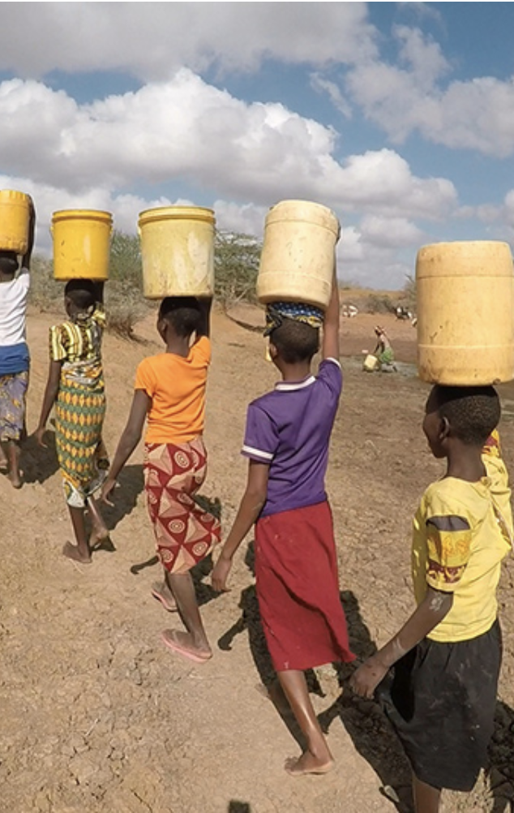
SIGNS OF CHILD LABOUR
Does not attend services or activities (barriers, time)
Performance, attendance, behaviour at school
Visible signs or complaints (tiredness, hours, injuries, pain, ill health, infections, animal bites, vision, skin, etc.)
Signs of abuse, sexual abuse, hazardous work, unmet basic needs, neglect (physical/psychological)
Psychosocial reactions, stress, depression, drug, cigarette, alcohol consumption, etc.
Missing for periods of time or all together, returns home late at night or gone whole nights
Inappropriate/unexplained behaviour, language, possessions
Caregivers and children may not disclose information or give confused family histories or accounts
Notes:
Photo: World Vison Canada (https://www.worldvision.ca/stories/education/girls-education-facts-and-how-to-help)

Slide 11
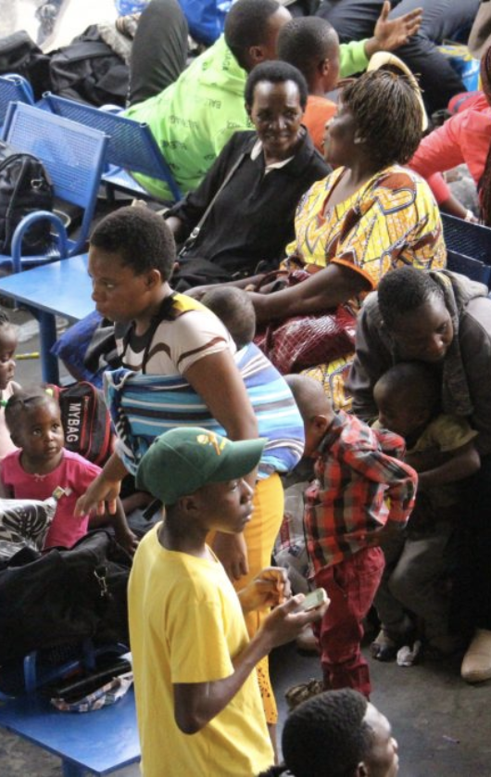
SIGNS OF TRAFFICKING AND SLAVERY
Reluctant to seek help or give personal information
Brought or moved from or within countries
Arrangements made by someone other than family
Limited knowledge of language or area
False/no documentation, passport, identification
Limited freedom of movement and free time
Frequently missing from alternative care, home, school
Abnormal patterns of enrolment across different schools
No evidence of parental permission to travel or pre-existing relationship, knowledge of accompanying adult
Unable to confirm details of person meeting them or accompanied by adult who insists on remaining with child and whom the child is uncomfortable with
Has a significantly older partner or married underage
Is unrelated or newly discovered at an address
Notes:
Photo credit: http://www.ipsnews.net/

Slide 12
BE AWARE OF THE RISKS
Safeguarding and PSEAH
Raising expectations
Confidentiality during meetings, interviews, documentation:
  Conflict and insecurity
  When children are withdrawn or rescued
Providing adequate follow-up
Ethical dilemmas

Slide 13
MAKING SAFE REFERRALS
According to the local referral system and vulnerability criteria, identify what the child is likely to need. Stick to the set guidelines.
Identify which child protection/humanitarian or organisation agency can meet these needs.
Contact the service provider to confirm eligibility and report the child.
If already in direct contact with the child or caregivers, explain the referral. If not, leave it for the appropriate agency or organisation to conduct follow-up and formal identification.
Document consent; make the referral and maintain confidentiality.

Slide 14
SUPPORTING AND REACHING CHILDREN AT-RISK OF AND IN CHILD LABOUR

Slide 15


MAPPING AVAILABLE SERVICES
ACTIVITY
PART 1
In your group:
Identify and list the …… services or activities which identify children in or at-risk of child labour in the context, and/or contribute to preventing and addressing child labour and the WFCL.
These may include services or activities which don’t currently identify children in or at-risk of child labour, but have the potential to.
Write your answers on coloured sticky notes.
You have 10-15 minutes.
Notes:
Adapt as necessary according to participants

Slide 16
MAPPING AVAILABLE SERVICES TO ADDRESS CHILD LABOUR
ACTIVITY
PART 2
In your groups:
Identify and list services or activities that are available in the context across other sectors that identify children in child labour and/or contribute to preventing and addressing child labour and the WFCL.
Write your answers on a different coloured sticky note for each sector where possible.
You have 10-15 minutes.
Notes:
Adapt as necessary according to participants

Slide 17
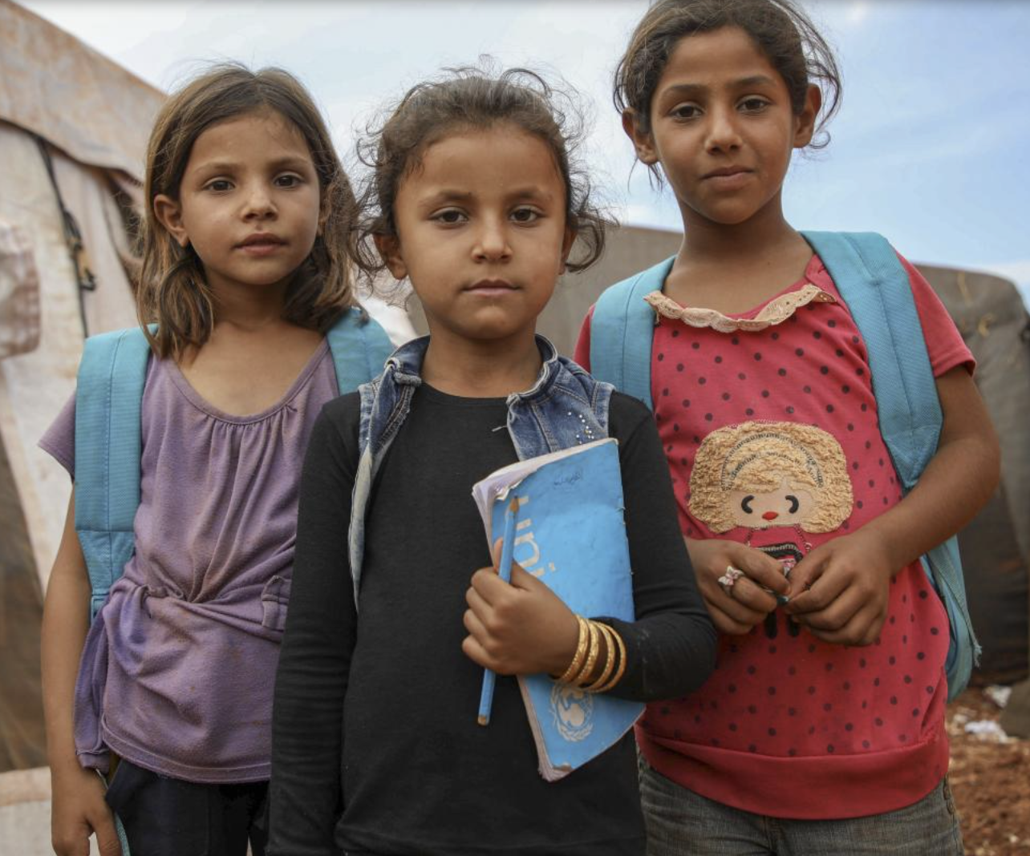
CREATE OPPORTUNITIES TO REACH CHILDREN IN CHILD LABOUR
THROUGH BROAD HUMANITARIAN PROGRAMMES
Work closely with others; engage with gatekeepers
Consult children in child labour and caregivers
Include child labour in targeting and eligibility criteria
Extend outreach
Develop flexible timing and locations
Adapt content, activities, and services for working children
Provide tailored information
Notes:
Explain that creating opportunities to reach children in child labour can include:
Working closely with others during design and implementation to identify measures to improve reach. including gatekeepers and other important local actors such as local and religious leaders or “local champions” who can help develop strategies, raise awareness, sensitise and shift community attitudes about child labour/WFCL and to promote access to education and local organisations who support children and adolescents, including services specifically for at-risk girls and survivors of SGBV.
Consult with children and adolescents in child labour and their caregivers on their needs and priorities, the types of services and activities they find helpful including with girls and female caregivers to identify gender specific barriers which prevent access. Establishing feedback mechanisms can help working children to confidentially report barriers, risks and safeguarding concerns.
Including child labour and its risk factors in targeting and eligibility criteria, expand or adjust criteria where programmes exclude highly vulnerable families with children in child labour such as accepting referrals from other actors, adapting criteria in collaboration with community actors.
Extending outreach to at-risk children and their families including, those outside regular target areas, or working in highly affected communities, or where they are isolated for other reasons, and not able or allowed to attend regular services, for instance hard-to-reach boys and girls, home-bound girls, children working in fields or on the streets.
Develop flexible timing and locations of services for instance in locations where working children live and work, or in other places that are accessible and known to children in child labour such as spaces in the community or drop-in centres or through mobile approaches in locations where children work.
Also ensure flexible schedules and timings make services more accessible, with availability during work breaks, outside regular work hours or on weekend days.
Adapt content, activities and services to the needs of children in child labour which are inclusive, gender and age responsive. Recognise that children in child labour will have considerably different life experiences than other children, they may be more mature, have different skills and different needs and interests. Higher participant-to-facilitator ratios or special adaptations for girls may be needed.
Make sure you provide tailored information to children in child labour, their families and communities, make sure it is accurate, safe and confidential, and provides information on services and how working children can access them. Base it on needs and gaps, and counter misinformation and harmful social norms about child labour. Use child-friendly and inclusive methodologies and preferred information channels for children in child labour.
Photo credit: https://www.unicef.org/education/emergencies

Slide 18
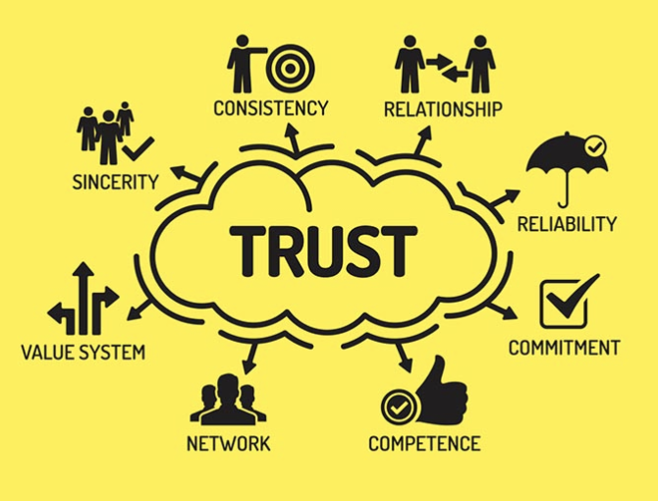
CREATE OPPORTUNITIES TO REACH CHILDREN IN CHILD LABOUR
BUILD TRUST
During recruitment
Commitment to meet basic needs
Start small: minimal but consistent contact
Build rapport, patience, and reliability
Parent and caregivers of homebound children
Involve case workers and supervisors
Consider safety of staff and associates
Unnecessary and sensitive information
Consider compensating children/caregivers for lost income
Notes:
Building trust can start at the beginning of implementation, during the recruitment of volunteers and staff who are from the same community as working children or who share similar experiences, speak the same language, and so can act as role models for children in child labour.
It’s important to build rapport with working children by spending time in the places where they work prior to engaging with them to provide services.
It’s important to show commitment to working children and their families and to helping them meet their basic needs.
Be patient and reliable and provide regular contact and support. At the same time, be careful to manage expectations and careful not to overcommit to services that cannot be provided.
Start small aim for minimal but consistent contact with working children and their attendance in activities and services.
Plan for engagement with particularly (adolescent) girls’ and their caregivers such as homebound children, in order to include them in activities or services.
Involve case workers and their supervisors in planning any engaging children who are in the WFCL and living and working in potentially illicit or dangerous environments.
Always consider the personal safety of staff and volunteers and never put them at risk of harm.
Photo credit: https://www.workstyle.io/

Slide 19
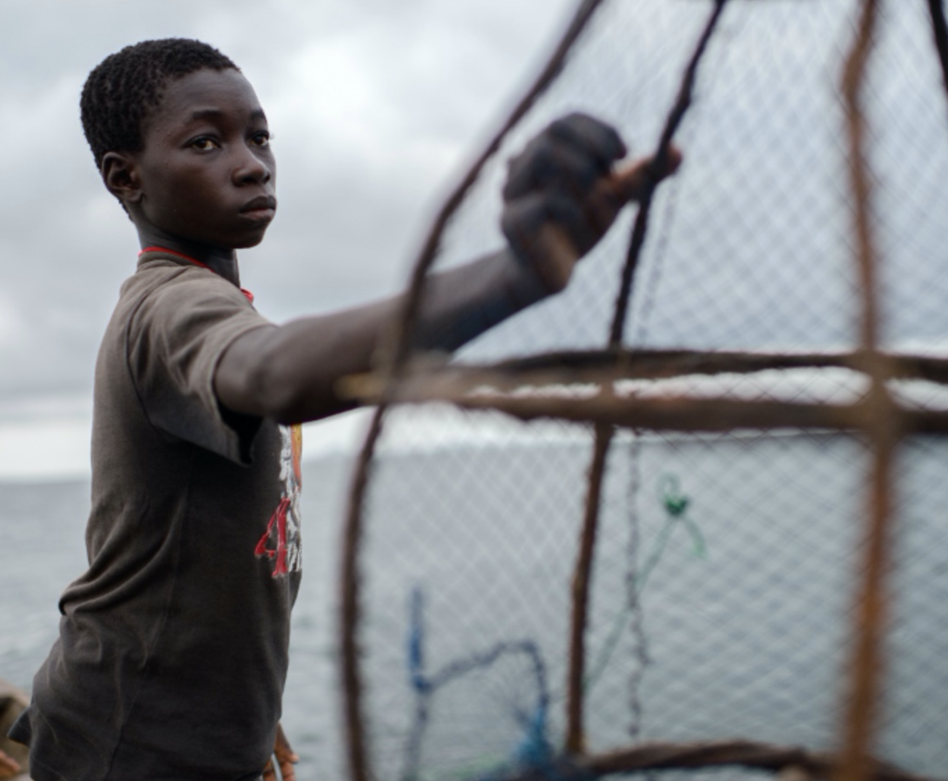
OPPORTUNITIES TO REACH CHILDREN IN CHILD LABOUR
DESIGN TAILORED APPROACHES FOR ADOLESCENTS IN OR AT RISK OF CHILD LABOUR
Identify barriers for working adolescents
Meet gender and age-specific needs and interests… “learning and earning,” peer-to peer; leadership; awareness and campaigns; peacebuilding; life, health, and employability skills; livelihoods
Meaningful participation and choice
Using safe and trusted community spaces
Age-appropriateness for younger and older adolescents
Notes:
Start by identifying gender-specific risks and barriers faced by adolescents, particularly girls.
Develop strategies to address the barriers and negative coping mechanisms which prevent working adolescents’ access and participation in humanitarian services and activities.
Isolation, social cohesion and integration, exclusion, stigma, and self-esteem are all significant concerns which should be considered during programme design.
Engage working adolescents in the design and implementation, monitoring and evaluation of programmes and activities. Support them to join positive peer networks and take part in peer-to-peer learning approaches.
Supporting adolescents in roles where they can initiate and lead activities in the community or which build awareness of child labour risks, build peace, or build self-esteem and social support networks can help prevent child labour and support reintegration and rehabilitation. We must also recognise they have different needs and interests with a greater desire for learning and earning in the period where they transition to adulthood.
For older adolescents who are above the minimum age for work, opportunities to access to age appropriate and safe livelihoods opportunities or develop employability skills, such as communicating with employers, preparing for CVs or job interviews, or developing life skills and engaging in positive peer group activities are much more important. Tailored learning opportunities often for children with significant learning gaps are also important for adolescents such informal learning, vocational training and apprenticeship opportunities.
Measures such as supporting adolescents to meaningfully participate in decision-making about the services and support they receive, and in their recovery from child labour/WFCL through services such as case management, care and living arrangements, livelihoods and technical training.
Considering age-appropriateness for older and younger adolescents which recognises that children nearer the top end of adolescence may want services delivered differently to younger adolescents or using safe and trusted community spaces for both boys and girls.
Photo credit: https://blogs.unicef.org/evidence-for-action/digging-deeper-with-data-child-labour-and-learning/

Slide 20

OPPORTUNITIES TO REACH CHILDREN IN CHILD LABOUR
PROVIDE TAILORED SUPPORT TO ADOLESCENT GIRLS, TACKLE GENDER INEQUALITIES THAT PREVENT ACCESS
Identify gender-specific barriers for adolescent girls
Relationships and trust with girls’ families; address concerns and risks
Highlight the benefits of participation
Work with adolescent girls, female role models, social networks, etc.
Services for girls with caregiving responsibilities, who are married, and/or who are young mothers
Economic empowerment, social and emotional learning, self-protection, health and life skills, SRHR and MHM
Address social isolation and increased risks to SGBV urgently
Notes:
An important part of this is identifying the gender-specific risks and barriers faced by adolescent girls, for example restrictions imposed upon them by their parents or husbands, or their roles in domestic work, caregiving, or commercial sexual exploitation.
Building relationships and trust with girls’ families is key, such as through engagement with parents, caregivers, adult family members, in-laws, husbands, or other gatekeepers to highlight the benefits of girls’ participation and address the risks and concerns they raise about their participation, putting in place mitigations measures to facilitate their participation.
Work with adolescent girls themselves and female role models in the community to design strategies to address harmful social and gender norms, help set an example, provide mentoring, social networks, and peer support to adolescent girls.
Adolescent girls and young mothers may often need flexible services or access to childcare, or other caregiving services for elderly or disabled family members to enable their participation where they are significant caregivers within the household.
Meeting their gender and age-specific needs and interests may involve engaging them in socio-emotional learning and other skills through life skills, vocational skills, peer-to-peer education and leadership, opportunities to monitor and address their own protection needs, economic empowerment, for example through livelihoods opportunities, small businesses, or financial literacy, or supporting their health through SRHR and MHM information and materials and nutrition information.
Finally, at-risk girls often face social isolation and increased risks to sexual and gender-based violence, which should be urgently addressed through risk identification and mitigation around girl’s personal safety and their economic empowerment and control by others, traditional gender roles and male dominance. Tackling discrimination against adolescent girls (formerly) in WFCL and engaging with boys and men as partners and allies in promoting gender equality for adolescent girls, including on access to education, prevention of child labour/WFCL and SGBV.
Photo credit: https://www.ilo.org/ipec/Campaignandadvocacy/WDACL/WorldDay2009/lang--en/index.htm

Slide 21
HOW AVAILABLE SERVICES REACH AND SUPPORT WORKING CHILDREN
ACTIVITY
PART 1
In the same group as the first activity think about the services and activities you identified.
Now identify different ways in which children in or at-risk of child labour are identified and reached through …….. sector services and activities:
  How does it happen? Special efforts made to identify or reach children in child labour? How effective are these efforts? What are the gaps to identifying children in child labour?
Write your answers on identification on one coloured sticky note, and answers on inclusion/reach on another coloured sticky note.
You have 10-15 minutes.
Notes:
Adapt as necessary according to participants

Slide 22
HOW AVAILABLE SERVICES REACH AND SUPPORT WORKING CHILDREN
ACTIVITY
PART 2
Identify different ways in which children who are in or at-risk of child labour are identified and included in services and activities across other sectors:
  How does it happen? Are any special efforts made to identify or reach children in child labour? How effective are these efforts? What are the gaps to identifying children in child labour?
Write your answers on identification on one coloured sticky note, and answers on reach/inclusion on another coloured sticky note.
Remember to note the different sectors.
Notes:
Adapt as necessary according to participants

Slide 23
ACTIVITY: UNDERSTANDING HOW CHILDREN IN CHILD LABOUR ACCESS HUMANITARIAN SERVICES
In different groups, read the case study
Identify the reasons why this child may not be able to access the available services and support they need to prevent them being in child labour.
Identify some concrete actions that could help this child better access humanitarian activities and support.
You have 15 minutes to discuss in your group, before feeding back in plenary.

Slide 24
KEY MESSAGES
Child labour can be identified through a wide range of points of contact, which cross sectors and systems.
Coordinated and safe multi-sector referral pathways with clear entry points are needed.
Be aware of the warning signs of child labour and its worst forms, understand the risks and make safe referrals to appropriate services.
Create opportunities to support and reach children in or at-risk of child labour.
Notes:
There are a wide variety of potential points of contact and ways in which children in or at-risk of child labour can be identified in humanitarian contexts, which cross sectors and systems.
It is important there are coordinated multi-sector referral pathways with clear entry points, criteria, roles and responsibilities, guidelines to protect confidentiality and safety of children wherever they are identified, including special measures for WFCL and GBV such as child protection case management.
Humanitarian actors should be aware of the warning signs of child labour and its worst forms, understand the risks and make safe referrals to appropriate services.
Opportunities can be created to support and reach children in or at-risk of child labour through adapting broad humanitarian programmes, building trust with children, families and affected communities, and providing tailored support to adolescent girls and boys.

