Slide 1

TRAINING PACKAGE
INTERAGENCY TOOLKIT: PREVENTING AND RESPONDING TO CHILD LABOUR IN HUMANITARIAN ACTION

Slide 2
SESSION 5: CORE SKILLS FOR HUMANITARIAN ACTORS TO PREVENT AND RESPOND TO CHILD LABOUR (1)

Slide 3
LEARNING OUTCOMES
By the end of the session you will be able to:
Identify 2 risks and 2 protective factors across each of the socio-economic levels that impact children’s vulnerability to child labour.
Briefly describe the programmatic framework for child labour in humanitarian contexts.
Assess how own programming may be putting children at greater risk of child labour and identify actions to mitigate or prevent this.

Slide 4
RISK AND PROTECTIVE FACTORS
RISK FACTORS
PROTECTIVE FACTORS
Increase vulnerability and likelihood that children become involved in child labour and/or increase the risk of significant harm for children.
Help reduce vulnerability and build resilience to protect children from child labour and/or help to reduce the negative effects of child labour.
Notes:
Risk factors increase vulnerability and therefore the likelihood that children become involved in child labour and/or increase the risk of significant harm for children, and protective factors can help to reduce vulnerability and build resilience to protect children from becoming involved in child labour and/or help to reduce the negative effects of child labour.

Slide 5

ACTIVITY: UNDERSTANDING RISK AND PROTECTIVE FACTORS FOR CHILDREN IN OR AT RISK OF CHILD LABOUR
IN YOUR GROUPS (INDIVIDUAL, CAREGIVER, COMMUNITY, SOCIETY):
Discuss the case study you have been given in your group.
Question: What might be some similar and some different risk and protective factors for the 3 children you have?
Think about the similarities and differences of risk and protective factors in their work and home life that affect their vulnerability.
Using different coloured sticky notes and the flipchart/white board, write protective factors and risk factors. Remember to note any differences.
Notes:
For mid-level practitioners

Slide 6
ADDITIONAL RISK & PROTECTIVE FACTORS
RISK FACTORS
PROTECTIVE FACTORS
Insecurity • Overstretched formal systems and services • Large informal economy with unregulated work • Access restrictions to formal labour market (e.g. refugees) • Child recruitment by armed forces and groups
Society
Social protection and safety nets
Functional child labour monitoring systems
Strong and inclusive child labour legal framework
Accessible and child-friendly services for those at risk of, or in child labour
Community
Closure of schools and disruption of education
Limited access to light or decent work for adolescents • Loss of land, livelihoods, and food insecurity • Weak community Child Protection Systems • Insecurity, discrimination, marginalisation •
Available quality education and decent work
Strong support structures and protection systems • Community organisations and services • Positive peer groups and recreational activities • Services for ill-health and disabilities
Family
Income poverty and lack of access to basic needs
Lack of documentation • Limited access to information • Displacement status of parents
Lack of adult family available who can work • Lack of childcare
Domestic violence and distress
Presence of both parents/caregivers
Adequate and safe income for adult family members • Access to food security, basic services, and information
Positive value placed on education in the household
Child
Out of school or with large educational gaps
Combining school with work
On the move, separated, or unaccompanied
Violence, abuse, neglect, or exploitation
Illness or disability
Displacement status
Lack of birth certificate
In armed group or gang
  In school or training
  Access to light/decent work
  Time for play and recreational activities
  Positive relations with parents, family members, and peers
  Life skills and access to information
  Good health
  Legal status and documentation

Slide 7
CHILD LABOUR
PROGRAMMATIC FRAMEWORK

Slide 8
STRATEGIC AND RESPONSE PLANNING LEADS TO THE IDENTIFICATION OF ROLES FOR SECTORS, ORGANISATIONS, AND INDIVIDUALS AND SHOULD…
…be coordinated and interagency
RESPONSE PLANNING SHOULD BE BASED ON...
Prioritised child labour (by scale, severity, urgency)
DECIDING ON SUITABLE ACTION SHOULD BE BASED ON...
Time frame (duration/phase of crisis)
… Organizational mandate and capacity, and can include…
…be based on situation analysis and evidence
Do No Harm: a responsibility of ALL humanitarian actors
Preventing child labour: most agencies can play a role
Responding to child labour, including the worst forms: only by specialised actors
Coordination of multi-sectoral responses
Notes:
It is often inter-agency and must build upon situation analysis, to provide the evidence and analysis of the magnitude of the problem.
A child labour response should reflect the prioritised child labour concerns determined through situation analysis, identifying the scale, severity, and urgency of different types and forms of child labour, can help provide a suitable timeline for action depending on the duration or phase of the emergency, which is supported by relevant sectors and agencies through the coordination of multi-actor and multi-sectoral responses to meet the urgent needs of at-risk children and families.
As well as identifying whether child labour is a priority concern that should be included in humanitarian response plans and sector-specific strategies, response planning can help determine the role and actions that humanitarian actors might take in preventing and responding to child labour.
When humanitarian actors think about the role, they may be able to play in the prevention or response of child labour, we can see from the slide in this bottom right-hand corner that we generalise these into three groupings.
Explain that all humanitarian actors regardless of their mandate and capacity have a responsibility not to do (further) harm to children in child labour in crisis settings, as humanitarian action can entail risk factors and inadvertently increase or worsen levels of child labour. That most humanitarian actors can play a role in preventing child labour through their work such as mainstreaming child labour messaging through their programmes, or supporting at risk families’ access to basic needs, education or livelihoods. While others who have the required experience or expertise, capacity and mandate may be able to respond and withdraw children from child labour and its worst forms for instance through individual case management support.

Slide 9
PROGRAMMATIC FRAMEWORK FOR CHILD LABOUR PREVENTION & RESPONSE
Society
  Strong legislative framework for child labour • Functional and resourced government services (social work, law enforcement, agriculture, etc.) • Child labour information management systems
  Coordination between sectors and agencies to prevent and respond to child labour
Community
  Child labour monitoring, identification, and referral systems
  Adequate resources for child labour prevention and response
  Social norms, attitudes, and practices that reject child labour and promote education for children
Family
    Families and caregivers are aware of children’s rights and the harmful impact of child labour
    Families can meet basic needs and have economic alternatives for child labour
Child
        Children know their rights and have access to education and pathways to decent work
        Child protection case management and social services for children in or at risk of child labour
Prevention | Preparedness |  | Child protection |  | Education |  | Early childhood development
Technical and vocational education and training |  | Food security and livelihoods |  | Health |  | Society-level systems, policies, and legislation
...and is underpinned by multi-sectoral prevention and response actions

Slide 10
PREVENTION AND RESPONSE FRAMEWORK
COMPLEMENTARY AND COMPREHENSIVE INCLUDES:
PREVENTION
ACTIONS
RESPONSE
ACTIONS
  Aims to prevent children from entering child labour
  Rapid identification and reduction of risk factors
  Promoting protective factors
  Address the needs of children in child labour, including the WFCL

Slide 11
PREVENTION
In preparedness and response
Rapid prevention when time and resources are limited
Preventing child labour associated with humanitarian action

Slide 12
ADDRESS RISK FACTORS AND STRENGTHEN PROTECTIVE FACTORS
RAPID PREVENTION ACTIONS
WHERE TIME AND RESOURCES ARE LIMITED
  For children:
  Building protective knowledge, skills, and behaviours for children at risk of child labour
  Individual support to children in or at risk of the worst forms of child labour
  In families:
  Provide context-specific child labour information • Quick-impact projects for known child labour risk factors
  Safe and protective family environments • Modify unsafe environments; prevent hazards for working children
  In communities:
  Context-specific child labour information • Quick-impact projects for known child labour risk factors • Strengthen child labour monitoring systems and law enforcement
  Support safe and protective community environments for at-risk children, modify unsafe environments, prevent hazards for working children
  Service providers and society:
  Promote inter-sector coordination • Inclusive humanitarian services for “invisible” and at-risk groups of (working) children and adolescents
  Advocate for funding, policy development, and law enforcement to protect children from child labour during crises

Slide 13
PREVENT CHILD LABOUR RELATED TO HUMANITARIAN ACTION
KEY PRINCIPLES
Humanitarian action can entail risk factors and inadvertently increase or worsen child labour
All humanitarian actors have the responsibility not to cause (further) harm to children, regardless of their mandate and capacity
Work with others to identify and mitigate risks
Do not undertake action for which an organisation does not have the right expertise or capacity
Withdrawing children from the WFCL should only be done by mandated actors and specialised agencies
Notes:
Explain that perhaps one the most important prevention priorities are that humanitarian action should never lead to child labour.
Humanitarian action can entail risk factors and inadvertently increase or worsen child labour.
Preventing child labour related to humanitarian action is crucial responsibility of all humanitarian actors regardless of their mandate or capacity must ensure that no further harm comes to children as a result of humanitarian action.
Working in coordination with others can help identify and mitigate risks which are suitable for different actors’ capacity and expertise.
Ensuring that only mandated and specialised agencies withdraw children from the WFCL?

Slide 14
PREVENT CHILD LABOUR RELATED TO HUMANITARIAN ACTION
KEY ACTIONS
Identify potential child labour risks during programme design
Put in place prevention and mitigation measures
Monitor the risk factors for children (situation and programme monitoring)
Ensure humanitarian programmes do not place children at (further) risk of child labour
Child safeguarding and Preventing Sexual Exploitation, Abuse, and Harassment (PSEAH) measures
Notes:
Key actions to prevent child labour related to humanitarian action include:
identify the potential child labour and safeguarding risks during programme design
put in place measures to prevent and mitigate child labour related to programming, this may be done through coordination, risk assessment and following safeguarding and PSEAH measures.
monitor the risk factors for children through situation monitoring of changes in the context which may impact child labour and its worst forms, and through programme monitoring which measure the impact of humanitarian action on children and their families, including changes to children’s role in the household, school attendance and work.
Ensure humanitarian programmes are carefully designed and planned to safeguard children at all times and not place children at (further) risk of child labour for instance:
Child protection programmes may present risks when separated children are placed in alternative care such as foster families who are income-poor, where they may face additional risks to exploitation by foster families which are not monitored and adequately support; or where their attendance or participation, organisation or leadership of leading child protection activities affects their school attendance.
Or in food security and livelihoods programmes which have particular risks for children in both their inclusion and exclusion of children who are above the legal age for work but below 18 years old. While they should where possible include working age children in safe and age-appropriate tasks as this is a key prevention measure against the WFCL, they should also have adequate safety standards in place to prevent child labour such as age verification, clear terms and conditions for acceptable work, instruction and supervision, regular monitoring, codes of conduct and safeguarding policies etc.
Finally, all humanitarian programmes should keep children safe from child labour through safeguarding and preventing sexual exploitation, abuse and harassment measures.

Slide 15
KEEPING CHILDREN SAFE FROM CHILD LABOUR THROUGH SAFEGUARDING AND PSEAH
PREVENT CHILD LABOUR RELATED TO HUMANITARIAN ACTION
Develop context-specific measures
Design and implement broad child safeguarding and PSEAH measures
Stipulate specific child labour responsibilities in safeguarding policies, and enforce zero tolerance policies
Consider the needs of marginalised children
Develop child-friendly and survivor-centred response mechanisms
Conduct training and awareness-raising
Orient staff and associates on responsibilities to safeguard and PSEAH
Work with children, adolescents, and communities to design and share gender- and age-appropriate, inclusive information
Integrate child- and adolescent-friendly information activities and educational outreach

Slide 16
ACTIVITY: DO NO HARM
IN YOUR GROUPS:
Using the short programming case study and example risk assessment you have been given:
  Discuss and identify any potential child labour risk factors related to the case study.
  Complete the risk assessment sheet you have using the questions as suggestions to consider.
  Discuss and identify suitable mitigation measures which can either:
    a) prevent them from happening, or
    b) mitigate them once they have happened
  Report back to the wider group.
Notes:
Using the short programming case study and example risk assessment you have been given:
Discuss and identify any potential child labour risk factors related to the case study.
Complete the risk assessment sheet you have using the questions as suggestions to consider.
Discuss and identify suitable mitigation measures which can either
a) prevent them from happening or
b) mitigate them once they have happened
Report back to the wider group.

Slide 17
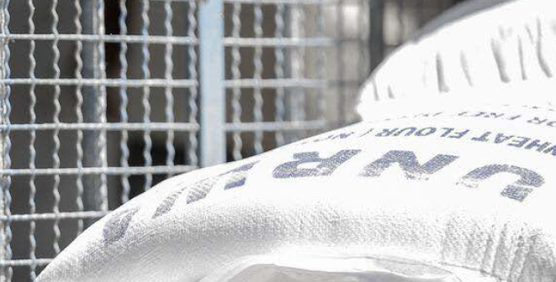
CASE EXAMPLE: GAZA
PREVENT CHILD LABOUR RELATED TO HUMANITARIAN ACTION
Identification and referral of children at risk of child labour
Case management services
Tailored interventions
Monitoring and evaluation
Notes:
https://alliancecpha.org/en/system/tdf/library/attachments/cs_12_gaza.pdf?file=1&type=node&id=41779
This case study describes how UNRWA addressed child labour issues at distribution centres in Gaza through an integrated education, economic-strengthening and protection project. The objective of the project was to mitigate child labour risks and find alternatives for children working as porters around UNRWA distribution sites
Managers of the 12 distribution centres, social intervention supervisors and operations support staff identified child labourers working in and around the centres. As expected, all children identified as working outside the distribution centres were boys. After identification, counsellors from community mental health teams established contact with the children’s families to obtain consent and plan a meeting.
Case management was initiated for each identified child. The caseload included 138 children in 103 families, as several children were from the same families. A total of 16 social workers were assigned six to seven cases each. Interventions looked at the needs and potential within each family, which was key in the effective response for the majority of cases. Monitoring was conducted through analysis of case management data and through regular project monitoring, management and follow-up.
The project is an example of an integrated, multi-sectoral approach to child labour in a humanitarian context, which was effective in addressing the entrenched, complex and sensitive issue of child labour. The effective collaboration enabled multi-disciplinary planning, implementation and learning.

Slide 18
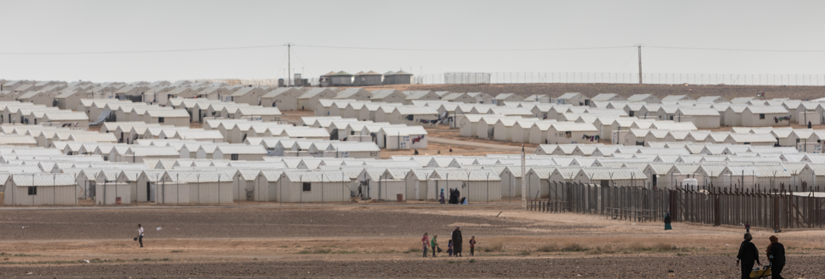
CASE EXAMPLE: JORDAN ZAATARI CAMP
PREVENT CHILD LABOUR RELATED TO HUMANITARIAN ACTION
1. Children’s booths
2. Alternative Collectors Scheme
3. Community mitigation steps
4. Monitoring and follow-up
Notes:
https://alliancecpha.org/en/system/tdf/library/attachments/case_study_11_sop_jordan.pdf?file=1&type=node&id=41778
This case study describes a Standard Operating Procedure (SOP) developed in Jordan to prevent child labour and identify at-risk children during distributions. At the entrance of each distribution site, a children’s booth was installed where children entering the site were screened. Children who arrived alone to collect relief items on behalf of their own or another family were registered and interviewed to determine their gender, age, reasons for collecting the items, family situation, vulnerability and the presence of other persons above the age of 16 years in their family who could collect distributions. The Alternative Collectors Scheme was put in place to ensure that households with nobody above the age of 16 years to collect the items in person could still receive distributions. To increase awareness about the SOPs, community awareness-raising was undertaken by all families prior to all distributions about collection of relief items, eligibility and procedures
Post-Distribution Monitoring (PDM) by phone was used to ensure that all vulnerable families had received their relief items and to collect feedback about the process.

Slide 19
KEY MESSAGES
When risk factors outweigh protective factors, children move quickly into child labour.
All humanitarian actors have a responsibility to prevent child labour associated with humanitarian action.
A holistic, complementary, and integrated programmatic framework should work to strengthen systems and protect children from child labour.
When time and resources are limited, practical preventative measures should be put in place to prevent the WFCL.
Notes:
When risk factors outweigh existing protective factors, children can move quickly from being in school or acceptable work, to being in child labour, or the WFCL. There are also important protective factors that build resilience and help to protect children from child labour.
All humanitarian actors regardless of mandate or capacity have a responsibility to prevent child labour associated with humanitarian action. Most humanitarian actors can play a role in preventing child labour through their work. While others who have the required experience or expertise, capacity and mandate may be able to respond and withdraw children from child labour and its worst forms.
A programmatic framework should develop holistic, complementary and integrated prevention and response actions to strengthen systems and protect children from child labour across multiple sectors and different levels of the socio-economic model.
When time and resources are limited, practical preventative measures should be put in place to prevent the WFCL and other serious forms of child labour that are emerging or worsening as an immediate result of the humanitarian crisis.

