Slide 1

TRAINING PACKAGE
INTERAGENCY TOOLKIT: PREVENTING AND RESPONDING TO CHILD LABOUR IN HUMANITARIAN ACTION

Slide 2
SESSION 3
CHILD LABOUR SITUATION ASSESSMENT AND ANALYSIS

Slide 3
LEARNING OUTCOMES
By the end of the session you will be able to:
List some of the key pieces of information needed to assess and analyse child labour in any given context (What We Need to Know)
Identify opportunities for collecting situational data on child labour in own or given context
Describe the key elements of how child labour should be integrated into needs assessment

Slide 4
DEFINING INFORMATION WE NEED TO KNOW ON CHILD LABOUR

Slide 5

DEFINING INFORMATION WE NEED TO KNOW ON THE CHILD LABOUR SITUATION
DISCUSSION:
What are the key information pieces we need to know about child labour in order to mount an effective response?
Consider information on child labour in
  Humanitarian situations
  National/local systems

Slide 6
WHAT WE
NEED
TO KNOW
WHAT WE NEED TO KNOW ABOUT CHILD LABOUR
HUMANITARIAN SITUATION
NATIONAL / LOCAL SYSTEMS
Scale and severity
Pre-existing and new forms
Main risk factors
Protective factors
Main risks faced by working children
Needs of children in child labour and their families
Available services and support
CL risk factors related to humanitarian action
Main provisions and gaps in capacity and legal/policy framework

Slide 7
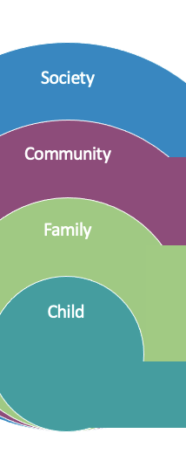
WHAT WE NEED TO KNOW: SUMMARY OVERVIEW
● Child labour policy and legislation, actors, capacities and systems ● Data and information management ● Humanitarian context: characteristics, child labour risks associated with humanitarian action, potential natural hazards, disaster risks and associated mitigation measures
● Community capacities to protect children from child labour ● Social and gender norms and cultural practices that influence the acceptability of child labour ● Capacities of community-level services and support ● Access to information on child labour
● Household food security and livelihoods, including basics needs and income generation ● Coping mechanisms of families to meet basic needs including reasons why families condone child labour ● Family and caring environment risk and protective factors, and gender norms ● The role of intimate relationships in child labour
● Vulnerability profile of children vis- à-vis child labour ● Patterns and scale of child labour prior to and during the crisis ● Negative impact of child labour on children ● The role of child protection, education, and youth livelihoods in vulnerability to child labour ● Participation & decision-making
Notes:
Explain that the WWNK in the toolkit are structured around the socio-economic model. The individual level focuses on information to identify vulnerability to child labour, access to basic needs and services, hopes and aspirations, at the level of families and caregivers the risk and protective factors at the level of caregivers and the family, at the community level the risk and protective factors in the community environment, social norms and community services, at society level the laws, policies, legislation, services and enabling environment including the humanitarian context crises profile’s and response capacity.

Slide 8
DISAGGREGATE DATA
AS A MINIMUM
Sex
Age
Disability
Minimum age for work
Compulsory age for schooling (primary/secondary)

Slide 9
COLLECTING DATA ON CHILD LABOUR

Slide 10
CONDUCT SECONDARY DATA REVIEW
PRINCIPLES
OFTEN INCLUDES
Review of existing data
Vital when CL is pre-existing
Helps primary data collection & rapid response
Coordinated and inter-agency
Preparedness and response
  Pre-existing child labour situation
  Legislative framework
  CL risk factors
  Protective factors that help prevent it
  Lessons learned
Notes:
Explain that:
During rapid-onset emergencies or when access, time or resources are limited, initial rapid assessments can help provide useful information on the WFCL or elevated child labour risk factors to help inform key elements of planning such as the Humanitarian Needs Overview (HNO).
Another option is integrating child labour indicators into the wide variety of needs assessments that will take place in humanitarian contexts across relevant sectors such as child protection, education, food security and livelihoods to inform mid- to longer-term response planning. However, when access, time and dedicated resources are available, humanitarian actors should work together to initiate more in-depth assessment or research on child labour (specific types of) to inform comprehensive, long-term programming.

Slide 11
OPTIONS FOR PRIMARY DATA COLLECTION
INTEGRATE CHILD LABOUR…
…WHEN ACCESS, TIME, RESOURCES ARE LIMITED
…WHEN ACCESS, TIME, RESOURCES ARE AVAILABLE
Initial rapid assessments to inform planning (Child Protection [CPIA]; multi-sector or joint initial assessments)
Needs assessments (sector specific or multi sector)
Needs assessments (sector specific or multi sector)
In-depth child labour assessment or research on child labour (specific types of), nature, patterns, prevalence to inform comprehensive, long-term programming and policy

Slide 12
OPTIONS FOR PRIMARY DATA COLLECTION
KEY CONSIDERATIONS
INITIAL ASSESSMENT
NEEDS ASSESSMENT
IN-DEPTH ASSESSMENT
Pre-existing concern or priority in the context
Using proxy indicators
Cross sector and multi sector opportunities
Coordination and harmonisation
Technical assistance
Notes:
Explain that during primary data collection humanitarian actors should consider:
Whether child labour is a pre-existing concern. Where it is or there are known patterns of WFCL or risk factors, the WFCL and child labour should be integrated into all 3 assessment options.
Using proxy indicators can help provide information, prevent delays, and help set targets based on known associated or risk factors, such as children out of school, increased households in need of food security, presence of the WFCL.
Making the most of cross or multi sector opportunities can be cost-effective, contribute to more comprehensive picture of child labour, and help build understanding and ownership of child labour across multiple sectors. As well as related humanitarian sectors such as child protection, gender-based violence, education, basic needs, early recovery, food security and livelihoods, cash and voucher assistance (CVA), and health. National child labour or household surveys, vulnerability assessments and Post-Disaster Needs Assessments (PDNA) all present opportunities.
Taking a coordinated approach to assessing child labour is recommended to improve the availability and quality of child labour data. Humanitarian coordination can help bring actors together during preparedness and response to develop coordinated child labour assessment frameworks.
If actors in humanitarian settings are not familiar with child labour assessments or research, it is important to seek support and technical assistance from actors who do. Humanitarian coordination structures are the best place to start to identify this expertise.

Slide 13
COORDINATED CHILD LABOUR ASSESSMENT FRAMEWORKS
DISCUSSION:
If you are developing a coordinated child labour assessment framework, what elements should it include?

Slide 14
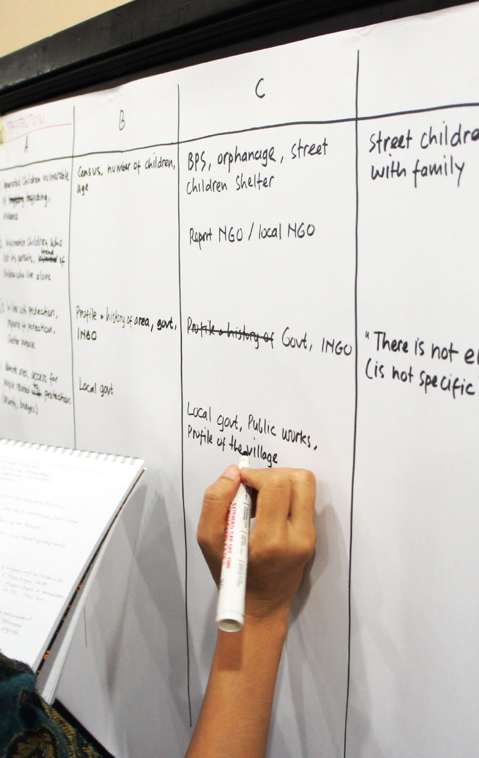
A COORDINATED CHILD LABOUR ASSESSMENT FRAMEWORK
Harmonised approach to data collection
Uses same definitions of CL/WFCL
Joint data set and common indicators
Includes priority CL and WFCL
Harmonised assessment methodologies
Disaggregation of CL data (age/working age/disability/diversity/sex)
SOPs (safeguarding / follow-up)
Geographic/thematic coverage
Involves key actors
(Photo credit ACAPS)

Slide 15

ACTIVITY: INTEGRATING CHILD LABOUR INTO NEEDS ASSESSMENT
In your groups:
Assign a reporter and a note taker
Imagine you are conducting a … CPRA/Multi-sector assessment
Think of 5-10 key questions that can be asked in this assessment which reflect child labour and the WFCL
Consider, in your context:
  What you need the information for
  How other related areas may be able to incorporate aspects of children’s work, child labour, or the WFCL*
20 minutes
Report back in plenary
Notes:
*Considerations on child labour, children’s work and WCFL can be retrieved asking questions e.g., questions on sexual violence, psychosocial distress, dangers & injuries, education, family separation. Use of questions on why/where and how children face difficulties may be useful to this effect.

Slide 16
KEY CHILD LABOUR INDICATORS
INFORMATION TO PRIORITIZE:
Essential
Other important factors
Age of working children
Days and hours of work per week
Tasks, nature, and conditions of the work
Whether working children are attending school
Sex, disability, health status, displacement status, or separation status (factors which are known to increase exposure to child labour)
Additional Information: individual tasks, health, psychosocial well-being, characteristics of work environment
Notes:
Explain that indicators on child labour should prioritise identifying the age of working children as this helps determine how many working children have reached the legal age of light or decent work, or those who are too young to work and therefore in child labour, remember age is one of the biggest determinants of child labour, the days and hours of work per week and the tasks, nature and conditions of the work which both help determine whether work is acceptable for the age of the child, classified as child labour or is hazardous.
Whether working children are attending school helps to determine whether work is negatively affecting education, which is another big determinant of child labour. Remember these are all closely linked with the definition of child labour.
Explain that other important factors to consider in the context might include gender, disability or health status, displacement status or separation status that can all influence or increase exposure to child labour, and a more detailed information which helps provides a complete picture

Slide 17
KEY CHILD LABOUR INDICATORS
THE IMPACT OF THE CRISIS ON CHILD LABOUR
  Types of child labour increasing/newly emerging because of the crisis?
  Changes to trends and patterns of child labour over the crisis?
  Attitude of communities towards child labour/WFCL? Has this changed?
  Impact of the crisis on economic and livelihood opportunities for adolescents above the minimum age for work but below 18 years?
  How does this compare between different groups?
Notes:
This slide shows a few indicators that would help indicate the impact of crisis on child labour, there are many more available in the WWNK tool of the Child Labour Toolkit.

Slide 18
KEY CHILD LABOUR INDICATORS
INDICATORS ACROSS SECTORS
PROXY INDICATORS
DIRECT INDICATORS
Increase in children out of school
Increase in children working
Increase in unmet FSL needs
New risk factors (e.g. asset or income loss, school closures, family coping strategies that involve child labour)
Gender- and age-specific risks (e.g. limited adolescent or girls’ education)
Child protection risks associated with CL
  Work as a cause of psychosocial distress
  Violence/sexual violence associated with work
  Dangers and injuries associated with work
Children managing work and school; attendance barriers for at-risk groups
Who in the household brings in income or food, including children
How boys/girls spend their time at home and outside the home
Notes:
Suggestions : might be good to include some recommendation around
Formulating neutral/objective questions
Using closed question for ease of use//open if the sample is small, you’re in the beginning of your assessment, etc…
Clarifying that each type of respondent (parents, children, other com members) will have a different tool to fill

Slide 19
IMPLEMENTING ASSESSMENTS

Slide 20
COLLECTING SENSITIVE DATA ON CHILD LABOUR
ESTABLISH LOCAL UNDERSTANDING AND DEFINITIONS OF CHILD LABOUR
TREAT DATA COLLECTION WITH EXTREME CARE
Locally used terms
Concepts of “work”
Literacy levels
Translation and field testing
Agreement
Identify sensitive topics in communities
Conflict, personal security, access
Protect the identities of children
Work around sensitive topics
Use people known to communities (where possible and appropriate)
Notes:
Explain that:
Understanding and agreement should be reached on locally used terms and concepts of children’s work and child labour, because these will impact how participants recognise and respond to questions. For instance, the term “domestic labour” may be less common than terms like “house boy/girl” or a “home helper”. Similarly, children working within their family can be regarded as “helping” rather than “working”. Or if children are working to pay off debt (e.g., bonded labour) or in exchange for goods, this may not be reported or regarded as work.
Where literacy levels are low questions must not be over complicated, questions should be translated and tested with responders and local enumerators to ensure they understand questions or for instance are able to calculate the number of hours per week worked by a child.
As many issues surrounding child labour may be considered sensitive within communities, data collection should be treated with high levels of care. Identifying topics which are considered sensitive or may place children and their families at greater risk of harm, particularly where conflict, personal security or access may influence results, is a priority. Also ensure the identifies of children are protected in data collection methodologies and tools and prevent bias, stigma and discrimination of children in the (the worst forms of) child labour. One way of working around sensitive topics is to ask households questions in more general terms about work or child labour within the community rather than within the household. Another may be to train and use people who are known to the informants or have existing relationships with children through service delivery, as data collectors.

Slide 21
KEY ACTIONS TO STRENGTHEN THE MEASUREMENT OF CHILD LABOUR
Gender, age-responsive & inclusive
Designing tools and methodologies
Training data collectors
Obtaining complete and reliable information
Notes:
Explain that:
Globally child labour is prevalent within household units in domestic and agricultural work. Gender and age-responsive data collection should focus on paid and unpaid, tasks and activities, inside and outside the home, collecting information on how children (girls and boys) spend their time, on work, domestic chores, caregiving, agriculture, and other domestic tasks. Be careful that focusing on only one type of child labour or the formal sector for instance may exclude other (worst) forms of child labour or vulnerable groups. It is important to capture data about both the formal and informal economy to ensure unregulated sectors are covered and work that may other be under-reported is obtained.
Suitable tools and methodologies, include
Direct observation to assess children’s places of work and identify potential hazards and risks; triangulating data between secondary data review, primary data collection, anecdotal evidence, organisational data and media reports.
Tools which collect and analyse data by sex, age and disability, and around the compulsory age for education and the minimum age of work.
Suitable sampling methods are needed which are inclusive of the most vulnerable populations. As random sampling can lead to the exclusion of children and families who are most vulnerable to child labour, statistically robust yet non-conventional sampling methods should be considered such as respondent-driven sampling, time location sampling, network scale-up sampling or capture-recapture sampling to prevent the exclusion of marginalised group.
Data collectors need a solid understanding of child labour concepts, training should cover terms and definitions used in the assessment including local interpretations, interpreting and recording accurate responses, calculating children’s participation in work such the hours they work per week, as well as the ability to explain the terms and definitions being used in the assessment to participants. Suggestion : Enumerators also have to be trained on safeguarding and referral protocols
Data gathering should be as complete and reliable as possible, overcoming potential challenges. For instance, the exclusion of vulnerable children from data collection e.g. those living on the streets, in alternative care or at their place of work, in seasonal agricultural.
Parents may also give incomplete or unreliable information either because they do not know what their children do at work, or they do not want to disclose the true nature of their children’s work, as it is known to be illegal, sensitive or taboo within the community. Triangulating information given by adult family members with information given by children and adolescents; ensuring household-level collection efforts do not exclude children in the most vulnerable households such as those on the streets or in alternative care, or by not asking specific questions about child labour in the household directly but asking more general questions about the activities carried out by each member of the household and for how long each week. It is also important to consider how the timing of data collection may affect reporting on child labour particularly in rural or agricultural communities where child labour is tied to seasonal events such as harvesting periods or periods of flooding or drought.
Suggestion here : triangulate also by meeting with teachers (if there is a school) or local leads who know the families.

Slide 22
INVOLVING CHILDREN IN DATA COLLECTION ON CHILD LABOUR
CONSIDERATIONS
ETHICS
Is it essential? Is it the only way to obtain reliable data?
What are the risks?
How can it be done ethically and empowering for children?
Are there suitable methodologies for children who may have big social and educational gaps?
Do no harm
Informed consent
Child safeguarding
Privacy and confidentiality
Expectations
Linking children and families to services
Notes:
Explain that the first consideration is whether it is essential to directly involve children. While information provided by working children tends to be completer and more reliable than that given by adult members of the household. Collecting information can put working children and their families at risk, particularly when children are in the WFCL, or they are not able to meet their basic needs. Risks also arise around duplication and assessment fatigue, trust between service providers and affected communities. Where data collection with children is the only way to obtain reliable data – for example, about the nature and conditions of children’s work, it must be carefully considered so that it is done in an ethical and empowering way using suitable methodologies to capture the experiences and observations of working children, such as individual interviews or child-friendly activities such as focus group discussions, body mapping, participatory ranking tools, risk mapping. The key ethics are of course those which are already familiar to us in humanitarian action.

Slide 23
ACTIVITY: COLLECTING DATA ON CHILD LABOUR
Assign a reporter and note taker.
Discuss the sentences you have been given and agree to an ending for each sentence.
You have 10 minutes.
Discuss back in plenary.

Slide 24
KEY MESSAGES
Disaggregate data by sex, age, disability, and minimum age for work/compulsory age for schooling.
Integrate child labour into initial rapid assessments and needs assessments when access, resources, and time are limited.
Integrate child labour into needs assessment and in-depth child labour assessment when access, resources, and time are available.
Coordinated assessment frameworks offer a harmonised approach to data collection across sectors.
Prioritise primary data collection on the age of working children; days and hours of work per week; tasks, nature, and conditions; and school attendance.
Establish local understanding of child labour.
Treat data collection on child labour and the WFCL with extreme care.

