Slide 1

TRAINING PACKAGE
INTERAGENCY TOOLKIT: PREVENTING AND RESPONDING TO CHILD LABOUR IN HUMANITARIAN ACTION

Slide 2
SESSION 17: HEALTHCARE TO PREVENT AND RESPOND TO CHILD LABOUR

Slide 3
LEARNING OUTCOMES
By the end of the session you will be able to:
Describe the complex relationship between health and child labour
List 5 physical traits that place children at greater risk of physical harm
Develop an action plan to support households with children in child labour in addressing health risks and access to healthcare services for own given context

Slide 4

DISCUSSION: WHAT DO YOU THINK?
All of these cases have accessed healthcare in the last few weeks. In your group, discuss and identify the key issues that relate to the case study you have been given. E.g., health risks, protective factors, how and why they are at-risk of child labour and ill-health, etc.
Record discussion.
You have 15 minutes.
Feedback in plenary.

Slide 5
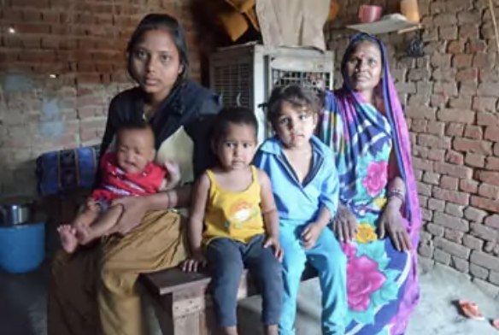
DISCUSSION: DANAH
Medical history of family, visits to health clinics, accidents
Access/ availability key services
Health needs within family
Risks to younger children?
Change in family composition
Reliant on children’s income
Displacement
Exposure to health risks
Single-headed household
Roles within/outside household: hours, tasks, risks, dangers
Cost of family healthcare
Protective factors
Notes:
Danah is attending a covid-19 clinic. While speaking to the nurses they ask her about her home life: “Of course, I am always busy, I have 5 children to feed, these are only 2 of them, my 7-month-old and 8-year-old. At home taking care of my elderly mother and younger son is my 11-year-old daughter. Since we were forced from our home and my husband died, life is very hard for all of us. My mother and children need a lot of care, we are very poor. Thank God the children are now old enough to work, my 13-year-old son’s work is the only income we have to buy nutritious food for the baby.”
Issues may be:
Medical history of family, visits to health clinics, accidents, the cost of healthcare for the family etc.
Healthcare needs of elderly mother and young children.
Exposure to health risks, infectious diseases, covid etc. (household/community/work)
Type of work children are performing – hours/risks/danger
Risks to younger children – health/dangers and injuries.
Ability to meet basic needs (without using children’s income).
Displacement and significant family change.
Single headed household.
Access to important services, childcare, education, adequate income
Photo: https://www.antislavery.org/slavery-today/bonded-labour/

Slide 6
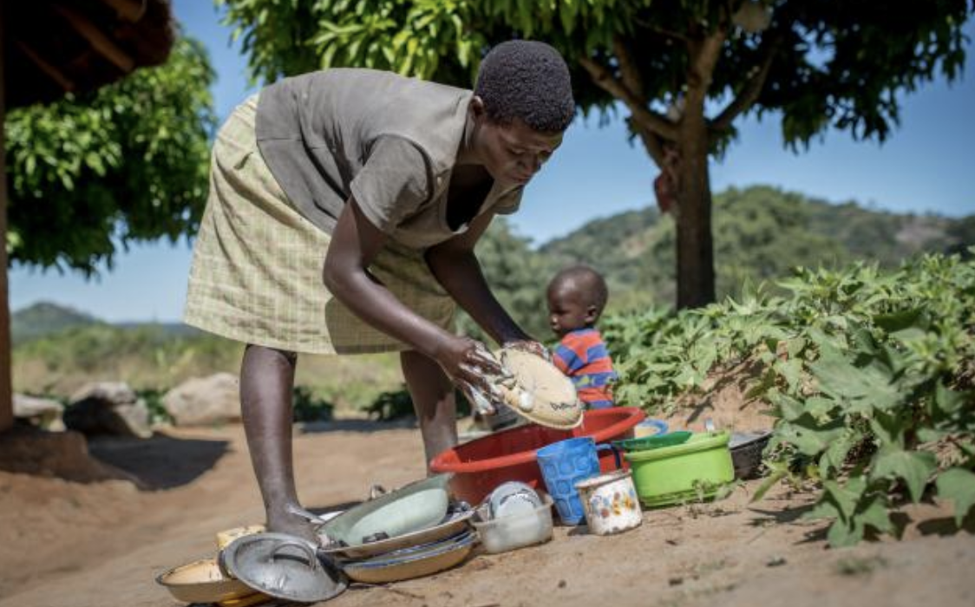
DISCUSSION: AMARA
Views and capacities of child
Psychosocial concerns
Access to support and services
Access to socialisation and recreation –
Isolation?
School attendance versus responsibilities at home?
Neglect by parents?
Physical strain, injury risks
Long hours, heavy caring responsibility
Access/ availability key services
Protective factors
Notes:
Amara: During adolescent health sessions being run in disaster affected communities, a 14-year-old girl who is attending always seems tired and says she has to help a lot at home because of her parents’ poor health. She has younger siblings, including a sister who has learning difficulties. She says she often has to look after her sister as well as cook dinner for the family.
Issues may be:
Medical history and health needs of girl and family (parents and sister with learning difficulties), cost of healthcare for the family, etc.
Role of girl in healthcare for family.
School attendance versus responsibilities/work at home.
Work for long hours, prevent socialisation and recreation essential for development.
Psychosocial distress or mental health concerns,
Views of child: May be happy to help at home and not want to stop helping. Their views and attitudes are important.
Access to additional support and services.
Photo: https://www.oxfam.org/en/not-all-gaps-are-created-equal-true-value-care-work

Slide 7
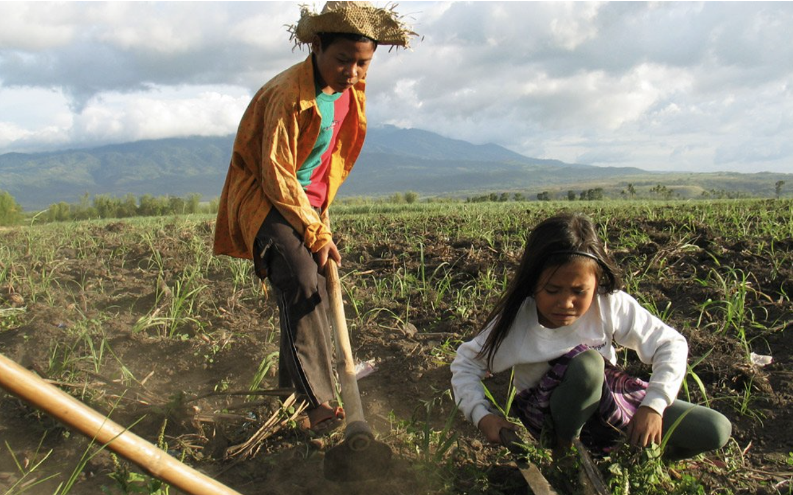
DISCUSSION: MATEO
Children replacing adult labour
Exposure to pesticides at work, play and home – How?
Hours of work versus school
Medical history indications of long-term exposure
Risks to other children in the family
Capacity to identify chemicals and take precautions
Hazardous work: frequent pesticide harm
Presence/Evidence of other dangers/injuries/
health needs
Protective factors
Notes:
Mateo: A father brings his son into a rural health clinic with headaches, dizziness, nose bleeds and nausea, he thinks he has been exposed to chemicals, but he is not sure what one, they live and work on a large farm close by where the father works as a farm labourer. The father says this has never happened before and the children don’t normally work, but they have had to recently because there are less people to work on the farm because of covid restrictions.
Issues may be:
Possible exposure to pesticides (work, play, home e.g., storage, containers for food or water, clothes that have been in contact with pesticides, playing in fields or touching plants applied with pesticides, pesticide drift, working to mix, prepare, apply pesticides.)
Presence of other dangers at work. Evidence of injuries or other health care needs, visits to health care facilities etc.
Hours of work, hours of exposure to pesticides.
Presence of caregiver when poisoning occurred – ability to identify the chemical.
Children’s capacity to identify or remember chemicals, follow instructions, take safety precautions etc.
Evidence of long-term exposure to pesticides: respiratory difficulties, emotional or neurological changes, developmental delays, organ damage etc.
Children replacing adult labour.
Child labour common on local fruit farms.
School attendance.
Photo ILO Joseph Fort in https://www.gfauk.org/special-report/child-labor-today/

Slide 8
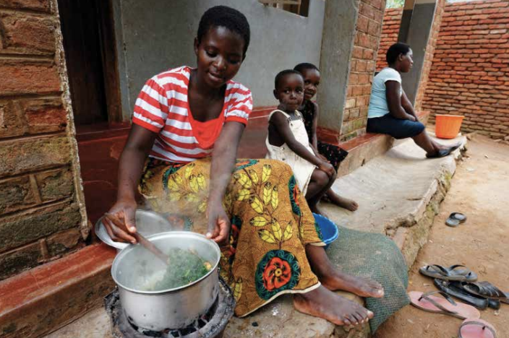
DISCUSSION: JOYCE
Physical, emotional, sexual abuse by family
Domestic labour
Family separation
Physical strain
Child care skills: Risks to pre-school child
Psychosocial distress/mental health concerns
Medical history health clinic visits, injuries
Access to services
Hazardous materials/tasks
Forced labour or coercion
Evidence of sexual violence/abuse: STIs, unwanted pregnancy, etc.
Protective factors
Notes:
Joyce: A young girl of around 14-years-old brings in a 2-year-old boy who has swallowed a cleaning liquid, while the parents are at work. As the health worker talks to the girl, they realise ‘the parents’ are not the girls’ parents or relatives. When they ask the girl who she is, she says she helps at the house of the family, she keeps saying she is going to be a lot of trouble and ‘they’ will be very angry with her. You can see marks and bruises on her arms and legs, and she seems very frightened and nervous.
Issues may be:
Domestic labour outside of the family, family separation, coercion or forced labour
Injuries, physical, emotional, sexual abuse by employers, visits to health clinics, evidence of STIs, unwanted pregnancy and other consequences of sexual violence and abuse.
Working with hazardous materials/tasks, long hours, repetitive movements, delayed development
Access to services – adolescent and sexual and reproductive health care, education, legal etc.
Psychosocial distress and mental health concerns.
Child’s capacities and skills to care for pre-school child
Photo: http://www.oit.org/wcmsp5/groups/public/---asia/---ro-bangkok/---ilo-jakarta/documents/publication/wcms_552766.pdf (Tackling child labour in domestic work)

Slide 9
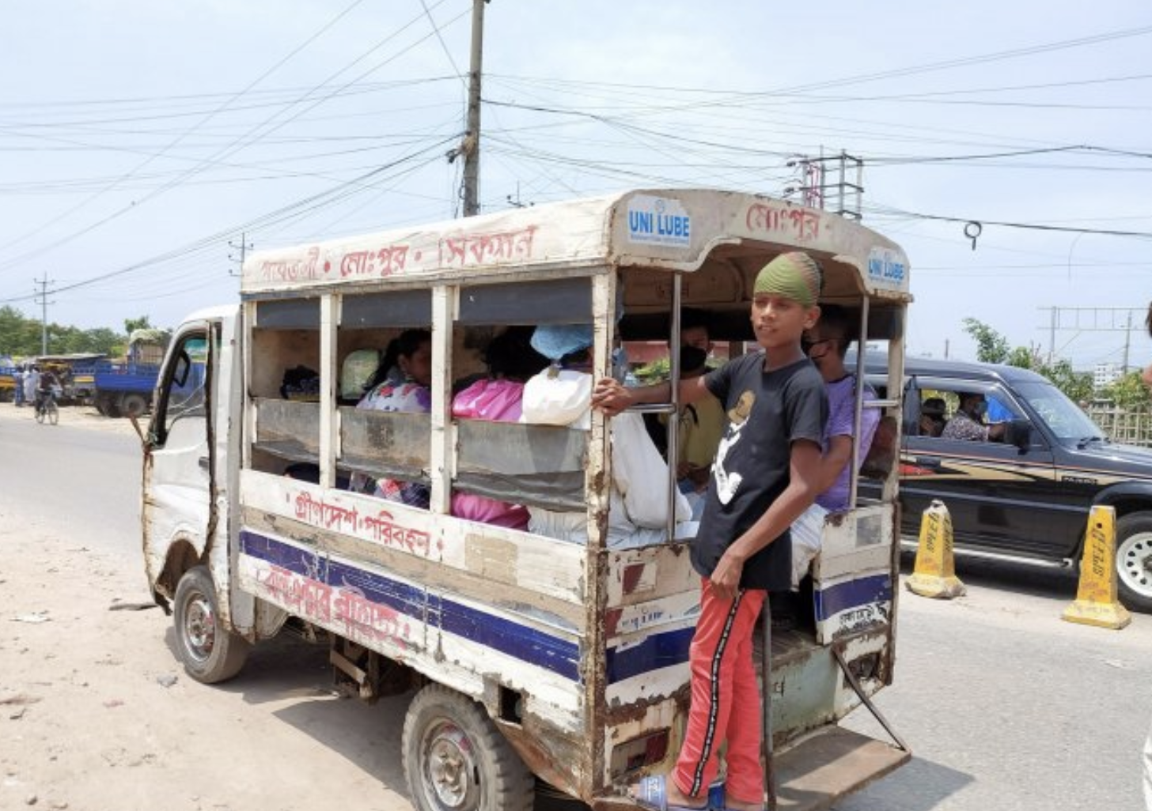
DISCUSSION: SADAD
Family separation
Poor living & working condition: on the streets, group living, with employer
Support network
Acute illness, injury, impairment, death
Coercion: forced labour?
Physical/ sexual abuse
Psychosocial distress/mental health concerns
Hazardous work: exposure to fast dangerous traffic, accidents, pollution, abuse,
Risk-taking behaviours
Capacity/support for self care, treat wounds, prevent long term impairment, etc.
Working with hazardous materials/tasks
Long term ill-health (nutrition, hygiene, diseases)
Protective factors
Notes:
Sadad: You are a working in a mobile clinic set up to meet the needs of a population influx. A boy of 15 years-old comes in as his leg has been badly injured in a road traffic collision. He is dirty, has no shoes on and is wearing ragged clothes. He is alone. While the health worker is tending to his injuries, she speaks to him. He says he has no family at home who can take care of him but it’s ok because he has other people who can, he doesn’t think it’ll be a problem if they can give him the things to look after the injury. He wants to leave quickly as he keeps saying he must get back to work, but the injury is serious, and he will need lot of care. He is reluctant to talk but says he works on the buses; you can see healed wounds from old injuries.
Issues may be:
Capacity or network to care for self, wounds, rehabilitation of injury – physio to prevent long term impairment etc.
Physical or sexual abuse, coercion, forced labour
Risk behaviours, nutritional deficiencies, infectious diseases etc.
Psychosocial distress and mental health concerns,
Separation from family
Living situation, child living or working on the streets, group living arrangement, with employer
Photo: https://reliefweb.int/report/world/educo-coronavirus-will-increase-number-children-who-are-victims-child-labour (Educo: Coronavirus will increase the number of children who are victims of child labour)

Slide 10
WHY HEALTHCARE AND CHILD LABOUR?
Wide-ranging health concerns link to child labour
Unmet health needs and barriers to accessing healthcare
Health is often a significant burden in households with child labour (costs, time, parental health/disability, poverty, exclusion)
Healthcare workers have:
  Frequent interactions with working children who require healthcare
  Role often seen as a trusted community member for children
  An important opportunity to help vulnerable children/caregivers access support and services
Notes:
DISABILITY AS A RISK FACTOR FOR CHILD LABOUR
For example, children with disabilities often have limited access to inclusive education and consequently have low skills and limited chances to find decent work, making them more vulnerable to child labour. Living with disabilities also implies extra costs, such as healthcare, which can push families into poverty and increase child labour risks.
Poverty can also cause disability because it can lead to neglect, malnourishment, denied healthcare, violence against children and child labour. While global evidence seems to confirm that children with disabilities have a higher vulnerability to child labour, this is not always the case. A study in Indonesia2 found that children with disabilities who were out of school were not engaged in economic or household activities; rather, they were found to be inactive at home. It is therefore important to always assess correlations in each specific context.

Slide 11
DISABILITY (AND ILL-HEALTH) AS A RISK FACTOR CHILD LABOUR
INCREASED VULNERABILITY MAY COME FROM:
Limited access to education, low skills, decent work opportunities
Extra costs for (health) care, aids, education, etc. pushes families into poverty
Poverty can cause disability (neglect, malnourishment, abuse, violence, etc. )
EVIDENCE IS NOT CLEAR… In some places provides a level of protection from child labour?

Slide 12
HAZARDS IN THE WORKPLACE
Biological hazards
Chemical hazards
Ergonomic hazards
Physical hazards
Psychological hazards
Social hazards
Other physical risks
Working conditions
Notes:
Recap the range of dangers and hazards children often associated with children’s work, as these help not only understand the harmful consequences of child labour, but also help identify areas where preventative and risk reduction strategies can be put in place. The field of occupational health uses the following categories:
Biological hazards: dangerous animals and insects, poisonous or sharp plants, bacteria, parasites or viruses (HIV, hepatitis).
Chemical hazards: toxic gases, liquids (solvents, cleaners), metals (asbestos, mercury, silica, lead), fumes (vehicle exhaust, glues), agrochemicals (pesticides, herbicides and insecticides), explosives.
Ergonomic hazards: work that requires lifting, carrying or moving heavy loads, repetitive or forceful movements, or work postures that are awkward or which must be held for a long period of time.
Physical hazards: extreme temperatures (hot or cold), noise, vibrations or radiation.
Psychological hazards: Stress, intimidation, monotonous work, lack of control or choice, insecurity, harassment, abuse (sexual or physical violence), heavy sense of responsibility.
Social hazards: isolation from peers and family, association with drugs or adult behaviour.
Other physical risks: risk of falling, being struck by objects, being caught in or between objects, being cut or burned.
Working conditions: long working hours, night work or work in isolation, an obligation to commute to or work in insecure areas.

Slide 13












CHILDREN ARE MORE VULNERABLE THAN ADULTS
Size and age
Skin
Respiration
Brain
Enzymes
Internal systems
Energy consumption
Fluid requirements
Sleep requirements
Temperature
Cognition and behaviour
Skeletal and muscles
Notes:
Children are exposed to the same dangers faced by adults in the workplace. However, they are affected more significantly by hazards and risks because their bodies are still growing, and they have special physical, cognitive, behavioural, and emotional characteristics that must be taken into consideration.
Some key developmental differences include:
Children’s size and age mean they may be asked to do tasks beyond their physical strength and build. Because children’s tissues and organs mature at different rates, there is not a specific vulnerable age in general, rather it depends on the particular hazard and level of risk as to what age a child is most vulnerable.
Children have two and half times more skin per body weight than an adult, which, along with thinner skin, can result in greater absorption of toxins. Skin structure is only fully developed after puberty.
A child breathes more deeply and frequently than an adult taking in more pathogens and toxic substances/pollutants than adults. A resting child has twice the volume of air passing through the lungs compared to a resting adult over the same period.
The development of a childs’ brain, can be hindered by exposure to disease and toxic substances. Metals are retained in the brain more readily in childhood and absorption is greater.
Enzyme systems are immature in childhood, resulting in poorer detoxification of hazardous substances.
Internal systems such as gastro-intestinal, endocrine, reproductive and renal systems
are maturing during childhood and are less efficient in eliminating hazardous agents. Exposure to toxins can hinder maturation of internal systems. The endocrine system and hormones play a key role in growth and development and can be especially vulnerable to disruption by exposure to chemicals during childhood and adolescence.
Because children are growing, they consume high levels of energy, water, and air. As they intake more they receive higher doses of whatever diseases, toxins and contaminants are present in the air, water, or food.
Children are more likely to dehydrate as they lose more water (per kg of body weight) than adults, through their lungs (greater passage of air through them), skin (larger surface area), and kidneys (less able to process concentrated urine).
10 to 18-year-olds require about 9.5 hours of sleep a night for proper development.
Children have increased sensitivity to heat and cold as the sweat glands and thermo-regulatory system are not fully developed.
Physical strain, especially when combined with repetitive movements, on growing bones and joints can cause stunting, spinal injury, and other life-long impairments.
Younger children have less ability to recognize and assess potential safety and health risks at work and make decisions about them.
Physical strain, especially when combined with repetitive movements, on growing bones, joints and muscles can cause stunting, spinal injury, and other life-long impairments.

Slide 14
FACTORS
THAT EXACERBATE PHYSICAL VULNERABILITY
A lack of work experience
Wanting to perform well
Learning incorrect health and safety behaviour from adults
Having little or no training or supervision
Lack of rights, agency, control, ability to organise
Notes:
There are also factors which exacerbate children’s innate physical vulnerabilities. These can include a lack work experience which means children are less able to make informed judgements about what is safe or not. Children’s sense of wanting to perform well and are willing to do extra or go further to please adults without realising the risk. If adults are not practicing correct health and safety within the workplace, children will learn incorrect and unsafe behaviour from them, and having little or no safety induction and ongoing training, means children won’t know when they are placing themselves in danger, or what they should be doing to minimise hazards. Inadequate even harsh supervision can only exacerbate children’s behaviour towards safety. Children are often powerless in terms of organisation and right, agency and control in the workplace which weakens their position in the workplace and ability to refuse unsafe working practices.

Slide 15
PSYCHOSOCIAL IMPACTS
Psychological abuse, violence, belittlement, harassment
Stigmatisation, discrimination, marginalisation
Isolation, limited freedom of movement and social integration, family separation
Negative sense of personal security and identity, limited future perspective, stress, low self-esteem, a sense of helplessness and further mental health problems
Notes:
Children often experience severe psychosocial consequences when they are in child labour and work or live in an environment where they are belittled and harassed or experience psychological violence and abuse. Cumulating over time, children may suffer stigmatisation, marginalisation and discrimination from their peers and within their communities, particularly if they differ in appearance or behaviour to other children in their communities.
Children who work in extremely dangerous situations and in exploitative and abusive conditions where they are abused, degraded, and rejected by employers, peers, and others risk psychosocial distress caused by isolation, limited freedom of movement, social integration with others and separation from their primary caregivers who can ensure a child’s welfare and healthy development. Children in these situations may become highly depend on their employers for their basic needs and have little power to escape maltreatment.
Children’s sense of personal security can be negatively impacted by child labour as can their personal identity and value, affecting how far children are able to shape their futures. This can lead to serious emotional expressions including stress, low self-esteem, helplessness and sometimes strong or overwhelming negative feelings.

Slide 16








PSYCHOSOCIAL FACTORS IN CHILDREN’S WORK
Job content
Workload and work pace
Work schedule
Control
Environment and equipment
Interpersonal relationships at work
Precarious working conditions
Home-work interface
Notes:
Job content helps determine motivation in the workplace. A lack of variety and repetitiveness, under using skills, meaningless work, high levels of uncertainty, conflicting demands, and a lack of opportunity to learn and develop new skills, experiences and self-esteem all lead to poor psychological and physical health, boredom, anxiety, depression and resentment, undermine self-worth, and leave children ill-prepared for the demands of adult life.
Both work overload and under load (the amount of work and the difficulty of the work) can include work where children are machine pacing, high levels of time pressure, and continually subject to deadlines can have a problematic impact on child labourer’s psychosocial health. Long working hours and the physical effort and strain of many jobs where children carry heavy physical loads without aids, or work in conditions where they sit on the floor or in confined spaces for a long time contribute to children experiencing stress, high levels of and stress related illnesses.
Child labour which involves : Shift work and long working hours, including at night with unpredictable, inflexible or unsociable schedules, which may also conflict with work/home demands, can interrupt and reduce sleep patterns causing fatigue and exhaustion, stress, and impaired intellectual development affecting education and disruption of family relationships. Girls are especially at risk as they have a greater burden for household activities and economic activities at the same time, and generally have lower rate of school attendance and completion.
Children in child labour often face low participation in decision making and a lack of control over their workload, pacing and what is happening to them. Sometimes being forcibly moved, unable to maintain regular contact with important social or emotional bonds, cultural routines, and social practices, relationships and daily routines, has been related to experiences of anxiety, depression, stress, apathy, exhaustion, poor physical health and low self-esteem. Greater control and participation in decision-making can lead to greater satisfaction and higher feelings of self-esteem.
Psychological and physical health are closely related. Inadequate, unsuitable or poorly maintained equipment and poor environmental working conditions for children all play a key part in children’s psychological health. Chemical, physical, ergonomic, biological and psychological hazards are often found in combination in child labour.
Well-recognised hazards which impact mental health include toxic substances which impact developing nervous system and children’s psychological functioning. Unhealthy workplaces increase stress, fatigue and demoralisation. Dangerous tools, can induce stress and fear of accidents, or trauma by suffering or witnessing serious incidents, and serious injuries or permanent impairments in work related accidents may increase the risk of isolation or stigmatization. Age, maturity and vulnerability all affect how children are affected. Generally, younger children may be at greatest risk, but adolescents can be exposed to multiple hazards, use dangerous equipment, and may often work longer hours. A lack of training and adult supervision all contributes to higher risks.
Relationships in the workplace with employers (who are often also parents), supervisors, clients or peers, play an important role in the life of a child who is in child labour’ both positively and negatively. While support and attachment at work can have a positive effect, children are vulnerable to maltreatment, abuse and violence, sexual harassment, bullying, stigmatisation, threats, isolation, exclusion, a lack of social support, and feelings of powerlessness against those who are meant to protect them, can lead to stress, impairment of health and well-being, depression, anxiety, and loss of concentration.
Precarious working conditions all impact children’s psychological well-being. Unpredictable treatment from employers, role ambiguity, multiple tasks within the workplace, a responsibility for others, career stagnation, cycles of uncertain and poorly paid income, under promotion or over promotion, a lack of formal ‘contracts’, entitlement to sick leave, holiday pay, job security, with little or no legal options against exploitation or opportunity to complain or leave.
Conflicting demands of work and home have a significant impact on children. Children, especially girls have a heavy burden of responsibility when caring for family and siblings alongside other work. Children may also have more than one job and competing demands from both workplaces. For many children, parents or other family members are also their employers, and their homes are their workplace, meaning there are few restrictions on the demands that are made on them. While family-based work can strengthen psychological well-being, where family work is excessive, exploitative or abusive, family-based child-workers can be at even greater risk than children working outside their families, as they are denied their primary source of emotional security, socialization and learning. Evan if children don’t work in a family setting, the home-work interface can serve to decrease or increase psychosocial impacts. Parents can play an important role in mediating the impact of work on their children through support and encouragement or place them at greater risk where they have unreasonable expectations and are punished for not fulfilling them. Humanitarian crisis can magnify risks as many families feel they no choice or little power to prevent the exploitation of their children, low levels of support at home, a breakdown of social networks, disruption to familiar surroundings and disruption in education/schooling, are all familiar consequences of humanitarian crisis.

Slide 17
ADDRESSING CHILD LABOUR THROUGH HEALTHCARE

Slide 18

ACTIVITY: WHAT WOULD YOU DO?
In your group, discuss and identify what could be done for the child in the case study you discussed earlier as they access healthcare?
What could be done for children in a similar situation who have not accessed a healthcare facility but face similar vulnerabilities?
Feedback in plenary.

Slide 19
WHAT COULD BE DONE FOR DANAH?
Referral: child protection, economic strengthening, displacement or refugee services, elderly and child care
Healthcare checks for family not in attendance
Support to finance family healthcare
Provide public health information and messaging (disease control, injury prevention, child protection, etc.)
Confidentiality
Follow-up
Notes:
Danah is attending a covid-19 clinic. While speaking to the nurses they ask her about her home life: “Of course, I am always busy, I have 5 children to feed, these are only 2 of them, my 7-month-old and 8-year-old. At home taking care of my elderly mother and younger son is my 11-year-old daughter. Since we were forced from our home and my husband died, life is very hard for all of us. My mother and children need a lot of care, we are very poor. Thank God the children are now old enough to work, my 13-year-old son’s work is the only income we have to buy nutritious food for the baby.”
Photo: https://www.antislavery.org/slavery-today/bonded-labour/

Slide 20
WHAT COULD BE DONE FOR AMARA?
Individual health checks for family
Holistic family healthcare
Talk with parents
Referrals: health, child protection, disability, childcare services
Information and messaging (age-appropriate domestic/care tasks, injury prevention, child protection, etc.)
Support continued attendance to adolescent sessions, education, SRHS
Participation in care and plan
Follow-up
Notes:
Amara: During adolescent health sessions being run in disaster affected communities, a 14-year-old girl who is attending always seems tired and says she has to help a lot at home because of her parents’ poor health. She has younger siblings, including a sister who has learning difficulties. She says she often has to look after her sister as well as cook dinner for the family.
Photo: https://www.oxfam.org/en/not-all-gaps-are-created-equal-true-value-care-work

Slide 21
WHAT COULD BE DONE FOR MATEO?
Identify chemical/pesticide
Treatment for acute/long-term health needs
Reporting to relevant authorities for pesticide poisoning
Urgent child protection referral (WFCL)
Referrals: ongoing healthcare, economic strengthening
Give information and messaging (pesticide use, injury prevention, age-appropriate agricultural tasks for children)
Data collection/health/injury surveillance systems
Follow-up
Notes:
Mateo: A father brings his son into a rural health clinic with headaches, dizziness, nose bleeds and nausea, he thinks he has been exposed to chemicals, but he is not sure what one, they live and work on a large farm close by where the father works as a farm labourer. The father says this has never happened before and the children don’t normally work, but they have had to recently because there are less people to work on the farm because of covid restrictions.
Photo ILO Joseph Fort in https://www.gfauk.org/special-report/child-labor-today/

Slide 22
WHAT COULD BE DONE FOR JOYCE?
Treatment for boy (poisoning)
Treatment/initial communication with girl
Follow procedure for GBV/forced labour/highly vulnerable adolescent girls
Identify legal guardians for each child separately(?)
Immediate child protection referral (WFCL)
SRHS/MHPSS
Situation dependent: public health information, contact with parents/employers, legal and judicial, educational childcare sessions for girl, injury prevention
Data collection/health/injury surveillance systems
Follow-up
Notes:
Joyce: A young girl of around 14-years-old brings in a 2-year-old boy who has swallowed a cleaning liquid, while the parents are at work. As the health worker talks to the girl, they realise ‘the parents’ are not the girls’ parents or relatives. When they ask the girl who she is, she says she helps at the house of the family, she keeps saying she is going to be trouble and ‘they’ will be angry with her. You can see a few marks and bruises on her arms.
Photo: http://www.oit.org/wcmsp5/groups/public/---asia/---ro-bangkok/---ilo-jakarta/documents/publication/wcms_552766.pdf (Tackling child labour in domestic work)

Slide 23
WHAT COULD BE DONE FOR SADAD?
Treatment of acute injury/other unmet health needs
Long term injury care plan – assessment for aftercare
Identify legal guardians/living arrangements
Referral to community-based care/nursing
Immediate referral to child protection or street children services (WFCL)
Public health information: injury prevention, communicable diseases, SRHS
Data collection/health/injury surveillance systems
Follow-up
Notes:
Sadad: You are a working in a mobile clinic set up to meet the needs of a population influx. A boy of 15 years-old comes in as his leg has been badly injured in a road traffic collision. He is dirty, has no shoes on and is wearing ragged clothes. He is alone. While the health worker is tending to his injuries, she speaks to him. He says he has no family at home who can take care of him but it’s ok because he has other people who can, he doesn’t think it’ll be a problem if they can give him the things to look after the injury. He wants to leave quickly as he keeps saying he must get back to work, but the injury is serious, and he will need lot of care. He is reluctant to talk but says he works on the buses; you can see healed wounds from old injuries.
Photo: https://reliefweb.int/report/world/educo-coronavirus-will-increase-number-children-who-are-victims-child-labour (Educo: Coronavirus will increase the number of children who are victims of child labour)

Slide 24
KEY PROGRAMMING ACTIONS
WHAT CAN BE DONE TO RESPOND TO CHILD LABOUR THROUGH HEALTH
Work in coordination
Include CL in public health messaging
Include CL-related ill-health in health screening/preventive care
Integrate work related ill-health for children in injury and health surveillance systems
Provide health information to working children
Improve healthcare access for working children and children in WFCL
Establish/support functional referral mechanism for vulnerable children
Train and inform health workers
{
Notes:
Commonly coordination for health actors with other relevant stakeholders may include with
Health and safety experts (who know about hazards and health outcomes, prevention etc.),
Labour inspectors (who know about labour law enforcement) and other legal and judicial actors (who can provide support on the WFCL)
General health, nutrition, welfare experts (who know about vulnerabilities and health outcomes in children)
Specialised health experts (who know about specific medical conditions commonly experienced by working children).
Child protection actors or social welfare staff (who can provide tailored case management and support to children and their families)
Education actors (who can provide information on technical and vocational education and training courses, providers, risks and hazards, or access to education services for children)
Food security and livelihoods actors (who can provide economic and food security services for poor and vulnerable families)
Include child labour into public health prevention messaging, content might include environmental and occupational hazards, their harmful impact on children’s health; occupational health and safety advice; available healthcare services; referral pathways and reporting procedures.
Including the screening of child labour-related illnesses, injuries and diseases into healthcare, screening and preventive care programmes including health checks, urgent care admissions, vaccination and immunisations etc.
Providing health information to working children and their families might include information on preventive and responsive healthcare and nutrition in services for working children; advice to parents, caregivers and employers on how to reduce health risks for working children; sexual and reproductive health rights (SRHR) information and services; information about sexual and domestic violence and consent; pregnancy; marriage; family planning; parenting. This may be done directly through services or with other actors/sectors through opportunities such as life skills programmes, awareness-raising activities, learning programmes or other activities designed for children in child labour.
Improving access to health care for working children and children in child labour and the WFCL might include identifying and using suitable locations, days and times to provide health services, in or close to children’s workplace, during or after work hours, or at weekends for instance. Extending community-level health and nutrition preventive care and treatment to localities with high levels of child labour or through mobile services or by conducting targeted outreach to (individual) hard-to-reach children in collaboration with child protection or child welfare services where required such as street children or children who are sexually exploited.

Slide 25
HEALTH CARE WORKER ROLES
KEY INDIVIDUAL ACTIONS
Provide front-line health support
Recognise work-related ill-health in children
Respond to disclosures of WFCL
Speak to children about living and working conditions
Refer children to other important services
Work as part of a multi-sector team
Provide tailored health messages/advice
Meet unmet health needs with tailored services
Record information appropriately
Notes:
In order to identify the impact of children’s work on a diagnosis and treatment health care staff can talk with children or adolescents and explore:
children’s occupations and responsibilities at home or work
activities undertaken at technical schools or universities during apprenticeships
their working conditions and associated risks
bio markers and monitoring: blood lead levels, pesticide exposure etc.
end organ effects of exposure: hepatic enzymes, audiometry, kidney and lung damage etc.
Existing work-place risk assessment

Slide 26
CHILD LABOUR KNOWLEDGE & SKILLS FOR HEALTH WORKERS
TRANSLATE KNOWLEDGE TO ACTION
Common CL types, occupational hazards, work-related health concerns, and treatments
Communicating with highly vulnerable children and adolescents (girls)
Referral pathways and mandatory reporting for WFCL
Monitoring and reporting of CL-related health concerns in health and injury surveillance systems
Best interests and non-discrimination
Survivor centred (SGBV) response and care
International minimum standards
Notes:
Health agencies, care workers, medical staff and community-based health workers, can gain knowledge and skills on child labour, through briefings, orientations or training sessions. Content covered should include those on the slide.

Slide 27
ACTIVITY: ACTION PLANNING TO EXPAND OPPORTUNITIES TO ADDRESS CHILD LABOUR
In your group, use the activity worksheet (or flipchart paper for more space).
Develop an action plan based on the worksheet using the questions as a guide:
  What, How, Whom, Resources required, Potential risks, Coordination, Capacity
The emphasis is on moving forward and what can be done in the context to strengthen prevention and response to child labour through (inter-)sectoral or thematic activities

Slide 28
KEY MESSAGES
Children in child labour are highly vulnerable to health risks.
Yet children in child labour, particularly the WFCL, often face the greatest barriers to accessing healthcare.
Health is often a significant burden in households with child labour.
Children are more vulnerable than adults to the same physical hazards because of their age and development.
Healthcare workers can play a key role in preventing and responding to child labour.
Notes:
Children in child labour are highly vulnerable to health risks, including physical injuries, disabilities, malnutrition, psychosocial distress and mental health concerns, STIs, unwanted pregnancy and other consequences of sexual violence and abuse. At the same time, children in child labour, particularly the WFCL, often face the greatest barriers to accessing healthcare due to poverty and neglect by parents, caregivers or employers.

