Slide 1

TRAINING PACKAGE
INTERAGENCY TOOLKIT: PREVENTING AND RESPONDING TO CHILD LABOUR IN HUMANITARIAN ACTION

Slide 2
SESSION 13: EDUCATION TO PREVENT AND RESPOND TO CHILD LABOUR

Slide 3
LEARNING OUTCOMES
By the end of the session you will be able to:
Identify 4-5 potential challenges which prevent working children from accessing education in own context
Give examples of how education can prevent child labour
Develop an action plan to support children in child labour access learning and education effectively for own or given context

Slide 4
LINKAGES BETWEEN EDUCATION AND CHILD LABOUR

Slide 5

DISCUSSION: WHAT DO YOU THINK?
In your group, discuss and identify the key education issues that relate to the case study you have been given. E.g., education related risks, protective factors, how and why they are at-risk of child labour, poor education, etc.
RECORD DISCUSSION
TIME: 15 MINS
FEEDBACK IN PLENARY

Slide 6
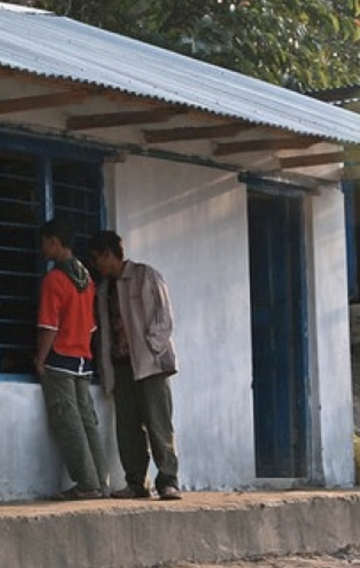
DISCUSSION: DANIEL
School closures
Unable to participate in remote learning
Availability of follow-up and (social) supports from schools and other actors
Teacher absenteeism, rapid staff turnover
Temporary decisions lead to long-term changes (motivation, relevance, money)
Difficult for parents to support education and pay for education costs
Difficult to manage work and school
Notes:
Daniel
Daniel, 13 lives with his family in a small rural village, before the outbreak he attended school, following long periods of school closure during the Covid-19 outbreak, Daniel starting working. “There was nothing to do at home, and my family was very poor, my parents used to have a small business, but they lost a lot of customers during the lockdown and had to borrow money, I didn’t want to sit and do nothing, my brothers and sisters were so hungry. We used to get some food at school, but this stopped when the school closed. If I don’t work, life will be harder, and we will never have the money to return to school, even when school opens.”
Risks
Schools were closed for long periods of time,
Lacked access to the internet and technology, unable to participate in remote learning.
Periods out of school lead to higher child labour risks
Restricted freedom of movement reduces follow-up and support available from schools (and outside of school from community leaders/CSOs/CLM teams etc.) for at-risk children. Reduced government capacity to support vulnerable children
Lockdown reduces social support such as free meal programs, health services, childcare services, and other social service provisions.
Teacher absenteeism, rapid turnover of staff affects support to at-risk children.
Decisions to drop out of school permanently.
Economic impact makes it difficult for families to support education and pay for school fees, supplies, and uniforms or compels children to work, or continue working after school opens.
Difficult to manage work hours, keep up with schoolwork, or attend regularly, because of work demands.
Despite free education, many families still need to pay tuition fees and additional costs.
children may not be interested in returning to school once they have started earning at work and learning practical work-based skills – see school as irrelevant curricula.
(Photo https://blogs.worldbank.org/education/educational-challenges-and-opportunities-covid-19-pandemic)

Slide 7
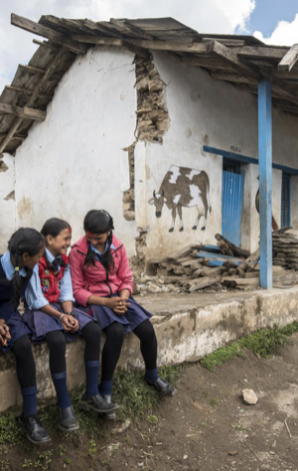
DISCUSSION: MARIA
Focus on rebuilding
Unsafe schools, poor learning environment
Psychosocial distress
Economic impact hampers children’s attendance in favour of work
Increased household workload/gender dimensions
Follow-up/additional support for at-risk children
Parental views on education
Availability of exam preparation/classes/catch-up
Notes:
Sana
Sana is 15, she was in school when the earthquake hit, while her classroom remained standing, some of the classes were badly damaged and children were injured and killed when the walls and ceilings collapsed. Sana lives with her father, elderly grandparents, and younger siblings. The school was closed for a period as temporary classrooms were set up alongside the less damaged classrooms. “My parents were happy when the school was closed, they were very busy and needed me to collect water and do the housework. Now school has opened, I was looking forward to returning to school, but learning is not fun anymore, the classes are noisy, and it doesn’t feel safe. I am trying to catch up at home and prepare for my exams, but my parents want me to help them all the time, sometimes they ask me to go to school just to register and then come home to help take care of my grandparents, some days I just don’t go… it feels pointless if I am not going to pass my exams.”
Risks
Refocus of priorities from quality education, teaching capacity, access for all etc., to the construction of temporary/permanent school buildings and developing safe and supportive learning environment.
Ability to concentrate in school might be hampered by experiences during the earthquake, learning in an unsafe school, or psychosocial distress
Poor access to adequate water and sanitation in school due to pre-existing issues and earthquake damage
Economic impact of earthquake hampers children’s attendance in favour of work.
Increased household workload to meet needs engages more children household work, collecting water, livelihoods activities.
Teacher absenteeism after natural disaster means at-risk children may not be identified.
Continued erosion of accessible and quality education makes school less attractive (safety school environments, safety travelling to and from school/poor learning environments, overcrowding,
Photo credit: https://plan-international.org/press-releases/nepal-earthquake-urgent-need-rebuild-and-repair-schools

Slide 8
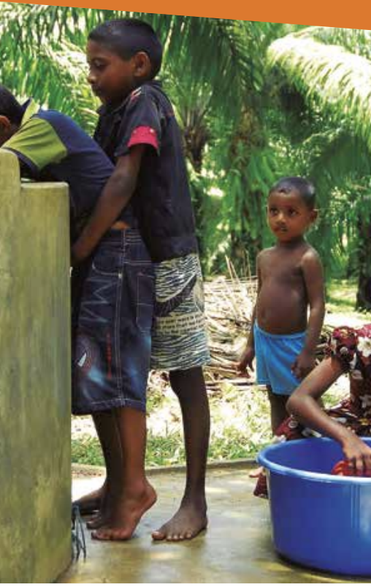
DISCUSSION: ISLA
Short- and long-term, cyclical, increasing severity
Heighten parental poverty/negative coping strategies
Regular disruption, relocation, school as a shelter, damage and destruction
Pre-existing vulnerabilities
Parental migration/Gender dimensions
Increased cycles of debt, inability to provide necessities for school
Psychosocial impact
Impacts prevent important supports for working children and attendance
Availability of secondary school
Notes:
Eila
“The past few years have been very difficult for my family. The rains have been really heavy and have flooded large parts of our village, sometimes there are landslides which close the roads. Every time this happens, we must relocate to the school which is also the emergency shelter, we have difficulty studying, and our books and uniforms are damaged. Normally in the dry season we can recover from the rains but this year it has been so hot and so dry, there has been water shortages, fires and wild animals coming into the village to find food and water. It’s all very disruptive. My family’s farm has done very badly. When it floods, all we can do is sit and wait for the water to subside, and during the droughts, there is not enough water to drink and bathe, and there is nothing we can do to stop our crops failing. My father died when I was small, and now my mother is talking about either me or her moving away to find work, she doesn’t want to as she wants me to continue school, but we cannot afford it at the moment. My mum has used a local moneylender to send my younger brothers to school but there is not enough money for me, instead I am working to help my mother on the farm and in her small sewing business.”
Risks
Increased severity and frequency of drought, floods and landslides leads to both short-term and long-term impacts which heighten parental poverty and negative coping strategies which entail different forms of paid/unpaid child labour, including:
Daily disruption (of education and other services), negative impact on quality education, deprivation of education (temporary closures, and/or intermittent school attendance), create environment for temporary or permanent school dropouts and risk children take up temporary or permanent employment/child labour, longer absences from school increase likelihood of full drop-out.
Repetitive relocation, family displacements, loss of livelihoods, and other push children to labour market to help families and increase drop out.
Aggravate poverty conditions and pre-existing socio-economic marginalization and vulnerability (single headed families, caring for elderly, agricultural livelihoods etc.)
Parental migration can lead to inadequate supervision and care, reduced school attendance, increased likelihood of school drop-out, neglect, abuse etc. Remittances might create disincentive for education (e.g., progression for adolescent boys, buy mobile phones, earn money, engage in daily labour work).
Increased poverty, hardship, cycles of debt, impact ability to provide necessities for children to attend school (clothes, shoes, transport, school fees, washing soap, food in and before school, replacing damaged uniforms and school supplies).
Psychosocial impact – fear of floods and landslides, inability to sleep, reduced concentration, school safety
School infrastructure destruction, overcrowding, two shift classes, loss of learning materials
Drought increases presence of wild animals, prevents children attending important supports for working children (tuition, evening or catch-up classes), and/or obliges them to finish classes early.
Other issues which push children into child labour (in extreme heat/drought) might include lack of water, drinking water, difficulties in bathing and washing, girls seek privacy for bathing further from home making them late for/not attend school, difficulty concentrating in hot classrooms, vulnerability to diseases, helping family collect water takes longer/walk further – late attendance.
DRR, preparedness, mitigation?
Availability of secondary school classes in rural villages, to continue education older children must travel long distances, and pay travel costs all are a further disincentive to continue schooling
Photo: https://www.ilo.org/wcmsp5/groups/public/---ed_norm/---ipec/documents/publication/wcms_651800.pdf

Slide 9
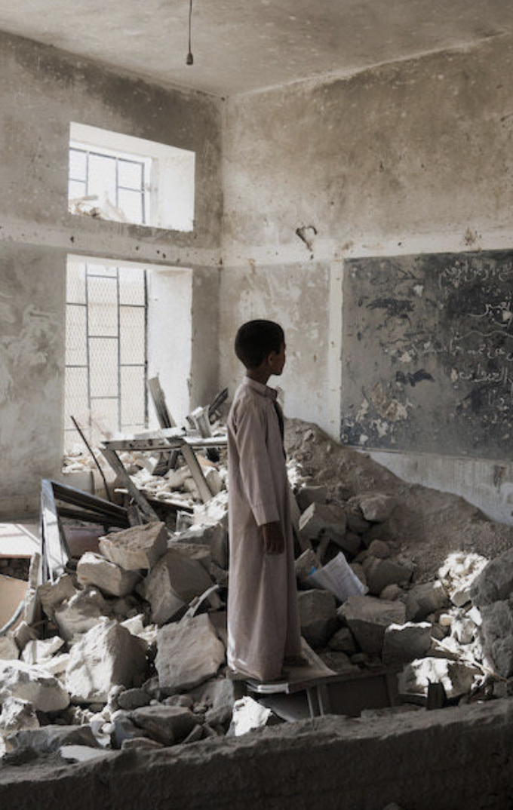
DISCUSSION: TAHIR
Limited/no educational opportunities
Opportunities for children to engage in labour
Lack of support for out-of-school children
Economic marginalisation
Impact of father’s injuries and disabilities
Risk that siblings will be pulled into work
School safety
Forced labour?
Risk of recruitment into armed forces?
Notes:
Tahir
Tahir is 12 years old; he was in school until it was damaged in the fighting and occupied by an armed group. Nobody goes to school there anymore, and now the closest school is a 45-minute walk away. After his father was badly injured in an air strike, he is now the only breadwinner, and works long days in a workshop using dangerous machinery that puts his health, safety and future at risk. “I have two sister and two brothers. I had no choice, I had to leave school and work because there is no one to support us. If I don’t help my family, we will not eat and none of brothers and sisters will go to school. Anyway, my days are too long, and I have no time to study. One day I want to open my own workshop and business instead of having a boss who is unkind to me. Then my brother can join me, their school is no good anyway, the teachers never come, the classrooms don’t have any windows or doors, they are over-crowded, and the journey is unsafe. It is sad that education has been so badly affected by the war, I used to enjoy classes.”
Risks
Lack of educational opportunities and school closures increases opportunities for children to engage in labour. If children out-of-school or dropped out recently are not properly supported, they may never return to school in favour of work.
Economic marginalisation pushes Tahir to work.
Cost and impact of injuries and disabilities of father
There is also growing concern that
Risk that siblings will gradually be pulled into work.
School safety
Elements of forced labour?
Risk of recruitment into armed forces who occupy school?
Photo credit: UNICEF from https://theirworld.org/news/shocking-rise-children-killed-maimed-attacks-on-schools-child-soldiers-un-report

Slide 10
… CONTRIBUTE TO CHILD LABOUR & SCHOOL DROP-OUT
EDUCATION RISK FACTORS
WHICH…
Poverty, economic marginalisation, household labour deficits
Disrupted and poor quality education
Limited/no time for learning, classes, homework, catch-up
Poor performance, concentration, learning difficulties, exhaustion, hunger, illness
Limited availability of catch-up, non-formal, or alternative education
Social status, appearance, discrimination
Limited skills, time, or resources of teachers
Policy barriers

Slide 11
WHY EDUCATION AND CHILD LABOUR
WHY EDUCATION & CHILD LABOUR
Fundamental right
Strongly associated with child labour risk factors
Critical for physical, psychosocial, cognitive protection
Critical for successful prevention and response to child labour
Prevention is better than cure:
  Prevent children enrolled before crisis from dropping out/entering child labour
  Response for children already out of school/in child labour before the crisis
Notes:
Some children are at greater risk of being excluded from accessing education: children living in rural areas; children living in urban slums; children living and working on the streets; adolescent girls, particularly those facing harmful practices such as child marriage; children who are trafficked (for labour or sexual exploitation); children who are refugee, internally displaced or migrant; children living in conflict set- tings; children who were out of school before the emergency or crisis; children associated with armed forces and armed groups; children in vulnerable households.

Slide 12
PREVENTING AND RESPONDING TO CHILD LABOUR THROUGH EDUCATION

Slide 13
QUICK FIRE PRESENTATION
Notes:
Adapt/write slides to local quick fire presentations

Slide 14
INEE MINIMUM STANDARDS FOR EDUCATION IN EMERGENCIES
FOUNDATIONS | ACCESS & LEARNING | TEACHING & LEARNING | TEACHERS & OTHER EDUCATION PERSONNEL | EDUCATION POLICY
Community participation Coordination Analysis Assessment Monitoring Response strategies Evaluation | Equal Access Protection and Well-being Facilities and Services | Curricula Training, Professional Development and Support Instruction & learning Assessment of learning | Recruitment & selection Conditions of work Support & supervision | Law & policy formation Planning and implementation

Slide 15

ACTIVITY: WHAT WOULD YOU DO?
PICK A GROUP!
Group 1: Foundations
Group 2: Access & learning
Group 3: Teaching & learning
Group 4: Teachers & other education personnel
Group 5: Education policy

Slide 16
ACTIVITY: WHAT WOULD YOU DO?
IN YOUR GROUP:
Discuss and identify what could be done under this area of education to improve education for children in child labour.
Develop some key recommendations:
  Consider the children in the case studies, the presentations, your context, and your understanding of the standards
  What are the differences for children enrolled in education before crisis, and children already out of school and in child labour?
Feedback in plenary.

Slide 17
FOUNDATIONS: COMMUNITY PARTICIPATION
Dialogue
Awareness campaigns
Activities to support education outcomes
Apprenticeships & training
ECD
Strengthen referral mechanisms between community and formal services
Support community-led initiatives for children:
Strengthen community-level education child labour monitoring systems
Link identified children to essential services
Training, confidentiality, mapping, etc.
Assess, monitor education access
Action planning
Integration
Mobilise resources
At-risk groups & working children
Awareness & advocacy
Identify & track at-risk of drop-out/in child labour (attendance, performance, at-risk groups, etc.)
School-based
CLM system?
Engage children in community-level initiatives:
Integrate CL in school-based participation
Support peer educators to develop and convey messages
Engage with community-level structures:
Notes:
Engage with community-level structures:
Assess & monitor education access for working children (Risks, barriers)
Action planning
Integrate child labour
Mobilise resources
At-risk groups & working children
Awareness & advocacy
Support community-led initiatives for children:
Dialogue to promote education
Awareness campaigns for children
After school and pastoral activities to support education outcomes
Local apprenticeships & training opportunities
Early childhood development for at-risk
Engage children in community-level initiatives:
Integrate child labour prevention in school-based participation activities (councils/groups/ activities)
Support peer educators to develop and convey messages
Strengthen community- level education child labour monitoring systems
Identify & track children at-risk of drop-out or who are in child labour
At-risk groups:
Irregular attendance, poor performance,
Not attending/dropped out
Combining school and work
Vulnerable households & at-risk groups
School-based child labour monitoring systems
Strengthen referral mechanisms between community and formal services
Link identified at-risk children, adolescents, families to essential services (education, child protection, basic needs, FSL, economic strengthening)
Training, confidentiality, mapping etc.

Slide 18
FOUNDATIONS: COORDINATION
Develop education strategies for child labour
Collaborate with social welfare/child protection
Advocate with donors for education funding
Involve key stakeholders and key sectors
Promote inclusion of child labour
Allocate time and resources, support collaboration (planning, analysis, etc.)
Dedicated child labour coordination
Integrated programming
Develop joint strategies (children out-of-school/in child labour)
Strategies to reach “hard-to-reach” children
Mobilisation & awareness campaigns
Re-integration of children from WFCL (joint programming)
Establish referral pathways (at-risk/WFCL/Combine/ Monitoring)
Provide evidence on linkages between education & CL, needs, and good practice in education
Prioritise funding for secondary education and other opportunities for adolescents and out-of-school children

Slide 19
FOUNDATIONS: ANALYSIS
Integrate child labour in education assessments
Promote sex and age disaggregated data
Involve other sectors in education needs analysis and response planning for children out-of-school, combining work, in child labour, and WFCL
Consider extending CLM in schools
Strengthen national/sub-national education monitoring systems, identify and track children at-risk/in child labour
Include child labour indicators in evaluations
Notes:
Integrate child labour in education assessments. Focus on dynamics between education & child labour and barriers to education
Promote sex- and-age-disaggregated data (age brackets for compulsory education age and minimum age for work)
Involve other sectors in education needs analysis and response planning for children out-of-school, combining work, in child labour and WFCL
Consider extending CLM in schools (Prevalence?)
Strengthen national/sub-national education monitoring systems identify & track children at-risk/in child labour. Including to function during crisis.
Include child labour indicators in evaluations

Slide 20
ACCESS AND LEARNING ENVIRONMENT: EQUAL ACCESS
Tailored
PSS & Life skills
Education staff
CVA
SCREAM
Caregivers
Gender
Quality education opportunities for children and adolescents
Specific strategies for children in or at-risk
Create pathways for out-of-school children to reintegrate
Tailored
ECD
1°, 2°, higher
Remedial
Life skills
TVET
Flexibility
Language
2nd chance
Inclusivity
Caregivers
CVA
Costs
Specific strategies for children removed from WFCL
Catch-up
AEP & Bridging
NFE – BLN, life skills, language, vocational, PSS, homework, etc.
Comprehensive multi-service package
Economic, IGA, vocational
Social emotional
,
Admission, enrolment, retention
Flexible learning modalities for working children
Mobile education
Childcare
Adapted timetables
Self-study
CFS/AFS/TLS

Slide 21
ACCESS AND LEARNING ENVIRONMENT: PROTECTION & WELL-BEING
Promote safe & secure learning for all
Promote safe and supportive learning environment for children withdrawn from CL
Identify and address:
  Child labour risks associated with education (abduction/forced recruitment from schools, sexual exploitation by teachers, child work in schools)
  Stigma and discrimination for working children
  Specific needs of girls
Measures to prevent and respond to GBV in schools
Keep safe documentation and enrolment information – confidentially and security
Individual or group-based support
Activities to build self-esteem and promote psychosocial well-being
Guidance and support for teachers to meet needs of children who experience CL/WFCL
Keep safe documentation and enrolment information – confidentially and security
Notes:
KEY ACTIONS FOR FACILITIES AND SERVICES
{ Promote safety and accessibility of education facilities for all learners to prevent school dropout and
child labour. Consider:
· secure and disaster-resilient learning structures;
· sufficient teaching materials;
· learning aids for learners with special needs;
· adequate teacher–student ratios;
· adequate classroom space–student ratios;
· adequate WASH facilities including safe drinking water, sex-separated bathrooms and hand-washing facilities;
· menstrual hygiene management (MHM) facilities in schools including dedicated changing/ washrooms and sanitary products.
{ Promote multi-sectoral services that equip children who were (formerly) working or in child labour with essential skills and help to reduce barriers to education such as:
· health and vaccination programmes;
· nutrition and school feeding programmes;
· recreational and sport programmes;
· peer group activities and life skills programmes.

Slide 22
ACCESS AND LEARNING ENVIRONMENT: FACILITIES & SERVICES
Safety & accessibility of education facilities to prevent drop out
Promote multi-sectoral services through schools
Disaster resilient structures
WASH facilities
Menstrual hygiene management
Teaching materials
Learning aids for additional needs
Teacher-student ratios
Classroom space-student ratios
Health and vaccination programmes
Nutrition and school-feeding
Recreational and sport programmes
Peer group activities and life skills
Notes:
KEY ACTIONS FOR FACILITIES AND SERVICES
{ Promote safety and accessibility of education facilities for all learners to prevent school dropout and
child labour. Consider:
· secure and disaster-resilient learning structures;
· sufficient teaching materials;
· learning aids for learners with special needs;
· adequate teacher–student ratios;
· adequate classroom space–student ratios;
· adequate WASH facilities including safe drinking water, sex-separated bathrooms and hand-washing facilities;
· menstrual hygiene management (MHM) facilities in schools including dedicated changing/ washrooms and sanitary products.
{ Promote multi-sectoral services that equip children who were (formerly) working or in child labour with essential skills and help to reduce barriers to education such as:
· health and vaccination programmes;
· nutrition and school feeding programmes;
· recreational and sport programmes;
· peer group activities and life skills programmes.

Slide 23
TEACHING & LEARNING
CURRICULA
TRAINING, PROFESSIONAL DEVELOPMENT, AND SUPPORT
Ensure formal and NFE for working children adheres to education standards
Learning materials include child labour
Design life skills content to meet needs of working children:
  Risk/hazard mitigation
  PSS/overcoming adversity
  Health, hygiene, SRHR, HIV, CSE, etc.
  DRR, First aid
  Culture, recreation, sports, arts
  Leadership, job coaching, employability
Strengthen child labour knowledge and capacity of education personnel
  Context specific CL risks
  Safeguarding/PSEAH
  Gender sensitivity
  Learning and support for working children
Integrate content on CL into opportunities (induction, training, etc.)
Provide specialised training/support
Prevent and respond to stigma, discrimination, harmful social norms from education staff
Notes:
KEY ACTIONS FOR FACILITIES AND SERVICES
{ Promote safety and accessibility of education facilities for all learners to prevent school dropout and
child labour. Consider:
· secure and disaster-resilient learning structures;
· sufficient teaching materials;
· learning aids for learners with special needs;
· adequate teacher–student ratios;
· adequate classroom space–student ratios;
· adequate WASH facilities including safe drinking water, sex-separated bathrooms and hand-washing facilities;
· menstrual hygiene management (MHM) facilities in schools including dedicated changing/ washrooms and sanitary products.
{ Promote multi-sectoral services that equip children who were (formerly) working or in child labour with essential skills and help to reduce barriers to education such as:
· health and vaccination programmes;
· nutrition and school feeding programmes;
· recreational and sport programmes;
· peer group activities and life skills programmes.

Slide 24
TEACHERS AND OTHER EDUCATION PERSONNEL
DEFINE ROLES & RESPONSIBILITIES
RECRUIT & SUPPORT TEACHERS APROPRIATELY
Reflect child labour roles and responsibilities in TORs
Roles for support staff in providing specific support (counsellors, case workers, female mentors, teaching assistants)
Support schools (personnel, expertise, resources)
Connect education staff with referral pathways and specialised services
Refugee, IDP, migrant populations
Legal and policy barriers in recruitment
Advocacy
Training and support
Language
Notes:
KEY ACTIONS FOR FACILITIES AND SERVICES
{ Promote safety and accessibility of education facilities for all learners to prevent school dropout and
child labour. Consider:
· secure and disaster-resilient learning structures;
· sufficient teaching materials;
· learning aids for learners with special needs;
· adequate teacher–student ratios;
· adequate classroom space–student ratios;
· adequate WASH facilities including safe drinking water, sex-separated bathrooms and hand-washing facilities;
· menstrual hygiene management (MHM) facilities in schools including dedicated changing/ washrooms and sanitary products.
{ Promote multi-sectoral services that equip children who were (formerly) working or in child labour with essential skills and help to reduce barriers to education such as:
· health and vaccination programmes;
· nutrition and school feeding programmes;
· recreational and sport programmes;
· peer group activities and life skills programmes.

Slide 25
EDUCATION LAW AND POLICY
Minimum standards
Align minimum work age and schooling age
Specific sectors
Minimise policy barriers
Quality education opportunities for children and adolescents
Advocate to address gaps in law and policy
Strengthen linkages between formal and non-formal education
Tailored
ECD
1°, 2°, higher
Remedial
Life skills
TVET
Barriers that prevent access
Displacement
Documentation, registration, fees
Education gaps
Language
Use existing legislation & policy to inform humanitarian action
Include CL in national plans
Resources
Include NFE
Prevent pull factor of NFE
Raise awareness, advocate for legal rights against CL
Most excluded groups
Identify and analyse existing legal policy frameworks (Early yrs to tertiary)
Monitor and evaluate, record, report, and share good practice
Attainment of core competency
Hard to reach
Negative consequences
Impact

Slide 26
ACTIVITY: WHAT COULD BE DONE?
In your group now, discuss and identify what could be done for the child in the case study you discussed earlier as they access education.
Then discuss what could be done for children in a similar situation who have not accessed a health care facility but face similar vulnerabilities.
Feedback in plenary.

Slide 27
EARLY CHILDHOOD TO
ADOLESCENCE

Slide 28
EARLY
CHILDHOOD
EDUCATION (ECD)
WHY ECD & CHILD LABOUR?
Nurturing care and responsive parenting
Increase likelihood of completing formal education
Enable caregivers to work and improve economic position, reduce reliance on CL
Integral part of comprehensive CL response strategy
Optimal for brain development, cognition, motivation for learning, transition to 1° school
Children develop skills for later life
Reduce childcare responsibilities, enable access for parental education, skills development, etc.
Increase parenting skills and value of education

Slide 29
ADDRESSING CHILD LABOUR THROUGH EARLY CHILDHOOD EDUCATION
Mapping
Functionality
Capacity
Eligibility criteria
Consultation
Assess existing ECD for at-risk families
Integrate CL messages in ECD parenting programmes
Prioritisation
Outreach
Parenting skills
School readiness
BLN
ECD staff training
Benefits of education
Harmful impact
Harmful & acceptable tasks
Supports
Collaboration with other service providers
Referral pathways
Refer families identified in ECD
Provide information & link families
Design gender transformative ECD programmes to prevent and respond to CL risk factors

Slide 30
TECHNICAL AND VOCATIONAL EDUCATION AND TRAINING (TVET)

Slide 31
TECHNICAL AND VOCATIONAL EDUCATION AND TRAINING (TVET)
WHY TVET & CHILD LABOUR?
TVET provides knowledge and skills for decent (self-)employment
Suitable alternative to formal education for some children
In crisis, can fill the gap of secondary and higher education
Adolescents require skill development to generate income in crisis
Acute needs for decent work for children in WFCL
Benefits/weaknesses of formal and non-formal TVET in crisis

Slide 32
CREATE TVET OPPORTUNITIES FOR ADOLESCENTS
Map & assess
Labour market & value chain assessment
Community participation
Adults vs children
Advocacy
Support adolescents transition from child labour to TVET
Existing TVET opportunities & providers
Design gender and age-appropriate TVET programmes
Outreach
Awareness raising
Admission requirements
Gender and age
Financial
Follow-up
Adolescent-friendly info
Establish particulars (minimum age, compulsory education)
Consultation
Decent work & employability
Specific needs
CVA as a support
Social norms
Ensure non-formal TVET meets standards and guidelines
Communicate eligibility criteria
Adequate content
Links to formal
Delivery, distance
BLN & life skills
OHS/Safe work
Gender/girls
TVET for adolescent refugees
Entry requirements & other barriers
More likely to enter WFCL
Significant contribution

Slide 33
ACTIVITY: EXPANDING OPPORTUNITIES TO ADDRESS CHILD LABOUR
In your group, use the activity worksheet (or flipchart paper for more space)
Develop an action plan based on the worksheet using the questions as a guide:
  What, How, Whom, Resources required, Potential risks, Coordination, Capacity
The emphasis is on moving forward and what can be done in the context to strengthen prevention and response to child labour through (inter-)sectoral or thematic activities.

Slide 34
Disruption to access and quality of education is strongly associated with child labour risk factors. Children who drop out of school during crisis are more likely to enter child labour.
Education is critical for successful prevention of and response to child labour.
Children in school before crisis need to get back to school as quickly as possible after the crisis has occurred (key preventative measure).
Children out of school before crisis or with large education gaps: tailored, age-appropriate learning opportunities are needed.
Develop robust strategies to meet education needs and address education barriers for groups in or at-risk of child labour.
KEY MESSAGES

