Slide 1

TRAINING PACKAGE
INTERAGENCY TOOLKIT: PREVENTING AND RESPONDING TO CHILD LABOUR IN HUMANITARIAN ACTION

Slide 2
SESSION 13: CHILD PROTECTION: CASE MANAGEMENT 2

Slide 3
LEARNING OUTCOMES
By the end of the session you will be able to:
Design a case plan for working children
Identify 3 potential/common challenges that arise during case implementation for children in child labour
Develop responses (actions and amendments) to a case plan to overcome these challenges

Slide 4
ROLE OF THE CASE WORKER…
…IN RELATION TO CHILD LABOUR
Manage child labour cases safely
Assess children in child labour
Provide high-risk cases with an appropriate timely response
Develop long-term solutions with children, caregivers, and employers
Develop case plans and coordinate implementation of safety planning
Notes:
Manage child labour cases safely which follow SOPs, guidelines, minimum standards, eligibility criteria, best interest of the child etc.,
Assess children in child labour, including occupational hazards and risks associated with different forms
Provide high-risk child labour cases with an appropriate timely response
Develop long-term solutions with children, caregivers and employers to remove them from child labour and ensure healthy development.
Develop case plans and coordinate implementation including safety planning, developing harm reduction strategies, referring children to multi-sector and specialised services and mediation

Slide 5

ACTIVITY
Review the list of “Common day-to-day challenges for case workers who work with children and families affected by child labour or the WFCL,” which has been collected from global experience.
Rank them in the order of most to least common in their context.
Feel free to add new challenges that exist in the context.

Slide 6
CHILD PROTECTION CASE MANAGEMENT PROCESS
First contact, identification, and referral to case management
Registration and initial assessment
Assess the needs through comprehensive assessment
Case Closure
Develop individual case plan
Start implementing case plan
Follow-up, monitoring, and review

Slide 7
INITIAL CONTACT AND IDENITIFCATION

Slide 8
RECAP IDENTIFYING CHILD LABOUR:
POINTS OF CONTACT
Schools, local and humanitarian service providers, health clinics, distributions
Community outreach, community-based structures, religious/community leaders
Community centres, safe spaces, multi-service centres, group activities
Working with employers, employers’ associations, trade unions
Contact with children in the workplace, shops, streets, or fields
Working with children previously in child labour (outreach or peer networks)
Existing monitoring systems (child labour/child protection/camp management)
Community-level profiling or assessment
Social welfare and assistance/CVA/FSL programmes
Law or border enforcement, registration or arrival points (IDPs/Refugees/UASC)
Notes:
Contextualize this slide based on the feedback from participants in session 6. Core skills where identification was covered.

Slide 9

DISCUSSION
In your groups:
Discuss what currently happens in the context when a child in child labour is identified? Discuss the positives and negatives of:
  Whether there is criteria for accessing case management services.
  Is it active or passive?
  Does it make a difference who a child is initially identified by? (agencies and sectors?)
  What happens when a child does not meet the case management criteria?

Slide 10
INITIAL CONTACT WITH A CHILD IN CHILD LABOUR:
GOOD PRACTICE
Follow identification and reporting requirements
Seek consent to intervene and share data
Provide caring and compassionate response
Provide information (rights and services)
Take basic information and contact details
Follow referral mechanisms
Identify and respond to immediate needs
Determine whether children meet the vulnerability criteria for case management
Notes:
It is important to follow any identification and reporting requirements in the context including mandatory procedures required by national or local policy or legislation for children in child labour and its worst forms and any agreed inter-agency procedures,
Seek consent from the child and family to intervene on their behalf and share case information with service providers.
Provide a caring and compassionate response and information to the child and family about rights and available services.
Only take basic information including contact details so that further contact is possible, and follow-up can be conducted.
Follow previously agreed referral mechanisms, and if a child is identified by an agency that has no expertise in supporting vulnerable children, make a referral to a child protection or another specialised agency.
Identify and respond to immediate needs such as medical assistance, food or shelter and protection from life-threatening events and
Determine whether children meet the vulnerability criteria for case management.

Slide 11
GOOD PRACTICE
WHEN CHILDREN DO NOT MEET THE CRITERIA FOR CASE MANAGEMENT:
Refer to appropriate services
Provide information on who can support them
Sensitively explain why you are not able to support
Remain polite and friendly
Share case management criteria widely so it’s known who you can help and how
Provide feedback to agencies who refer children to you who fall outside your criteria
Notes:
Explain that when children do not meet the vulnerability or risk criteria:
Children and their caregivers should be referred to appropriate services and provided information on who can support them.
Sensitively explain the reason why you are not able to support them and
Remain polite and friendly.
Share your case management vulnerability criteria with other organisations so they know who you can help and how
provide feedback to agencies who refer children to you who fall outside your criteria.

Slide 12
REGISTRATION AND INITIAL ASSESSMENT

Slide 13
GOOD PRACTICE
REGISTRATION
Record basic information
Make the most of every opportunity to observe and discuss with children work, environment, and welfare
Registration information on child labour should include:
  Name and place of employment (contact details), the type of work involved, number of hours and days worked, and where the child can be found if not in work
  Initial concerns related to hazardous and dangerous work, education status, immediate protection risks, and the health and well-being of the child

Slide 14
GOOD PRACTICE
INITIAL ASSESSMENT
Helps develop case plan
First opportunity to establish relationship and build trust
Immediate physical protection, exposure to factors which cause life threatening situations, workplace conditions, basic needs, protective factors
Enough information to determine a preliminary risk level of the child to help determine next steps
Notes:
Explain that it is often the first opportunity for case workers to establish a relationship and to build trust with a child in child labour, and with their caregivers.
Initial assessment of children in child labour should consider immediate physical protection, health and safety concerns in the home and work, including exposure to physical or sexual abuse and injuries related to sexual violence; life-threatening situations such as violence, extreme heat, cold, height, depth; exposure to toxic substances; infectious places; deprivation of oxygen; broken bones, internal and soft tissue injuries. It should also contain overviews of the workplace conditions (hours per week, rest periods, hazards, and violence); of access to basic needs such as food, shelter, healthcare, and education; and of protective factors in place. Initial assessment should provide enough information to determine a preliminary risk level of the child which will determine the next steps.

Slide 15
COMPREHENSIVE ASSESSMENT

Slide 16
DISCUSSION
How does comprehensive assessment for children in child labour currently take place in the context?
What tools are used?
  What questions are included that related to child labour and children’s work?
  What are their best practices for talking about children’s work with children, caregivers, and other family members?
  What are the key challenges and gaps?

Slide 17
GOOD PRACTICE
COMPREHENSIVE ASSESSMENT
INCLUDES:
Opportunity to assess holistic needs of a child in child labour
Immediate, medium-term, and long-term risks to the child
Strengths, skills, resources, and protective influences to counteract the harmful impact of child labour
Child, caregivers, broader family, other (working) children in the household
Home, workplace, and community visits
Child’s wishes and needs
Notes:
Explain
Child labour has profound long-term consequences for the health and development of a child, and a comprehensive assessment must consider the immediate, medium-term, and long-term risks to the child as well as the strengths, skills, resources, and protective influences the child, their family, and peers (in cases where there are no caregivers) have to counteract the harmful impact of child labour.
The assessment should provide information on the needs, strengths and weaknesses of the child, the broader family/household situation, and the community.
It should also identify whether other children in the household are working, accessing preventive services such as ECD, education or training, or whether they face additional protection risks.
A comprehensive assessment should include a visit to their home, community, and workplace where this is safe and appropriate, to verify their living and working conditions.
Caseworkers should also speak with the child about their own wishes and needs.

Slide 18
COMPREHENSIVE ASSESSMENT
KEY ACTIONS:
GOOD PRACTICE
Identify and understand locally used terminologies and concepts
Know the eligibility criteria, risk levels, and associated case management actions for children in child labour
Be aware caregivers/children may hide certain aspects of the child’s work: mitigate this and ask probing questions; use child friendly means; cross-check
Use and strengthen your observation skills
Notes:
Key actions include:
identifying and understanding the different terminologies, definitions and concepts used around child labour among families, communities and other, as there may be cases in the community where children work alongside their caregivers, their caregivers may not see what they do as work but as a normal part of family life, or they may use different words to describe the same type of work; this is commonly the case for domestic labour. It’s important we clarify and translate definitions to ensure that we can all understand each other. This also applies to translators who should be briefed and trained on techniques to communicate with vulnerable children and the key child labour terminology. Making sure translators record what children share instead of their own interpretation.
Knowing the organisational eligibility criteria, risk levels and associated case management actions associated with different types of child labour can help case workers think on their feet and provide appropriate responses for children and their families, without raising expectations unnecessarily.
Being able to recognise that caregivers and children may hide certain aspects of their work, or not tell “the whole story” particularly when it is an illegal form of work, as well as not being able to talk directly or privately with a child, particularly where social norms and beliefs are important aspects of children’s work. Means we must seek to overcome this and understand different perceptions around child labour by using techniques such as probing questions about what children do all day, their school attendance, time spent with family and friends; using child friendly methods such as drawings, role play, photos, stories, maps or diagrams to help describe children’s days or experiences or to guide discussions with children; and crosschecking with multiple sources who know the child and family.
Another important skill to help understand the true situation of children is using our observation skills to identify risks related to the work environment, potential hazards, treatment of the child by employers, the appearance and condition of the child, workplace safety and facilities. In high-risk cases, the case worker may need initially to collect information using observation and discussion instead of writing in order to put the child, employer or family at ease and must always explain why they are there.

Slide 19
GOOD PRACTICE
COMPREHENSIVE ASSESSMENT
KEY ACTIONS:
Build trust and non-judgement
Seek privacy without parental or employer influence
Develop activities/spaces where there is limited time away from home/work to reflect
Build information over time, assess extent of harm at home and work first
Allow for adequate time for individuals
Provide emotional support
Act immediately on disclosures
Notes:
As we have already mentioned building trust and creating relationships with children and caregivers that are helpful and non-blaming are essential.
Where possible try to secure privacy and confidentiality and seek consent to talk without parents/caregivers or employers being present wherever possible. I
f it’s not possible to talk to children in the context, work to develop activities and/or spaces for working children where they have time away from their place of employment or family to reflect on their situation, including their living and working conditions.
Do not aim to collect extensive information on children’s work in the initial stages; instead, focus on determining the extent of harm faced by the child at home, in the community and in the workplace.
Make sure that there is enough time to focus on identifying the individual needs of all children within the household who are involved in harmful work when working with families.
When children become distressed during case work, focus on providing emotional support to the child and seek advice from trained MHPSS specialists where possible. Do not continue to ask questions about work which may prolong their distress.
And if a child discloses sexual or physical abuse, act immediately to minimise further harm, and keep the child safe. In order to do this, you must always discuss the case with case management or supervisors and know the local referral and reporting pathways for urgent safety concerns.

Slide 20
ACTIVITY: SPOT THE RISKS AND HAZARDS
THERE ARE LOTS OF CHILD LABOUR RISKS AND HAZARDS IN THESE PICTURES DRAWN BY CHILDREN
How many can you spot?
Write as many as you can in the chat box.
What are your observations as you identify them?
If these were real life children, how would you respond?

Slide 21
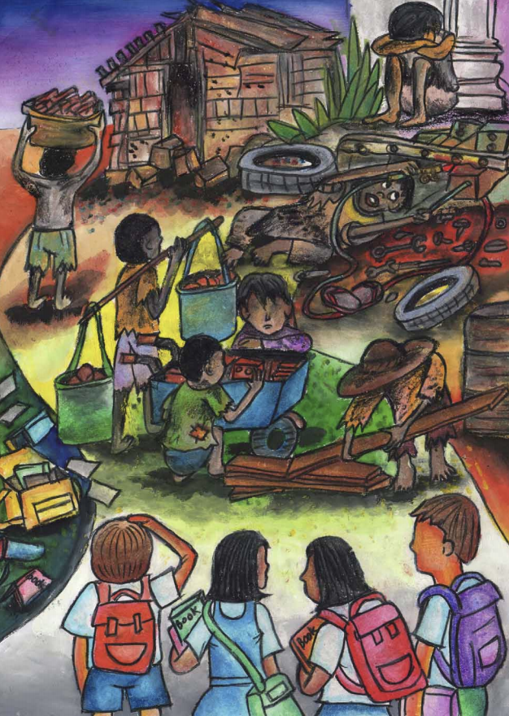
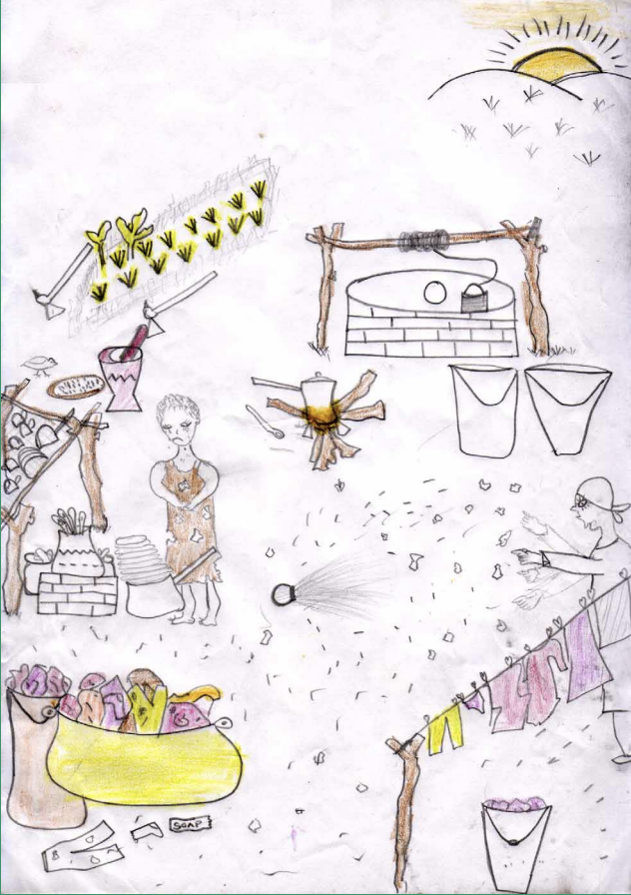
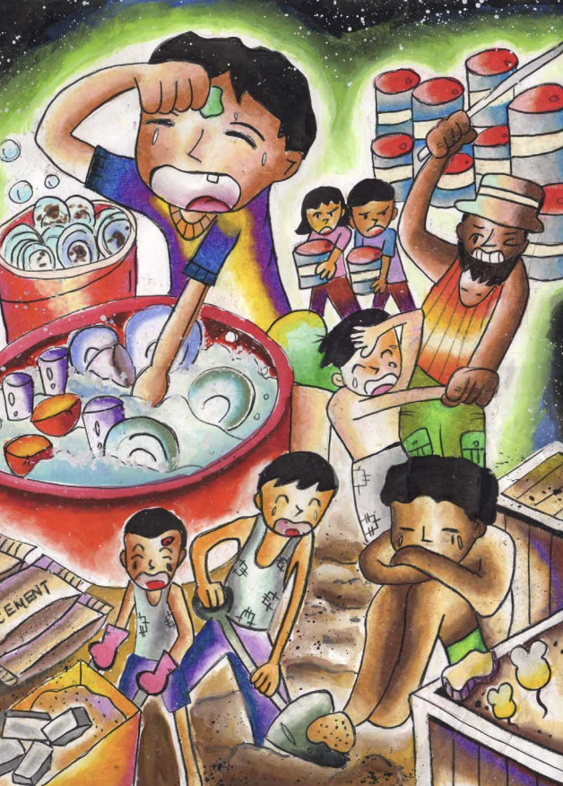
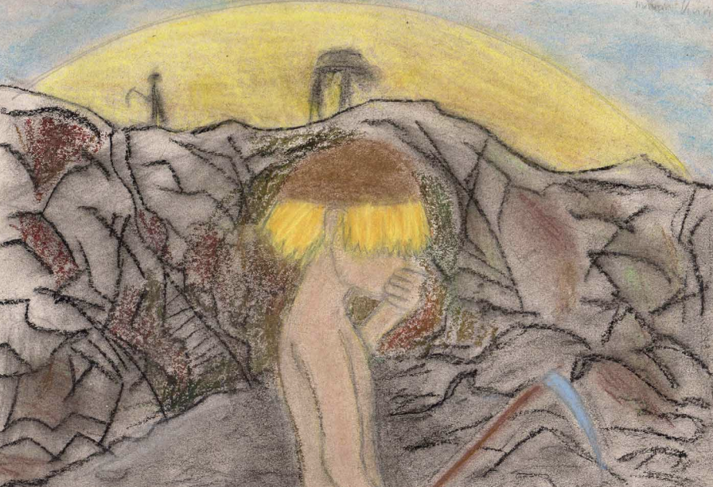
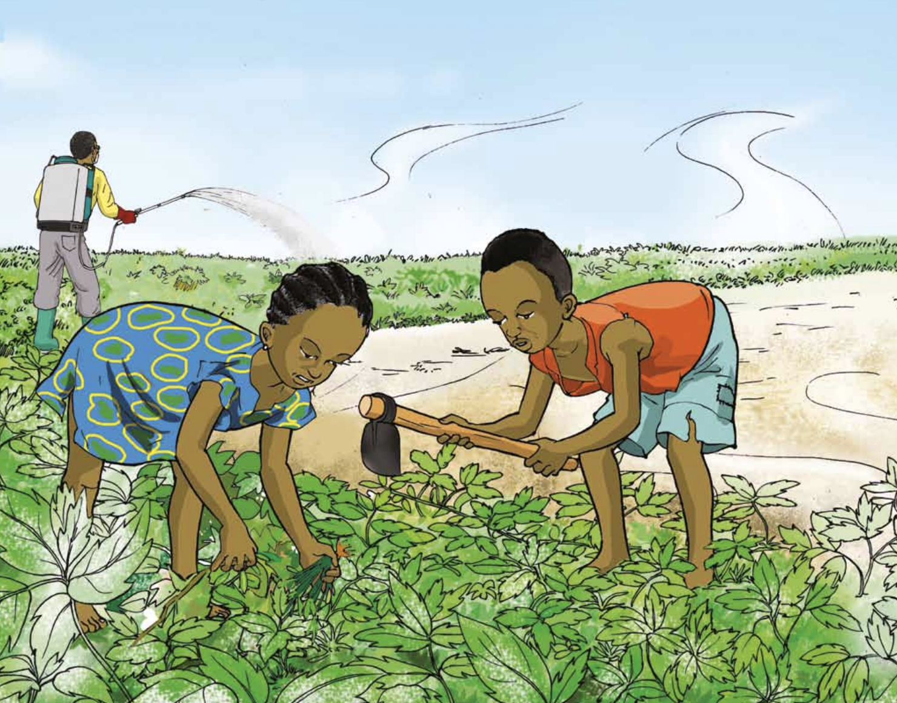
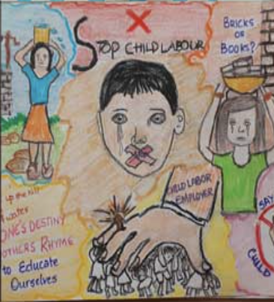
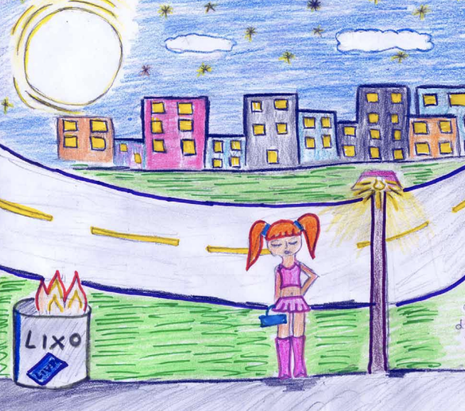
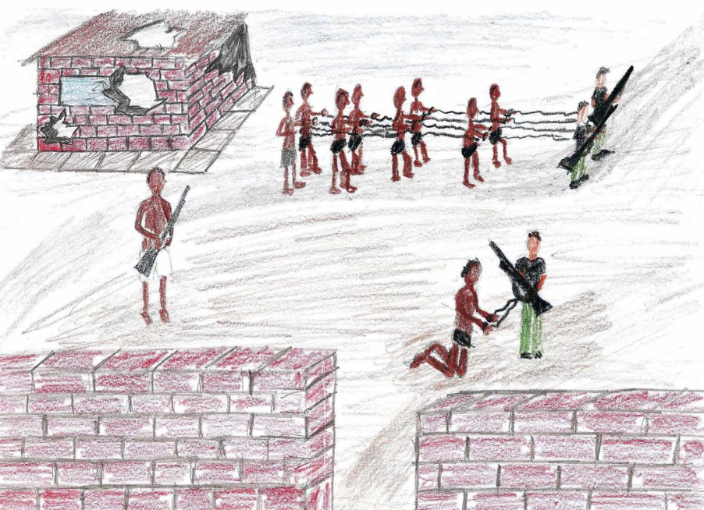
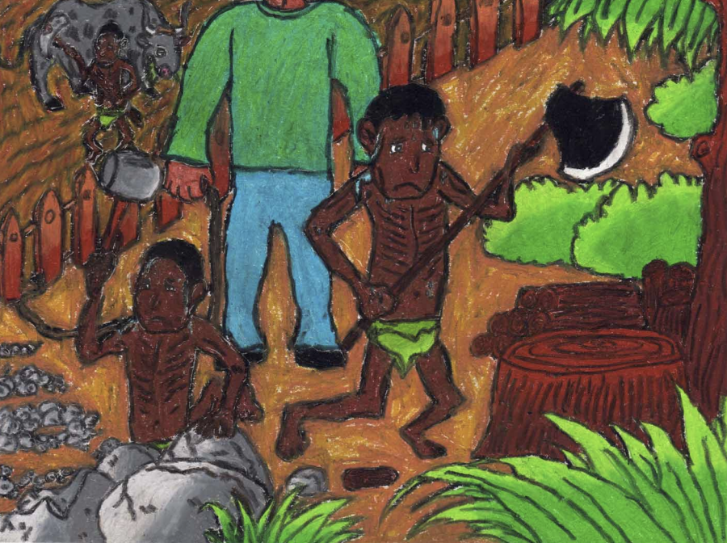
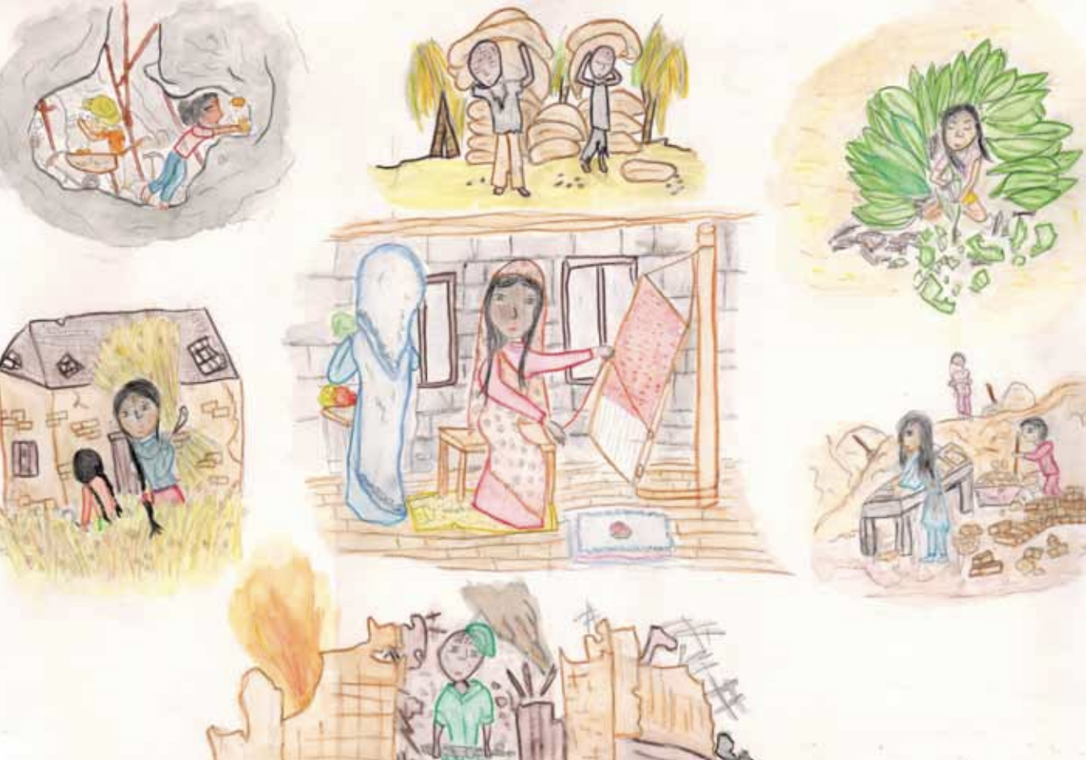
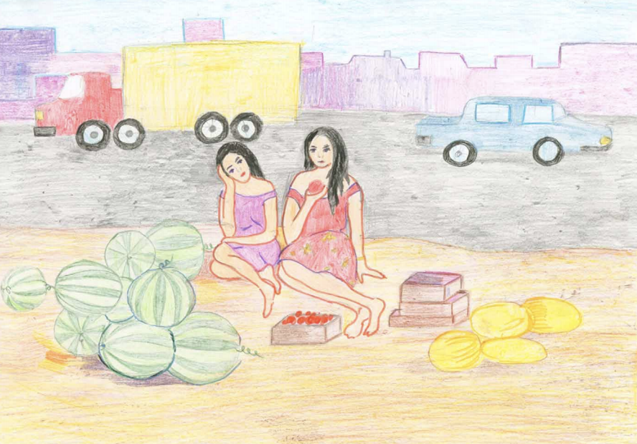
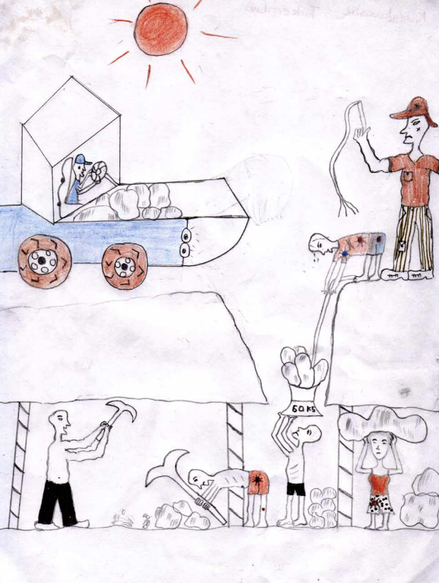
SPOT THE
Notes:
https://www.ilo.org/ipec/Campaignandadvocacy/Scream/resources/WCMS_113847/lang--en/index.htm
https://www.smilefoundationindia.org/anti-child-labor-campaign-held-for-school-children-during-quarantine.html
http://www.fao.org/3/i3527e/i3527e.pdf

Slide 22
WHAT DID YOU OBSERVE?
Sharp tools
Carrying heavy loads
Wearing no or unsuitable clothing/footwear
Physical abuse/punishment
Distress/psychological abuse
Lack of voice, control, freedom
Working at night
Working in industry
Fumes
Pesticides and chemicals
Traffic
Machinery
Dust
Heat (sun/fire/ovens/kilns)
Sexual exploitation/abuse
Animals/insects/rodents
Weapons and conflict
Working underground

Slide 23
OBSERVATION SKILLS
Key skill to obtain visual information about activities and conditions
Less intrusive and threatening
Help assess situation, give context and verification
Observing, interpreting, taking mental notes and later written notes on the appearance of:
  The child's tasks and activities
  Treatment of the child and other working children in the location
  Of the condition of the child (health, welfare, etc.)
  Notable gender differences
  The environment and facilities
  Potential hazards
Notes:
OBSERVATION
Observation is less intrusive and threatening in many instances. It can often be used in the first moments of meeting a child in child labour to assess their situation. Observing children in their workplace or home can also both give context to and verify information provided in other settings such as interviews by children, caregivers, employers or community members.
Observation can also give context to home and work, and verify information provided in other settings such as interview by children, caregivers, employers, or community members.
Observations should focus on
Activities and tasks performed by a child and where they work (their workplace or home) and their means and conditions of communication between them and others around them.
Appearance, types of tasks/activities, and treatment of other working children in the same location, any notable gender differences.
Appearance and condition of the child (physical, welfare and emotional e.g. bent back, weak, damage to hands, war-related injuries, hearing problems).
Treatment of child by employers or parents – tangible (violence, harassment, breaks etc.) and intangible (freedom of movement, locked doors, slavery etc.)
Home or worksite environment and facilities (hygiene, drinking water and sanitation, health and safety, lighting, ventilation, toxic substances, open or closed/hidden space).
Potential hazards in the setting (physical and psychological) and their likely effect on the child.

Slide 24
ACTIVITY: ASSESSING CHILD LABOUR
USING THE PHOTO YOU HAVE BEEN GIVEN
Assess a different aspect of that child’s life:
  The boy fishing – assess the psychosocial impact of their work.
  The girl in domestic labour – assess the physical impact of their work.
  The girl child with a disability who is begging – assess the impact of disability on their life.
This is a visual representation; make presumptions to conduct the activity.
What are the consequences of their work that case management might identify? What are the hazards and protective factors of their work?

Slide 25
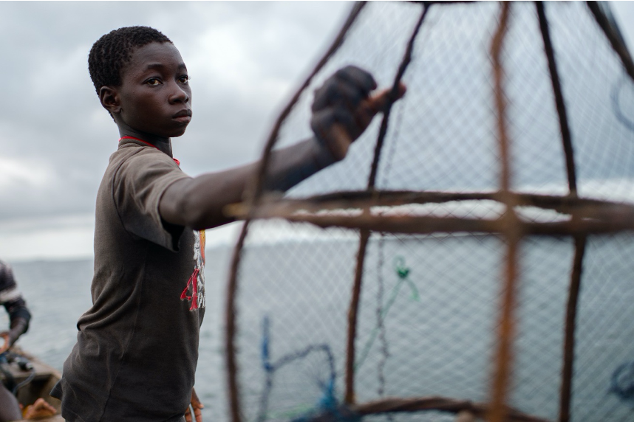
ASSESSING PSYCHOSOCIAL FACTORS
WHAT MIGHT THEY BE FOR THIS CHILD?
Interrupted and reduced sleep: fatigue and exhaustion
Long working hours and physical effort and strain
Working at night with unpredictable, inflexible, or unsociable schedules
Unpredictable treatment: multiple tasks within the workplace, a responsibility for younger workers, career stagnation, cycles of uncertain and poorly paid income
Inadequate safety precautions, extreme weather conditions,
dangerous tools: Stress and fear
Positive attachment with other children or family at work can have a positive effect
Notes:
Need to animate
Photo https://blogs.unicef.org/evidence-for-action/digging-deeper-with-data-child-labour-and-learning/

Slide 26
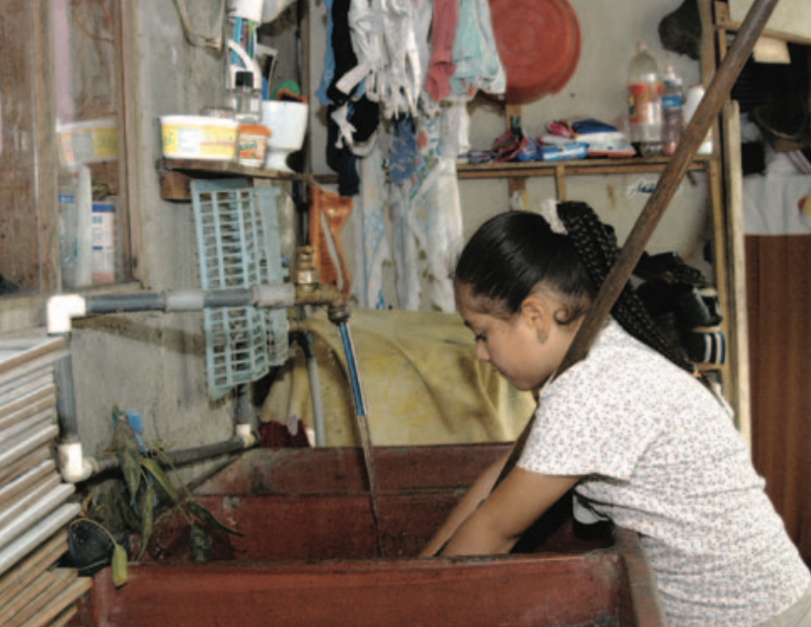
ASSESSING PHYSICAL FACTORS
Hauling water, firewood, fuel
WHAT MIGHT THEY BE FOR THIS CHILD?
Using, maintaining, and repairing equipment, tools, or dwellings: sharp/power tools, working at elevation or with electricity
Violence, harassment, abuse (physical and sexual): STIs, unwanted pregnancy, HIV, reproductive ill-health, psychological harm, sleeping on the floor, restricted movement
Preparing food: sharp utensils, animal products, fuels, fires, stoves, poor ventilation, smoke
Giving personal assistance and care for adults, children, or animals: injuries and bacterial, viral, parasitic illnesses
Cleaning homes or clothes: Bent over/joint movements for long periods, using excessive force, harmful cleaning detergents, chemicals or equipment, carrying heavy loads
Long hours: exhaustion, on call, 7 days a week, inadequate rest and sleep, fatigue
Notes:
Photo ILO Hazardous child domestic work: A briefing sheet 2007
Need to animate

Slide 27
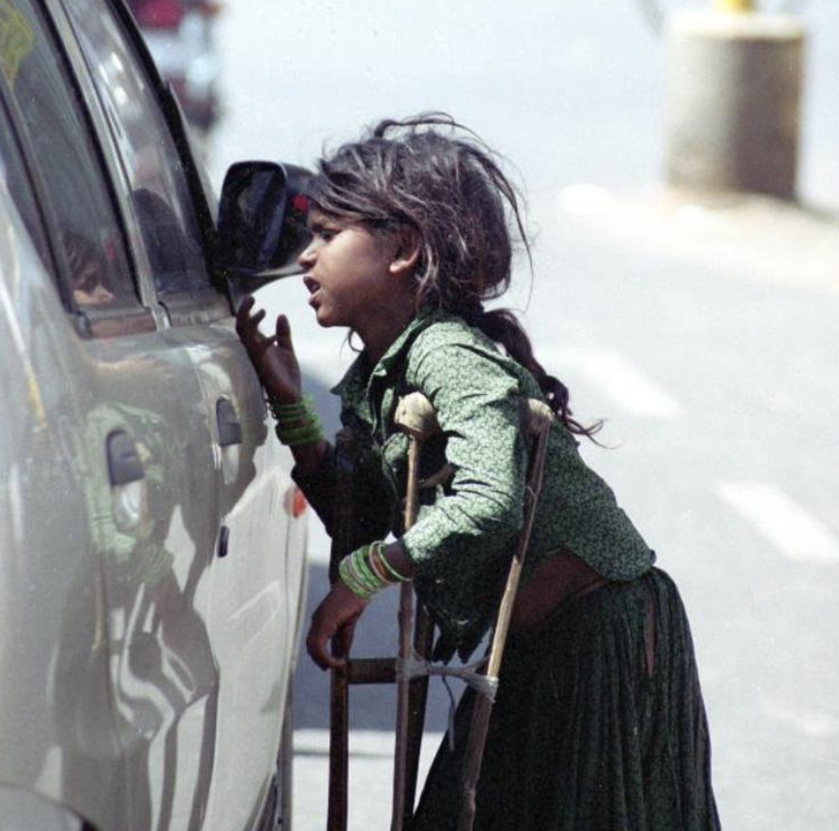
ASSESSING DISABILITY FACTORS
WHAT MIGHT THEY BE FOR THIS CHILD?
Child labour as a cause of disability: Injuries at work that lead to permanent disability; unhealthy working conditions that result in ill-health, which causes disability
Disability as a risk factor for child labour: Links to poverty, access to education, low skill levels, additional costs associated with disability and health care, poverty as it leads to disability, activity versus inactivity
Parental disability and ill-health: Additional burden of care looking after family members with disability, the household, or roles in income generation; levels of economic exclusion and social protection; additional costs associated with disability, care, and health care
Notes:
Need to animate
Photo https://www.vagabomb.com/India-Largest-Number-of-Slaves-in-the-World/

Slide 28
CASE PLANNING AND IMPLEMENTATION

Slide 29

CASE PLANNING
Based on comprehensive assessment
Identifies:
  Immediate, short, medium, and long-term needs, goals, and actions
  Who is responsible
  By when they should be accomplished
  Frequency and dates for review and follow-up
Involves the child and family
Different strategies, depending on level of risk faced by the child
Frameworks should be set locally through coordination
Notes:
Based on comprehensive assessment, a case plan identifies what should happen to meet a child’s immediate, short-, medium- and long-term needs (goals and actions); who is responsible for the actions; by when they should be accomplished; and the frequency/dates of follow-up visits and reviews. Case planning should be based on the assessment, should use different strategies, depending on level of risk faced by the child. A framework for expected time scales and response actions should always be determined locally in coordination with other child protection case management agencies to ensure a harmonised approach between actors.

Slide 30
GOOD PRACTICE
CASE PLANNING: KEY ACTIONS
Focus on needs rather than available services
Include safety planning and harm reduction
Be realistic, understand constraints, aim for incremental improvements
Work closely with parents and caregivers
Analyse causes and plan a response to these
Individual plans for all children
Joint planning between sectors
Balance “needs” versus “wishes”
Notes:
When a case plan is developed for a working child, it should focus on needs rather than available services. When there is a lack of appropriate services or alternative options, think about what is in the child’s best interest. Address the most critical needs first which have the most negative impact on a child. Look at service provision but also the role of the case worker and the family in mediation, local-level advocacy and support to help secure better safety and welfare for a working child.
Safety planning and harm reduction strategies is one way we can address safety without requiring extensive referrals to other services. Safety planning helps reduce the levels of risk that children face at home and work, particularly where they cannot/will not be removed quickly.
Remember to be realistic and understand local and individual constraints. While every effort should be made to ensure that children get back into full-time education and families have sustainable and adequate income to stop children working, this might not always be possible, and for children over the age of 15 this might not be desired.
Case plans should aim for manageable and incremental improvements in a child’s life, and these may begin small – for example, by ensuring children who are working have access to a support service for an hour or two a week or providing safety equipment, before advancing into more complex issues. It’s clear we need to work closely with parents and children together from the beginning, particularly for children aged over 10 who are starting early adolescence. Involve employers where it is not possible to remove children from work. For young children under 10 years, work closely with caregivers first, and then work with the children.
It’s important we analyse the causes of child labour (in the household for instance behavioural and cultural factors versus economic factors and develop appropriate plans which respond to them or respond to a combination of both.
Where multiple children are in a household, or multiple children are working, individual plans for each child should be developed involving key figures in each child’s life to ensure that siblings are equally protected and prevented from being drawn into child labour as an unintended consequence of one child being withdrawn from work. Some of the more common examples of this can be seen for instance when we provide ECD, to free up an older child’s role in caring for younger siblings, this may then put them at risk of other forms of child labour or early marriage, or another example is by securing a place in school for a primary school age child who was previously working, we must be careful this doesn’t push any older adolescent siblings into more hazardous work as the household seeks to make up for the lost income.
Case plans must be developed individually but while considering the holistic needs and wellbeing of the entire family if their implementation is to be successful at withdrawing children from harmful work. And whilst as child protection workers, we may want to prioritise their “need” so to get them back into education, or reduce the risks of improve self-care and protection, we also need to recognise and balance children and adolescents wishes including the services and activities which they “want” for instance the vocational skills, income-generating activities, sports, recreation they find interesting and engaging.

Slide 31
CASE PLANNING: TIME FRAME
HIGH RISK: Within 3 days comprehensive assessment. Immediate safety and well-being, develop trust, reduce exposure to life-threatening hazards, safety planning, meeting basic needs while creating longer-term objectives to focus on integration, learning, and economic assistance.
MEDIUM RISK: Within 1-week comprehensive assessment. Prevent further deterioration and child labour becoming WFCL, strengthen well-being, reduce risks and harm, and increase access to services.
LOW RISK: Within 2 weeks comprehensive assessment. Provide information and awareness about child labour and access to services such as school, food and income support, health, cash, learning, and PSS opportunities.

Slide 32
DISCUSSION
What are the timelines that are being used locally?
Are case workers able to work within these timelines?
To what extent are the child and/or caregivers involved in the planning?
What are the minimum services that should be provided for children in high-risk child labour/WFCL?

Slide 33
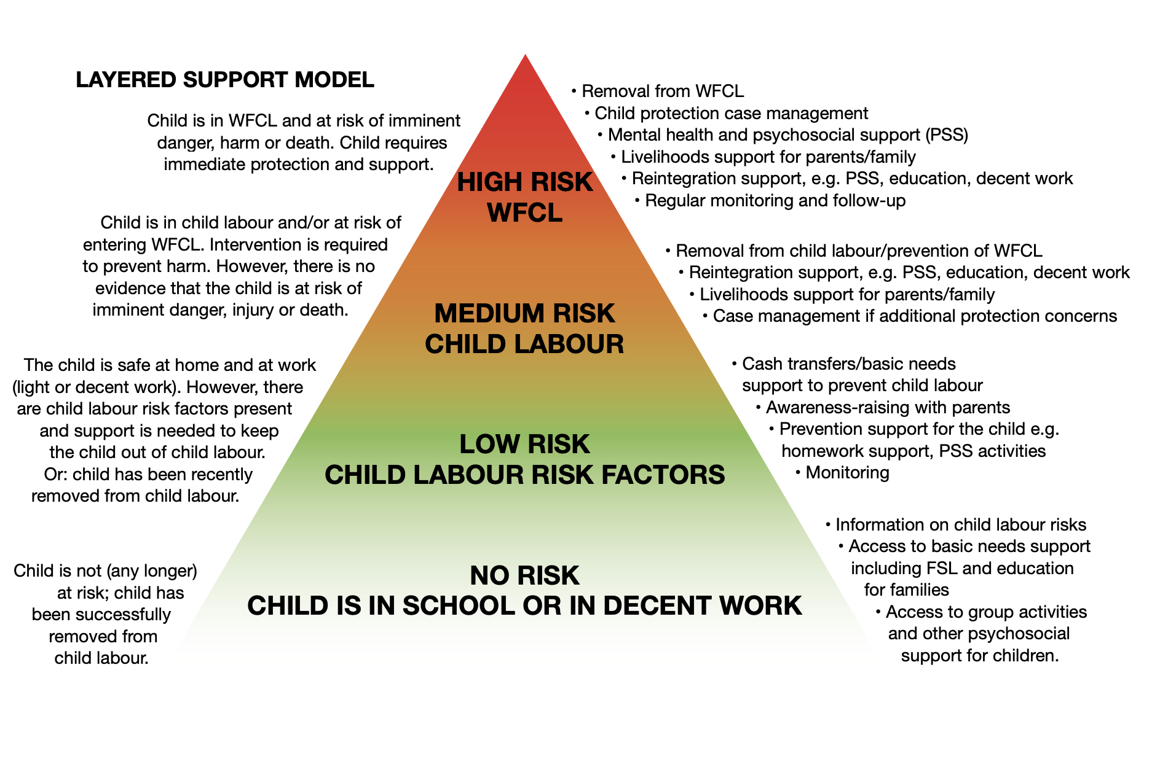

Slide 34
GOOD PRACTICE
CASE PLANNING: HIGH RISK CASES
Take immediate action – report to supervisor
Prioritise basic needs and safety planning
Under 14 years: aim for immediate removal
Tailor specialist and general services and care to individual needs and support access
Focus on most serious protection needs, risks, and hazards
Seek to transfer to safer tasks/conditions where cannot be removed
Follow SOPs and seek support for removal
Notes:
Case workers should take immediate and rapid action, assessments and planning should be complete within a week, and you should report and work on the case with your supervisor. While basic needs and safety planning to reduce immediate harms and provide children with basic skills to protect themselves, should be a priority, if a child is under the age of 14/15 years, aim for immediate removal. Seek advice from the ILO, industry experts, unions, confederations, or other NGO partners on making work safer for appropriately aged children. All children in high-risk child labour will require tailored plans with both specialist and general services and care, and where needed additional supports to facilitate access to referral services. Where children have multiple protection needs or where they are exposed to multiple hazards, plans should focus on the most serious or life-threatening hazards and protection risks, until a long-term plan including case management, integration into learning and economic assistance/livelihoods can be put in place. Where children can’t or won’t be removed, seek to transfer the children to a safer task within the workplace or reduce the number of hours they work. Where this is not possible, seek temporary leave from work or for the work to terminate voluntarily with the support of the family. And where children are situations from which they must be removed, always follow SOPs set out at a coordinated level and seek legal counsel or assistance from law enforcement and/or other legal professionals to support removal.

Slide 35
IMPLEMENTING THE CASE PLAN AND REFERRAL
WITH THE CHILD, FAMILY, AND OTHER ACTORS THROUGH:
Direct support and services from the case worker
Referrals to other services or assistance within the organisation responsible for case management
referrals to other agencies or service providers
referrals within established child labour monitoring and referral systems
Notes:
During implementation case workers work with the child, family and other actors to achieve the desired improvements, this might be through direct support and services from the case worker such as providing information, counselling, emotional support, mediation, safe work kits, other NFI kits, or emergency cash), referrals to other services or assistance within the organisation responsible for case management such as group activities for children, vocational training, food assistance; referrals to other agencies or service providers such as livelihood programmes for parents/caregivers, health or WASH; or referrals within established child labour monitoring and referral systems if these are available.

Slide 36
DISCUSSION
What are your experiences of implementing case plans for children in child labour?
What are key challenges you face?
How have you overcome these challenges?
Were you successful in overcoming the challenges? What worked and what didn’t?

Slide 37
IMPLEMENTING THE CASE PLAN AND REFERRAL
KEY ACTIONS:
Monitor impact of interventions on other children in the household
Address other protection risks
Provide families additional support while plan is being implemented
Know the law
Provide additional and necessary support during referrals
Support children and their caregivers to implement harm reduction strategies
Adhere to strict confidentiality and information-sharing procedures
Access emergency case funds
Support children’s reintegration
Provide follow-up at work, in the community, and with family
Notes:
Key actions can include:
monitoring the impact of interventions on other children in the household, including their workload, work type and school/ECD attendance.
Addressing other protection risks that the child may experience in the home and community such as violence, separation from caregivers alongside child labour, as addressing protection concerns comprehensively will lead to better outcomes.
Provide additional support to families during implementation for instance, childcare or ECD to allow parents to attend activities or training, or legal support.
Knowing relevant legislation and policy as it relates to child labour and its worst forms helps case workers to be able to reinforce the capacity of others and raise concerns and complaints to duty bearers.
Accompanying children where needed, and making sure that children have the necessary support, translation and documentation, can help make referrals more successful, and where urgent removals from work may not be possible, or in children’s best interests, case workers should support children and their caregivers to develop and implement harm reduction strategies and safety plans that can provide some immediate protection for children.
As in all case work, adhering to strict confidentiality is essential to do no harm, while access to emergency case funds can help to pay for things like emergency healthcare, transport or other incidentals to support harm reduction strategies, while accessing safe work kits, NFI kits and similar, can help the economically vulnerable in the short term.
Support children’s reintegration into the community, including social, educational and economic support and provide follow-up visits and support in the community and family.

Slide 38
FOLLOW-UP AND REVIEW

Slide 39
DISCUSSION
Brainstorm what you think should be observed during follow-ups to identify the changes, improvements, or continuing risks in a child’s environment at home, work, and the community.
How often do you conduct follow-ups for children in child labour?
Do you provide follow-ups at different frequencies for children who face different risks?

Slide 40
FOLLOW UP & REVIEW
To determine how the case plan is being implemented
Whether objectives are being met and continues to meet the child’s needs
What adjustments are needed
Decide if a child’s circumstances have changed, activities are completed, challenges are encountered, and a review is needed

Slide 41
FOLLOW UP: FREQUENCY
HIGH RISK: Frequent. Twice weekly in initial phase, weekly once exposure to severe harm is reduced and the case plan is implemented consistently. Use weekly visits and other means when this is not possible.
MEDIUM RISK: Follow-up required. Weekly in initial phase and every two weeks once plan is implemented consistently and child has reintegrated back in school.
Where this is not possible, conduct visits in person every two weeks, and monitor by other means such as phone calls or monitoring uptake of services such as attendance at school.
LOW RISK: A recommended child should receive follow-up every two weeks, and then it can be lowered to once a month in order to focus on monitoring a child’s well-being, ensuring continued education, and removal from child labour.

Slide 42
FOLLOW UP & REVIEW: KEY ACTIONS
PROCESS
Family/home visits; formal or informal school visits and contact; visits to child’s workplace; engagement with service providers; in the community where working children frequent; community centres/safe spaces; community-based follow-up
Observation and interviews with: child, parents, employers, school management and teachers, key people in the community, or law enforcement
Ad hoc; regular and planned; at services
Planned with a purpose
Safety of child, family, and case worker
Notes:
Including in homes, workplaces, the wider communities or through service provision. However, we conduct our follow up it should always be planned, visits to provide services or conduct ad hoc monitoring can be a good opportunity to observe a child’s environment and behaviour to verify progress, but visits must have a purpose, and consider any potential repercussions or safety issues for the case worker or child whether that be at home or work, including their exposure to further harm because of the interaction with a case worker. Case workers should always consider their personal safety when conducting follow-up visits, particularly in children’s workplaces or homes that are complicit in exploitation.

Slide 43
FOLLOW UP & REVIEW: KEY ACTIONS
OBSERVE ENVIRONMENT AND BEHAVIOUR. VERIFY PROGRESS.
Is the child receiving medical support, is the treatment plan followed?
Are injuries and poor health prevented at home and at workplace?
Is the child registered for school, attending, improving?
Has mediation with employers improved working conditions/treatment?
Is safety equipment being used?
Has a parent’s behaviour/attitude to work changed?
Are parents engaging in livelihoods? Is additional support needed?
Are adolescents attending and progressing in TVET, job placement, etc.
Notes:
Make sure that the child (and family) are receiving the planned services, that their exposure to harm and hazards has been reduced, and that the circumstances of the working child are stable and improving. Examples of how this can be done include checking whether the child has received medical support, and that any treatment plan is being followed, that injuries and poor health are being prevented at home and in the workplace or that the child has registered for school, continues to attend and their progress improves, or that their attendance and progress in vocational training, job placement, or coaching. In the workplace checks can include how mediation with employers has changed their conduct towards the child or whether working conditions have improved, whether safety equipment is being used, and at home checks can include how a parent’s behaviour and attitude has changed towards their child work, or how parents are engaging in livelihoods interventions or training, what kind of additional support or guidance they need.

Slide 44
DISCUSSION
In your group:
Use the workplace checklist.
Reflect on the checklist and whether you feel the follow-up you conduct includes any of the things mentioned in the checklist.
How could such a tool could be integrated or used in their context?

Slide 45
ACTIVITY
Individually:
On 3 separate sticky notes, write 3 challenges you face during implementation and follow-up in case management for children in child labour.
Report back to your group.
As a group:
Pick 2 or 3 of the priority challenges from the flipchart.
For each challenge, discuss solutions you could implement to overcome the challenge, identifying what works or doesn’t in the context.
Report back in plenary.

Slide 46
PROBLEM SOLVING
Solution-based thinking
Involve case supervisors, arrange case reviews or case conferencing
Adhere to global standards, follow locally agreed procedures for case conferencing
Use negotiation and advocacy to act on behalf of children and families to seek positive change, resources, and services
Play an influential role in promoting dialogue about child labour
Be prepared to provide significant levels of support
Notes:
Problem solving in case management should involve case supervisors, conduct reviews and use case conferencing, negotiation and advocacy skills to act on behalf of a child or family and to help them seek positive changes at home and work, access resources and services, and playing play an influential role in promoting dialogue about child labour at the local level, building relationships over time and providing practical support to accompany advocacy and dialogue.

Slide 47
DISCUSSION: CASE CLOSURE
In what situations does the case management system in the context allow for case closure?
At what point is the case of a child who has been removed from the WFCL considered closed?

Slide 48
CASE CLOSURE
KEY ACTIONS
Open/closed versus active/passive
Follow locally-agreed criteria
Review completion/participation in activities and services until decision that case management is no longer necessary/worthwhile
Close case:
  For adolescents if enough improvement in safety and welfare
  For transitions, including with continued support
  If positive outcomes are not achieved (more specialised support is needed, a child is over minimum working age and all options have been tried/explored, an adolescent 15-18 years refuses further support)
  The case plan is successful and no further support is needed
Notes:
In some contexts some case management agencies change cases from ‘active’ to ‘passive’ rather than closing a case, so that some form of follow-up and monitoring may continue over a longer period of time. Explain that case workers should follow locally agreed criteria for case closure of child labour cases, which have been set in line with global minimum standards and case management guidelines. Case managers/supervisors should review and record the completion/participation of activities and services in the case plan until they decide (in conjunction with case workers or other authorities) that case management is no longer necessary or worthwhile. Case managers/supervisors may consider closing cases for adolescents if they feel there has been enough improvement in other aspects of the case plan such as physical safety and removal from hazards or welfare even if the child continues to work, or where the case plan has been successful, and support is no longer needed for a child. Transitions also need to be thought through where children will need some form of continued support, but maybe this won’t come from the organisations, ether because of age or because of organisational role or funding changing.
If positive outcomes in a case have not been achieved try to transfer the case to a more specialised service provision where possible, or in some circumstances case supervisors may consider closing a case when a child is over the minimum working age (15 years old); all options to reduce harm have been explored or tried, including taking legal or judicial action against parents and employers, or placing the child in alternative care to prevent them from being exploited; a child between 15 and 18 years refuses further social assistance or case management support; the case plan has been successful, and support is no longer needed; the best interest of a child has been fully considered and as much support put in place as feasibly possible.

Slide 49
ACTIVITY: CASE PLANNING AND HARM REDUCTION
USE THE CASE STUDY YOU HAVE BEEN GIVEN
DEVELOP A CASE PLAN, A SAFETY PLAN, AND HARM REDUCTION STRATEGIES
PART 1: DISCUSS AND IDENTIFY
PART 2: DISCUSS AND IDENTIFY
Risks/needs for which a positive outcome is needed?
What needs to happen? (the action)
What is the protection result?
Who is responsible?
Timeframe for which this action should be undertaken
What referrals are needed?
  The main hazards, risks, protective factors
  What information is missing/would you require from the case study?
  How would get that information?
  Would it change if the child was younger/older, a girl/boy, different ethnicity, refugee status, etc.?

