Slide 1

TRAINING PACKAGE
INTERAGENCY TOOLKIT: PREVENTING AND RESPONDING TO CHILD LABOUR IN HUMANITARIAN ACTION

Slide 2
SESSION 12: CHILD PROTECTION: CASE MANAGEMENT 1

Slide 3
LEARNING OUTCOMES
By the end of the session you will be able to:
Identify 4-5 key considerations when developing case management programmes for working children
Describe the principles behind a vulnerability criteria/risk matrix for children in child labour
Explain the differences between case management support that would be given to children in child labour in different vulnerability/risk levels

Slide 4

DISCUSSION
IN YOUR GROUP, ANSWER THESE QUESTIONS:
Why is case management important for children in child labour and the WFCL?
How do children in child labour currently access case management services in this context?
NOW REVIEW THE WORK SHEET

Slide 5
KEY PROGRAMMING CONSIDERATIONS

Slide 6
OVERARCHING
PRINCIPLES
Adequate capacity:
  Technical expertise
  Dedicated case workers
  Adequate funding for quality services
  To provide direct services or network referrals
Practical guidance and tools
Safety for case workers
Monitoring and analysis, information management systems
Notes:
Overarching principles include
having adequate capacity to do this in line with minimum standards on child protection including:
technical expertise in child protection and case management should be provided by qualified case workers, who work under adequate supervision;
dedicated case workers who are responsible for assessment, case planning and implementation including home visits, for providing one-to-one services, facilitating referrals and providing follow-up;
access to adequate funding for quality services to children, for a minimum of six months but ideally for longer, so that children can be supported until their holistic needs are met;
and capacity to either provide direct services or make referrals to tailored, holistic support to children and their caregivers including basic needs, food security and livelihoods, education, health and other essential services.
Case workers and supervisors should be supported by practical guidance to help assess working children, evaluate their working and living environment of children, and identify hazardous types and conditions of children’s work, as well as warning signs of other WFCL. This includes having forms where child labour types and conditions are integrated into case management forms and child protection/GBV information systems that support case management services.
Organisations providing case management for children in child labour must identify and mitigate safety risks for case workers as they will be engaging and negotiating with employers, including parents/family members, peers or criminal networks whom children work for. While all child labour in one sense can be considered illegal there are forms which are often shrouded in secrecy and highly hidden, particularly those in the WFCL and illicit industries. Case workers need to be equipped to conduct case work safely.
And of course, any organisation providing case management should support monitoring and analysis of their cases and the wider child labour trends in the context through adequate information management systems which induce child labour indicators.

Slide 7
WORKING WITH OTHERS
COORDINATION AND MULTI-SECTORAL COLLABORATION WORKING FOR CASE MANAGEMENT
Coordinate case management through child protection
Identify/map functionality of existing case management systems for child labour
Identify key service providers across sectors
Harmonise procedures (risk matrix, standard service packages, SOPs for the removal of children from WFCL, children who go missing from services, etc.)
Notes:
Case management should be coordinated through the local or national humanitarian inter-agency child protection and/ or case management coordination structures, which include relevant government actors, child protection organisations and other service providers.
It should identify and map out the functionality, capacity, eligibility criteria and coverage of existing child labour case management systems such as Child Labour Monitoring (CLM) systems, GBV case management services, case management systems for specific WFCL such as those under Security Council Resolution 1612, CAAFAG, or case management services set up in refugee settings, including the Best Interest Procedure led by UNHCR and partners.
As well as identifying key service providers across sectors that should be included in the response for children in child labour.
Through coordination partners should work to harmonise case management procedures, set a risk matrix and minimum standards for services packages at inter-agency level to ensure that children in child labour and the WFCL receive the same level of quality and similar types of services regardless of the case management systems they receive support from. Where children require removal or rescue from the WFCL for instance, children in illicit activities, commercial sexual exploitation or slavery, it should only be done with the legitimate, nationally mandated agency or agencies, that are authorised to carry out the removal, demobilisation and/or rescue of children. Clear SOPs should be developed to support case management. SOPs should also be developed for children who go missing or who have move away for work or who are trafficked, establishing procedures for tracing and follow-up of disappeared or trafficked children with relevant partners and analysing the causes of disappearance or movement of children in order to address the risk factors for migration and child trafficking.

Slide 8
WORKING WITH OTHERS
PLANNING FOR SUCESSFUL REFERRALS FOR CHILD LABOUR
  Include emergency funds in case of management budgets
  Plan for additional support, and accompany children and caregivers to referral services
  Support referral partners to build capacity and delivery of services for children who are (formerly) in child labour
Notes:
Measures to help the success of referrals include:
Emergency funds in case management budgets, so case workers can use case funds to support the implementation of case plans, and to cover various costs: for example, emergency medical referrals, equipment to support harm reduction strategies, or fees for specialised services or other individual support needs;
Planning for time and facilitation to allow case workers to accompany children and caregivers to referral services such as transportation, translation, completing forms and navigating systems that they may not be familiar with;
supporting referral partners to build their capacity on delivering services for children who are (formerly) in child labour, capacity may be need to be strengthen in education service providers such as schools, learning centres and TVET centres; health services including MHPSS providers; or legal services providers. Training support, such as on caring for child survivors, and operational support, such as equipping services with child- and adolescent-friendly materials can help.

Slide 9
VULNERABILITY CRITERIA, RISK MATRIX, AND DIFFERENTIATED RESPONSES FOR CHILDREN IN OR AT RISK OF CHILD LABOUR

Slide 10
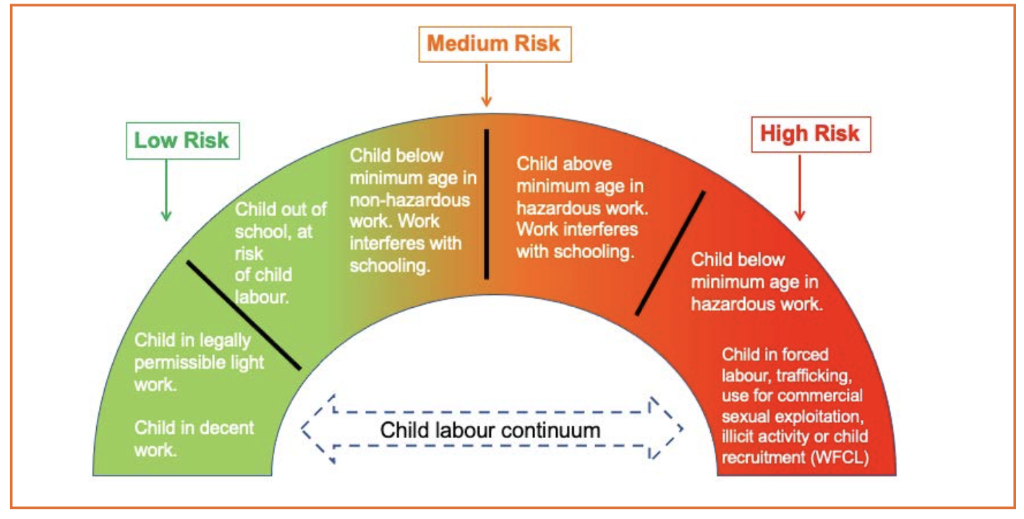
ESTABLISH VULNERABILITY CRITERIA AND RISK MATRIX FOR CHILD LABOUR
INFLUENCED BY RELATED RISK AND PROTECTION FACTORS
Notes:
Explain that in countries where child labour rates are high or increasing because of humanitarian crisis, particularly alongside significant levels of other child protection concerns, high caseloads can exceed existing case management capacity. Where this is the case, individual organisations and coordination groups will need to agree how to prioritise cases, in order to manage their caseload to determine jointly which cases are considered to be low-, medium- or high-risk cases, what follow-up actions are required at each of these risk levels and provide urgent support to children who are in life-threatening situations. As children’s vulnerability is influenced by a variety of risk and protective factors which can change depending on the circumstances it can be helpful to think of child labour as a continuum where children can move back and forward depending on the risk and protective factors in place. For instance, a child who was in school before the crisis (low risk) may be forced to drop out of school and enter child labour (medium risk) during the crisis as a result of a loss of livelihoods in their family; or a child who was in child labour prior to the crisis (medium risk) may become separated from their family during the crisis and be highly vulnerable to trafficking, which is one of the worst forms of child labour (high risk). Equally by supporting an adolescent working in hazardous child labour, with a package of case management including, harm reduction strategies, access to TVET, preparation for decent work, and caregiver income support a child can move from high risk to medium risk.

Slide 11
DEVELOPING VULNERABILITY CRITERIA AND RISK MATRIX
HELPS TO:
Prioritise and manage high caseloads and provide urgent support to high-risk cases
Assess and analyse the situation of individual children
Determine their risk level and take the required actions to respond to their needs
Set criteria in relation to capacity
Clarify which children can be supported through case management or other interventions
Engage children, caregivers, community in validating vulnerability criteria
Notes:
Case management vulnerability criteria for child labour, as well as a risk matrix which is based on the continuum can help:
Define the different types of child labour and conditions associated with different risk levels and their corresponding case management actions.
They can help case workers assess, analyse and determine the risk level of an individual children and take the required actions to respond to their needs;
help set context-specific vulnerability criteria in line with the capacity of case management services;
Ensure clarity over which children can be supported through case management and which children should be supported through other interventions,
and engage children, caregivers and the community in validating vulnerability criteria.

Slide 12
DEVELOP A HOLISTIC PACKAGE OF RESPONSE FOR CHILDREN IN CHILD LABOUR
Age and gender-specific that meets safety, care, physical and mental well-being, pathways to learning, financial sufficiency, social reintegration needs
Delivered through, but not limited to:
  Social/peer activities, mentoring, life skills
  Healthcare, aids for impairments, SRH, MHPSS
  Education pathways
  Parenting support, including for adolescent caregivers
  Addressing stigma, discrimination, marginalisation
  Support the safety of children (safety plan/body safety)
Notes:
A holistic care package should be age and gender specific and respond to the risk factors and levels of harm associated with child work, child labour and (specific) worst forms of child labour. Key interventions include but are not limited to social activities, peer groups, mentoring and life skills programmes, healthcare, including aids for potential impairments, SRH services and Mental Health and Psychosocial Support (MHPSS), pathways from pre-school, to formal and non-formal education and ultimately decent work; parenting support including for adolescent mothers/fathers as well as their (foster) parents or caregivers; and actions to address stigma, discrimination and marginalisation of children formerly in child labour or WFCL.

Slide 13
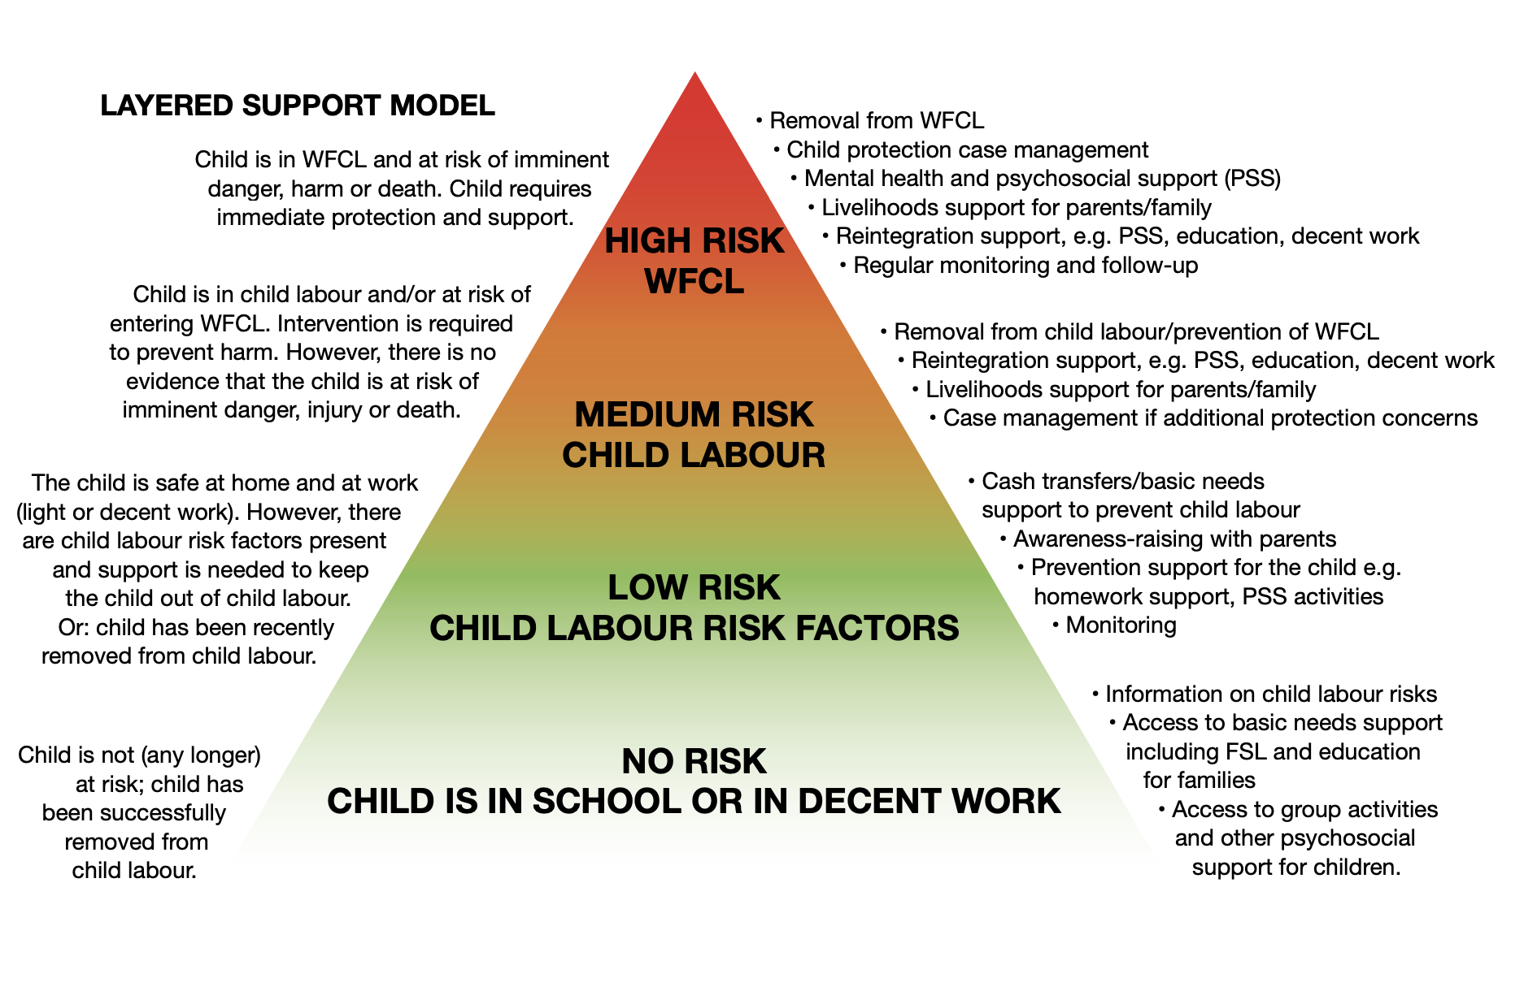
RESPONSE ACTIONS
LAYERED SUPPORT MODEL
KEY ACTIONS:
Clearly define differentiated programming
SOPs for high-risk cases that involve multiple protection risks, including the WFCL and SGBV
Promote case management as a priority for high-risk children
Promote a layered support model
Notes:
This illustration is one example of a layered support model but specific response actions should always be determined in the local context.
Layered support models can help clearly define differential programming responses for cases, outlining the key actions for high-, medium- and low-risk levels, develop standard operating procedures (SOPs) for high-risk cases that involve multiple protection risks including the WFCL and SGBV, and promote case management services as a priority for children who are identified to be at high risk.

Slide 14
TO SUPPORT DIFFERENTIATED PROGRAMMING
AGREE THROUGH INTER-AGENCY COORDINATION:
Timeframe and steps for case assessments and follow-up
Case management tools for identification, registration, and assessment inclusive of child labour risk and protective factors
Actions for timely response to high-risk cases
Notes:
Agree on the actions for timely and adequate response to low-, medium- and high-risk cases, to support differentiated case management programming for children in child labour. This includes:
The timeframe and steps for comprehensive assessments of identified children at different levels. Ensure that these are aligned with global minimum standards and agreed upon in the local context between case management partners.
The development/adaptation of case management tools or identification, registration and assessment tools which are inclusive of child labour risk and protective factors, ensuring that assessment forms capture information on access to formal or non-formal education or age-appropriate vocational training, and potential barriers to education;
Additional risk factors or protection concerns such as disability, ill health, family separation, children associated with armed forces and armed groups, and sexual abuse; a child's family environment and its relation their child’s work such as their living situation, with or without their parents/caregivers, where they are not living with their parents, what kind of contact they have with their parents.
The ability of families to meet basic needs, indicators of neglect, parental understanding and attitudes towards child labour, the role of parents/caregivers and family in creating/facilitating children’s work, family income and information about which family members are working, paid or unpaid, the role of children’s income in the household and what their income is used for.
Workplace conditions and hazards such as where and with whom the child works, the type of work and tasks they perform, their hours and schedule, the nature of work whether it is voluntary or forced, their level of freedom and choice, exposure to sexual or physical abuse or violence, physical hazards, their consequences, and remuneration.
Discrimination and marginalisation of the child and/or the family and how this influences child labour risks.

Slide 15
DEVELOPING RESPONSES FOR HIGH RISK CASES
AGREE THROUGH INTER-AGENCY COORDINATION:
Immediate actions: imminent risk of life-threatening danger, harm, or death of a child
Procedures for how cases are discussed and dealt with, including between case workers and supervisors
An SOP for situations that require removal or rescue of a child
An SOP for situations where removal or rescue of a child is required but is not possible or in their best interests
Procedures for refugee, IDP, or migrant outlined by relevant agencies, such as government services, UNHCR, or IOM
Notes:
Procedures should include how cases are discussed and dealt with between case workers and their managers or supervisors prior and during taking any actions towards the child and/or their family.
SOPs should be developed between child protection case management agencies, law enforcement actors and other relevant actors, such as social welfare and alternative care actors for situations that require the removal or rescue of a child – for example, intercepting of child trafficking, CAAFAG or commercial sexual exploitation. Remember that NGOs and UN agencies do not usually have the mandate to remove children from high-risk situations, although in some places they may be given the authority by either by the Ministries of Justice through a court order or Ministries of Social Affairs.
SOPs are also needed for children in situations where removal or rescue of a child is required but is not possible or in the best interest of the child. Including liaising with relevant actors including law enforcement actors to plan for actions to meet the needs of the child without placing them or staff members at risk. Where working children are refugees, internally displaced or migrants, case management procedures outlined by relevant agencies, such as government services, UNHCR or IOM should be followed.

Slide 16

ACTIVITY: USING VULNERABILITY CRITERIA AND RISK MATRIX
      Review the risk matrix and layered support model you have been given.
      Discuss the following questions:
    How do you think this case management tool is/could help in the context? How is it currently?
    What are/would be the main challenges in implementing this tool?
    Do you see gaps in this tool or things you would change?
      Now develop the changes/adaptations/contextualisation you would like to make to the tools, targeting the key areas you feel are most important in this context.

Slide 17
KEY MESSAGES
Case management for working children is a systematic and timely way to provide direct one-to-one support and referrals to services for children who are in CL/WFCL.
The types and levels of harm and danger to which children in child labour are exposed vary upon their workplaces, tasks, family and community environment, age, gender, and developmental stage.
Case management services for children in child labour should be tailored and provide a coordinated, multi-sectoral response that addresses their holistic needs.

