Slide 1

TRAINING PACKAGE
INTERAGENCY TOOLKIT: PREVENTING AND RESPONDING TO CHILD LABOUR IN HUMANITARIAN ACTION

Slide 2
SESSION 1
INTRODUCTIONS
An introduction of the course and participants
Guest speaker and introductions
Outline of training, agenda, and facilitation
Training expectations

Slide 3


Slide 4

GUEST SPEAKER
ADD: NAME, PHOTO, TITLE/POSITION OF GUEST SPEAKER TO SLIDE

Slide 5
FACILITATORS
ADD LOCAL FACILITATION TEAM – INCLUDE NAMES, POSITION, ORGANISATION (AND A PICTURE ON THE SLIDE IF FACILITATING ONLINE).
Notes:
Introduce the facilitators, and any specific role they have during the training.

Slide 6

ACTIVITY : INTRODUCTIONS AND EXPECTATIONS
Partner with someone you don’t know
Introduce yourself (name, role, organisation, operational area)
Discuss what you expect from the training
Pick your top three expectations, within your pair, and place each one on a post-it note
Come up as a pair, introduce yourselves to the group, and stick your expectations onto the flip chart

Slide 7
LEARNING OBJECTIVES
By the end of the course, you will be able to:
Appraise child work, child labour, and worst forms of child labour in own setting
Outline prevention and response best practice within child protection and other humanitarian sectors
Recognise own role in preventing and responding to child labour and worst forms of child labour in humanitarian settings

Slide 8
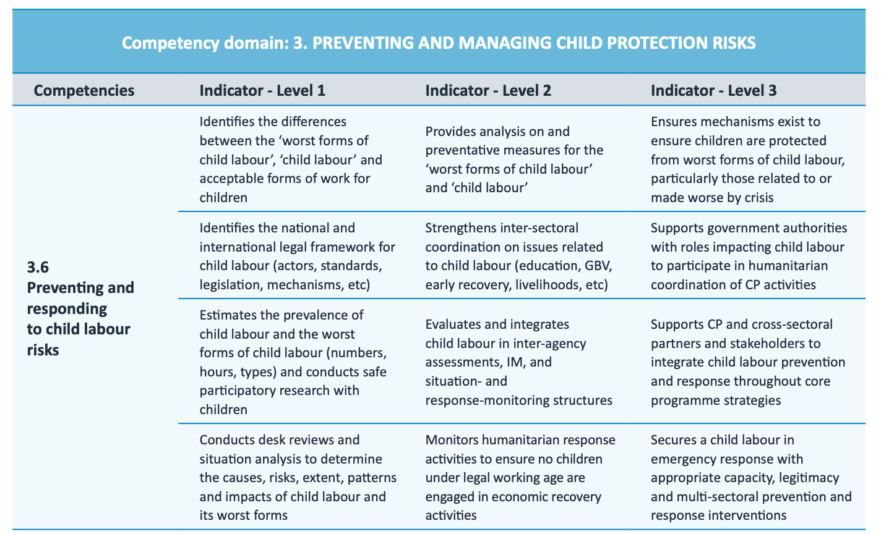
Competencies
Links to the CPHA Competency Framework
Notes:
In the Child Protection in Humanitarian Action Competency Framework, this course links to Competency 3.6 Preventing and responding to child labour risks, under competency domain 3: Preventing and Managing Child Protection Risks.
Remind participants that the competency framework is a practical tool to support professional development planning, recruitment, and performance management/appraisals for CPHA practitioners.
Guidance | Child Protection in Humanitarian Action Competency Framework | The Alliance for Child Protection in Humanitarian Action (alliancecpha.org)

Slide 9

PURPOSE
GLOBAL AIMS & PURPOSE
ALLIANCE FOR CHILD PROTECTION IN HUMANITARIAN ACTION
CHILD LABOUR TASK FORCE
To support the implementation of the Inter-agency toolkit: Preventing and responding to child labour in humanitarian action
To enhance the knowledge and skills of humanitarian and development actors to prevent and respond to child labour in humanitarian action

Slide 10
AGENDA
OVERALL AGENDA
 | CONTENT OVERVIEW
DAY 1
DAY 2
DAY 3

Slide 11
AGENDA
AGENDA FOR TODAY
 | OVERVIEW
9.00 – 10.00
10.00 – 11.00
11.00 – 12.00
12.00 – 13.00
13.00 – 14.00
14.00 – 15.00
15.00 – 16.00
16.00 – 17.00

Slide 12
LEARNING METHODOLOGIES
Group and individual exercises and analysis
PowerPoints and presentations
Plenary discussions
Action planning

Slide 13











GROUND RULES, COMFORT AND SAFETY
Notes:
This can be developed by participants but if the participants are mid-level they should know what is expected of them in terms of attending a training, so it may be ok just to go over the following rules, safety, comfort:
Mobile phones and laptops on silent mode. Attention during the training is essential and participants should not be using phones or social media etc., If the training is in an insecure areas, participants should not share details of the training or location on social media.
Be punctual at the start of the day and during break times.
Attend all sessions
Listen and respect others, show patience, kindness, do not interrupt etc.
Engage in the training: participate, ask questions, respond to questions, take risks
Confidentiality
Location of toilets, fire escapes, rules of evacuation, security, no smoking, smoking areas, breaks, lunch, teas and coffee, security etc.
Availability of extra support for those with additional needs.
Self Care Message

Slide 14

PARKING LOT

